Slide 1
BSW Professional Years Application Info Session
External Applicants

Slide 2
Topics of Discussion
Admission Requirements
Application Process
FAQ
Contact Information

Slide 3
Who is this application process for?
Non-social work UWindsor students and students with more than 2 transfer credits
Students with a CYC diploma or completed undergraduate degree

Slide 4
Admission Requirements
Successful completion of 20 courses towards your degree (as laid out in academic plans) OR successful completion of CYC diploma or undergraduate degree by August 31, 2025
Academic Qualifications
UWindsor Students
Minimum 70% GPA in social work courses (if in combined major then this includes Women’s Studies or Disability Studies courses)
Minimum 67% cumulative average
University graduates
Minimum 70% cumulative average in last 20 courses taken
Ontario CYC graduates
Minimum 3.0 cumulative average (excluding placement)

Slide 5
External Application Process Deadline: December 2nd, 2024
If non-UWindsor student must first apply through OUAC (can take up to 2 weeks to process) with transcripts
Apply for “Change of Program” to BSW in UWinsite Student
Submit application package to UWinsite***
Application form (ensure its signed and equity section is completed)
Personal statement
Professional experiences form
Study plan worksheet (UWindsor students only)
Application summary check list
Two reference forms + letters emailed by referees to transcripts@uwindsor.ca (one work or volunteer reference, and one academic or work/volunteer reference)
***Application materials can only be submitted AFTER the Change of Program request has been accepted and processed!***
https://www.uwindsor.ca/socialwork/460/bsw-application-and-admissions-process

Slide 6
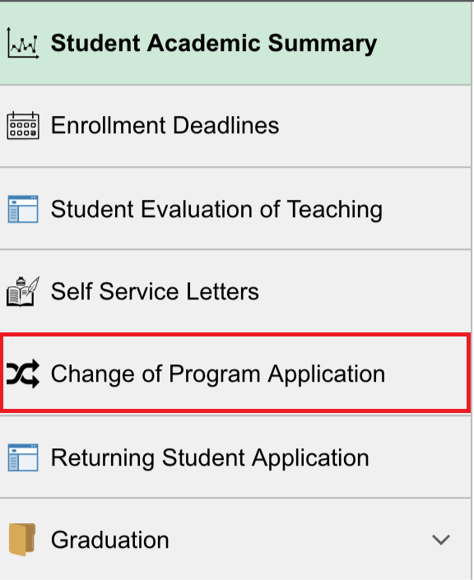
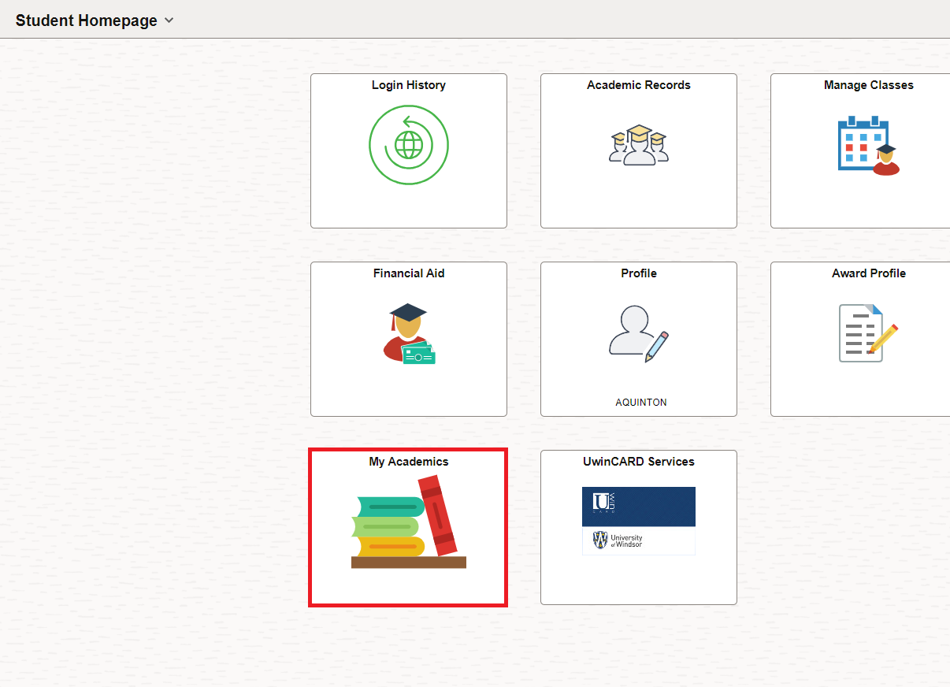
Submitting a Change of Program Request ask.UWindsor - How can I change my program?

Slide 7
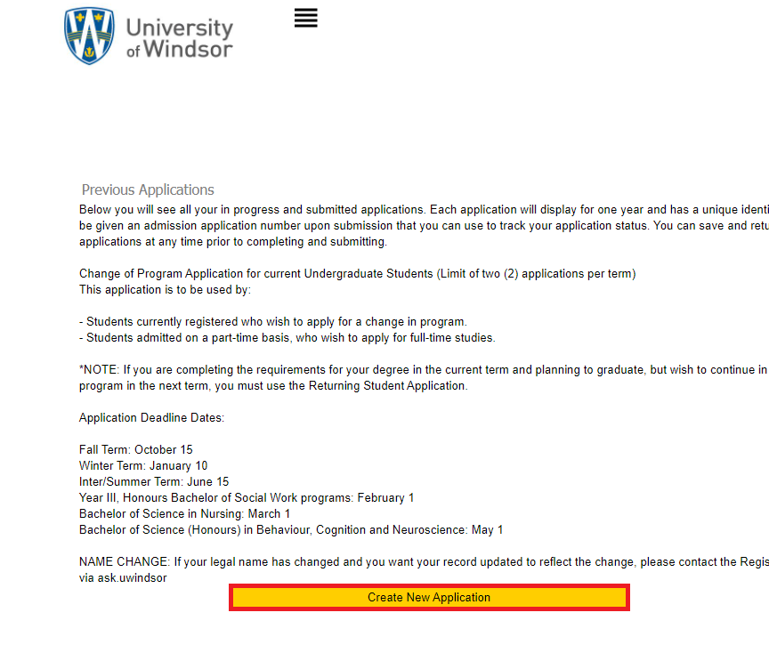
Go to Create a New Application
Complete the required fields
Click Save and then Continue to move on to the next page
Click Submit Application

Slide 8
How to submit application files
ask.UWindsor - How do I upload documents into UWinsite Student to support my undergraduate admission application(s)?

Slide 9
Important information
All parts of the application must be submitted by December 2nd, 2024!!!
Note: To Do List items will remain “Received” and the application status will remain “Incomplete” until UWindsor’s Office of the Registrar verifies the documents.
Do not upload multiple copies of the same document as it slows our processing. Your patience is appreciated while we process your documents.
On the Application Status page, the status may never appear “Complete” even after document verification if you do not meet all the requirements (ex: insufficient language score, or lack of passport), but UWindsor will still evaluate your application.

Slide 10
Application Package
Application form: Three pages, provide contact information, degree information, equity section and signature
Professional Experiences Form: If no experiences, check appropriate box and submit with application. If you have multiple experiences, make as many copies of the form as you need. Do not leave the number of hours blank! Provide estimates if you don’t know exact number.
Personal Statement: max 4 pages double spaced
Discuss your understanding of the Social Work profession, and how it is distinguished from other helping professions. (approximately 1 page)
Discuss how your work, volunteer, community engagement, and/or life experiences influenced your decision to purse social work as a career. (approximately 3 pages)
Study Plan: Indicate which courses you’ve already taken and which courses you will be taking in Winter 2025 and Summer 2025
Application Summary Check List
Notes:
We do not require a minimum number of hours of experience to accept your application
We evaluate your experience based on not only quantity but also quality:
What those experiences say about your motivation to become a social worker and your commitment to the profession
What skill sets, knowledge, or values you obtained from that experience which will help make you a good social worker
In considering the question “does my experience doing x count?” ask yourself:
What did I take away from that experience that taught me something about social work or that reinforced my desire to want to be a social worker?
What skill sets, knowledge, and values did I use and/or gain through this experience that will contribute to my professional development as a future social worker?
In short, you tell us whether an experience should “count”

Slide 11
References
1 work/volunteer reference and 1 academic or volunteer/work reference
Must be submitted to transcripts@uwindsor.ca with the subject line: BSW Reference – 110xxxxxxx (student ID)
Two parts: reference form and reference letter
Both must be submitted for reference to be complete!
References from friends, peers, relatives, clients, or your own personal helping/health professional will not be accepted.

Slide 12
Frequently Asked Questions
When will I know if I have been accepted?
All applications will be received by the school for review in mid-January, faculty members will then review and rank all applications
Admission decisions will be sent to the registrar’s office for processing in late February/early March
Offers of admission are conditional upon your GPA meeting the minimum requirements!
What if I don’t get into the program?
Increase your GPA by retaking courses
Try again next year
Consider your “discipline” as a degree completion option
How many students are admitted?
130-180 apply each year, 100 are admitted

Slide 13
Questions?
Kristina Nikolova, BSW Program Coordinator: Nikolova@uwindsor.ca
Brigitte Romao, BSW Program Secretary: bsw@uwindsor.ca
Taylor Fast, BSW Academic Advisor: Taylor.Fast@uwindsor.ca

