Slide 1
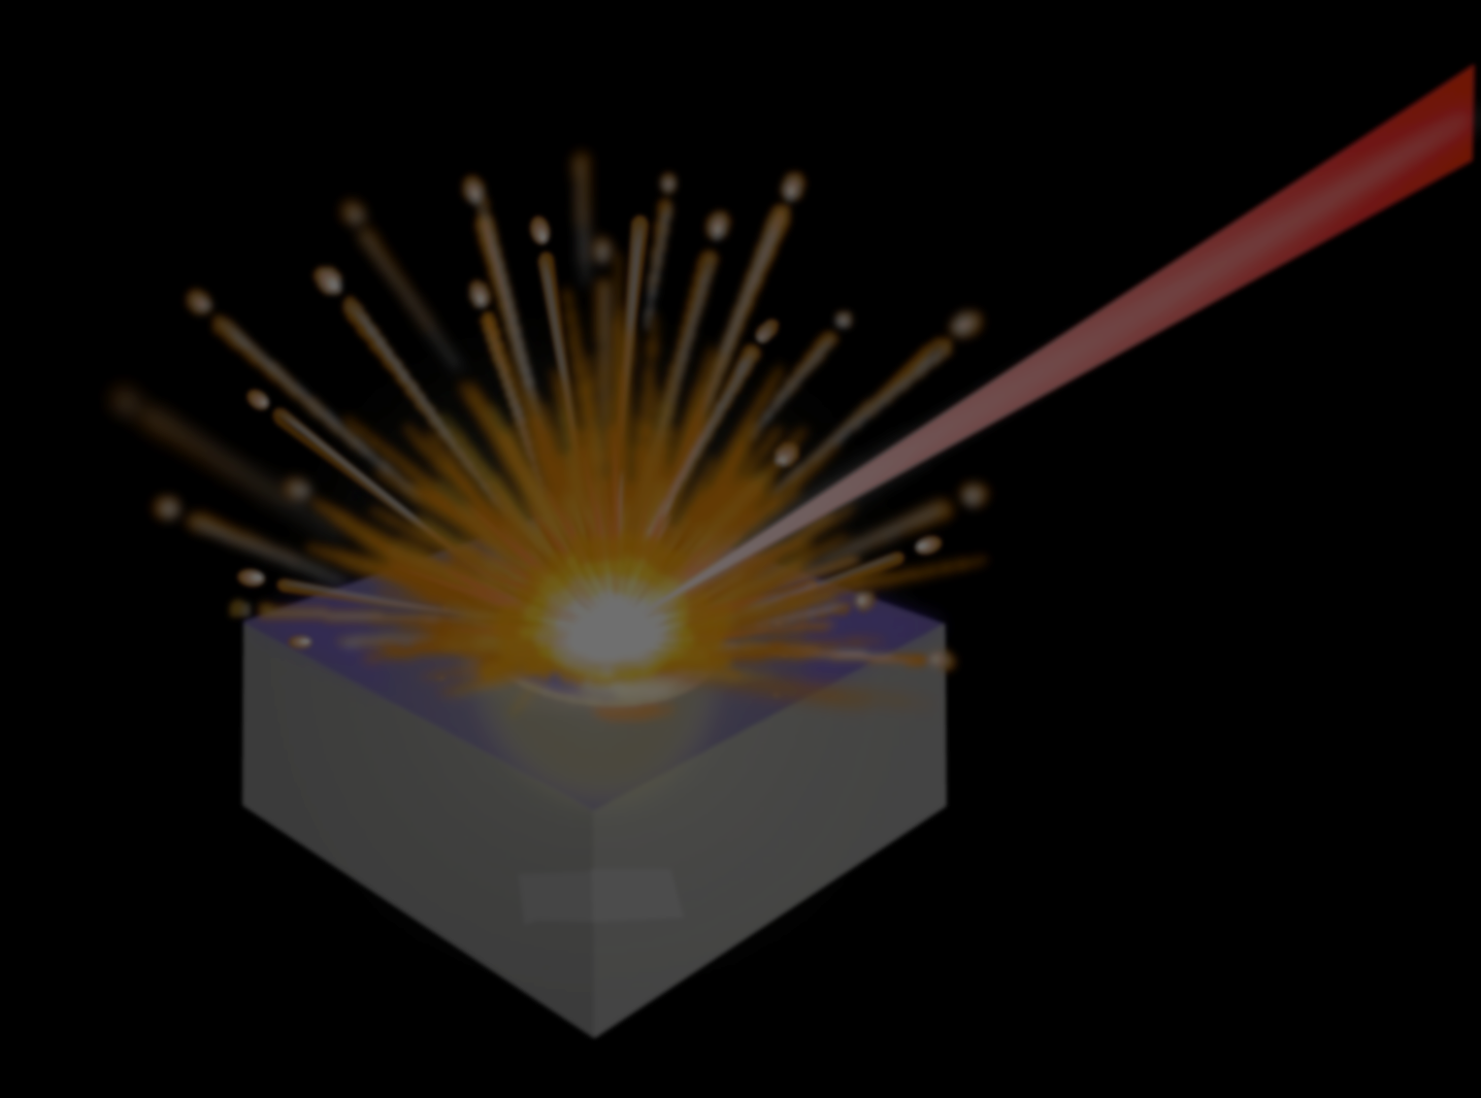

Healing Humanity One Spark at a Time: Biomedical Applications of a Laser-Induced Plasma
Presented at the University of Waterloo
Wednesday, May 5, 2-17
Steven J. Rehse
Department of Physics
Windsor, Ontario, Canada

Slide 2
Outline
Introduction of the Method. Laser-induced breakdown spectroscopy (LIBS)
Advantages of LIBS over other analytic methods
Biomedical Applications of LIBS
  A new paradigm for rapid pathogen identification
  A real time assay for nutritional zinc deficiency
Concluding Thoughts

Slide 3
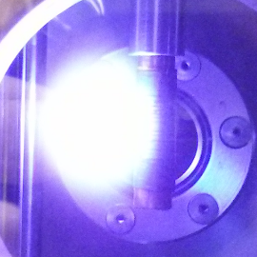
Laser-Induced Plasmas
Laser-induced plasma
What is a “laser-induced plasma?”
Incident Laser Pulse
Rare-earth metal target
Can be done with ns, ps, or fs lasers
Threshold irradiance:

Slide 4
LIBS primer
laser interaction with the target
pulsed
laser
absorption of laser energy
initiated by absorption of energy by the target from a pulsed radiation field.
pulse durations are on the order of nanoseconds, but can be performed with pico- and femto-second laser pulses.

Slide 5
LIBS primer
removal of samples mass (ablation)
melting
fragmentation
vapor
sublimation
crater
atomization
absorbed energy is rapidly converted into heating, resulting in vaporization of the sample (ablation) when the temperature reaches the boiling point of the material.
removal of particulate matter from the surface leads to the formation of a vapor above the surface.

Slide 6
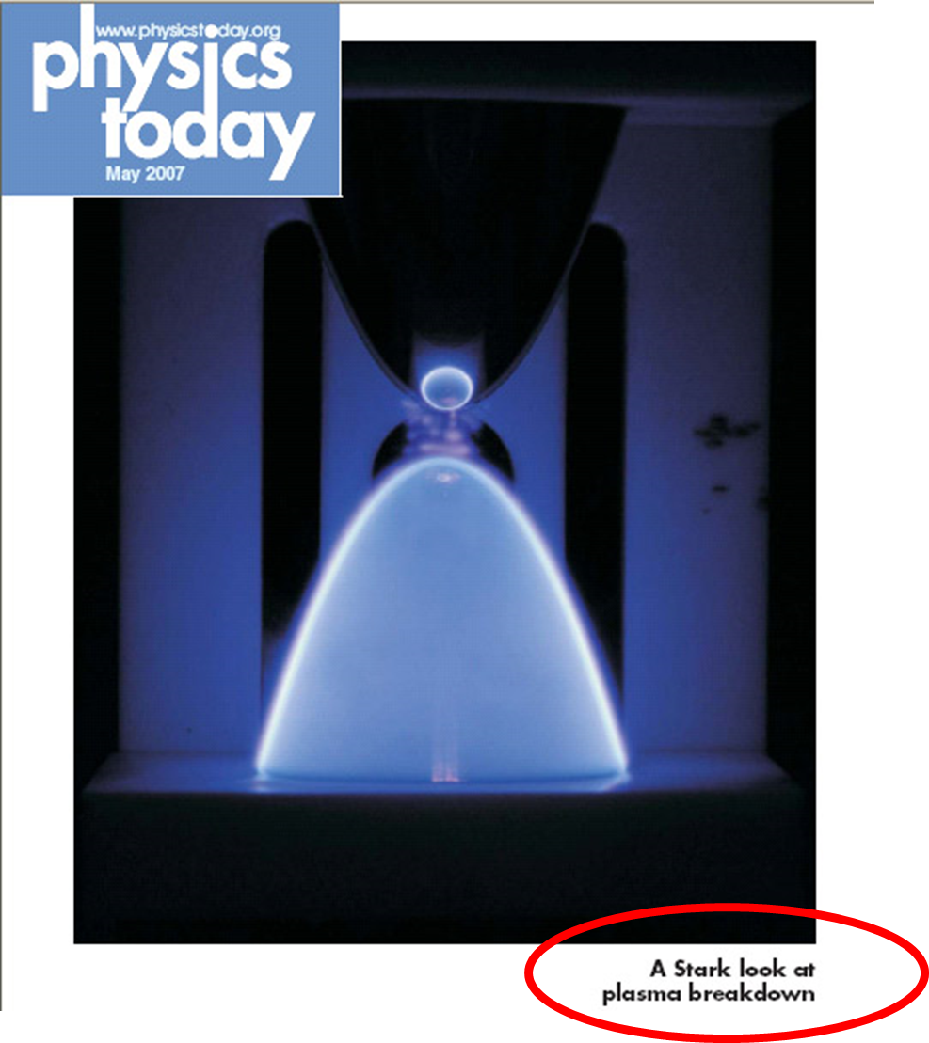
LIBS primer
plasma formation (breakdown)
absorption of the laser radiation by the vapor
continuum emission
electrical breakdown and plasma formation
shock wave
bremmstrahlung
The laser pulse continues to illuminate the vapor plume.
The vapor condenses into sub-micrometer droplets that lead to absorption and scattering of the laser beam, inducing strong heating, ionization, and plasma formation.

Slide 7
LIBS primer
expansion and element specific emission (atomic or ionic)
spontaneous emission
as atoms/ions decay to ground state
crater
debris
The dynamic evolution of the plasma plume is then characterized by a fast expansion and subsequent cooling.
Approximately 1 microsecond after the ablation pulse, spectroscopically narrow atomic/ionic emissions may be identified in the spectrum.

Slide 8
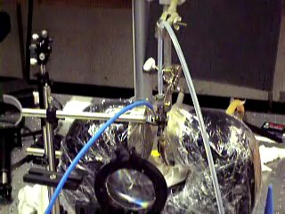

Slide 9
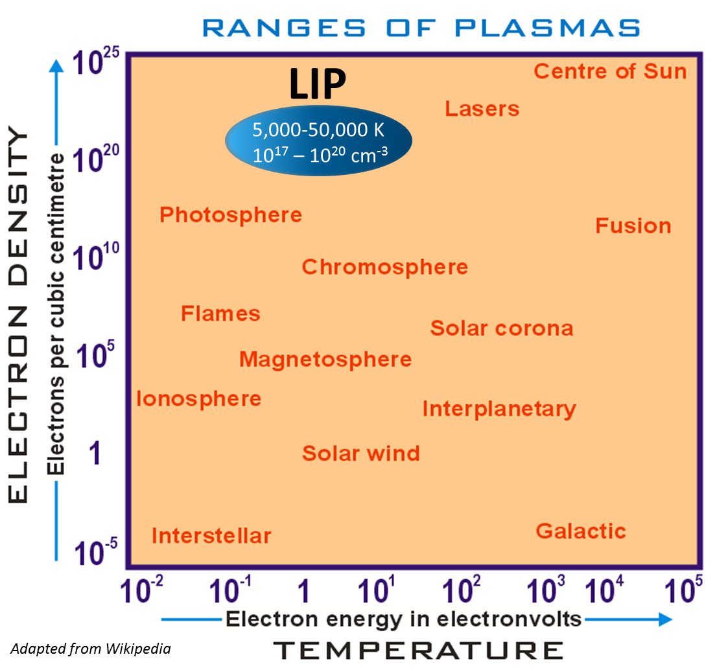
Laser-Induced Plasmas
Laser-induced plasma
What is a “laser-induced plasma?”
Incident Laser Pulse
Rare-earth metal target
Can be done with ns, ps, or fs lasers
Threshold irradiance:
We can do spectroscopy on that!

Slide 10
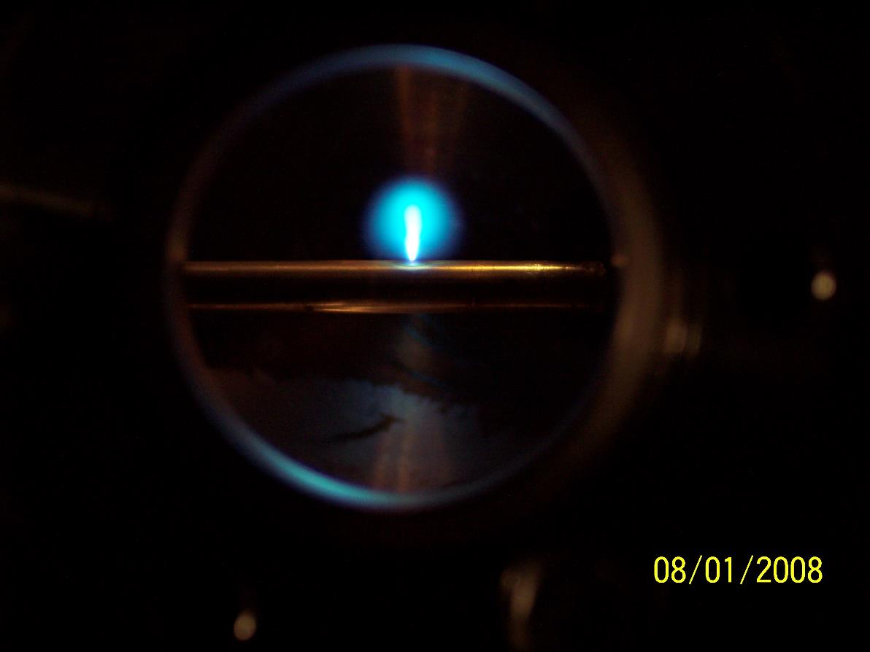
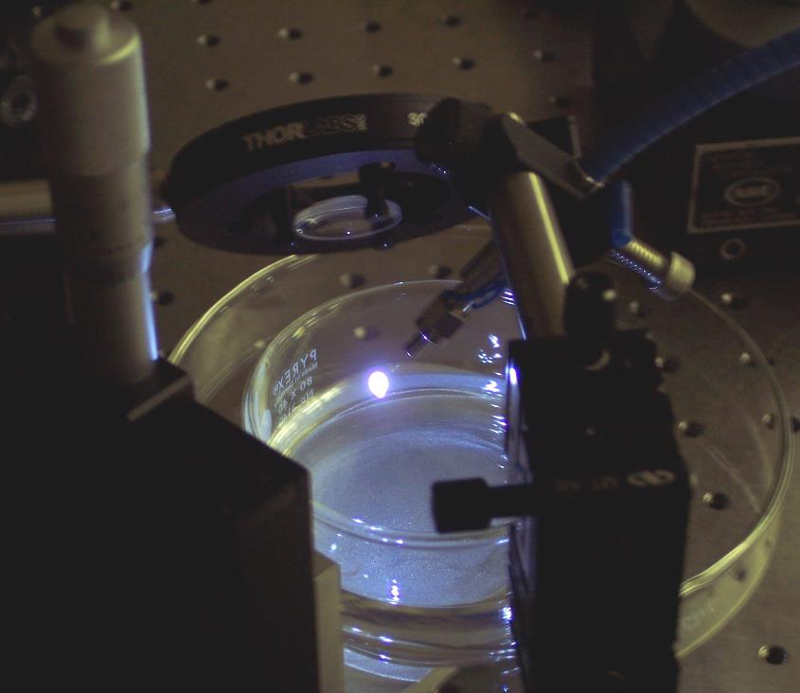
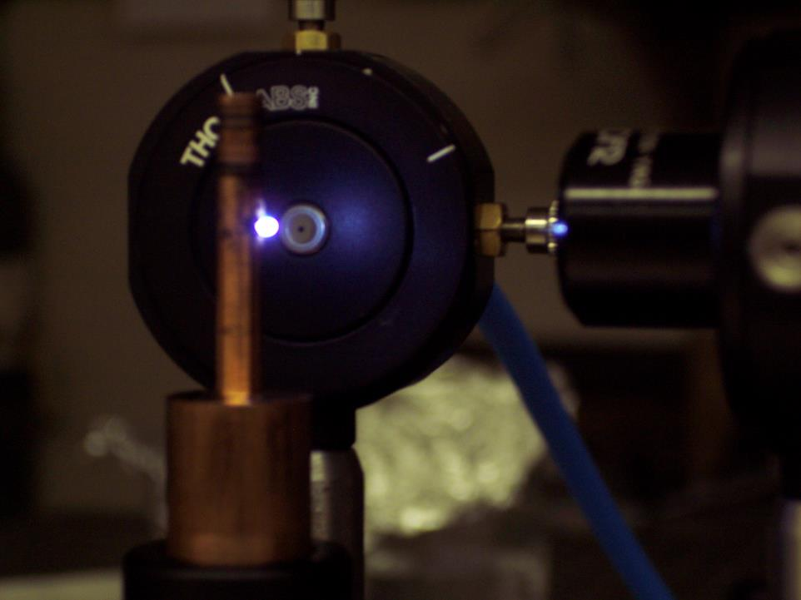
What It looks Like

Slide 11
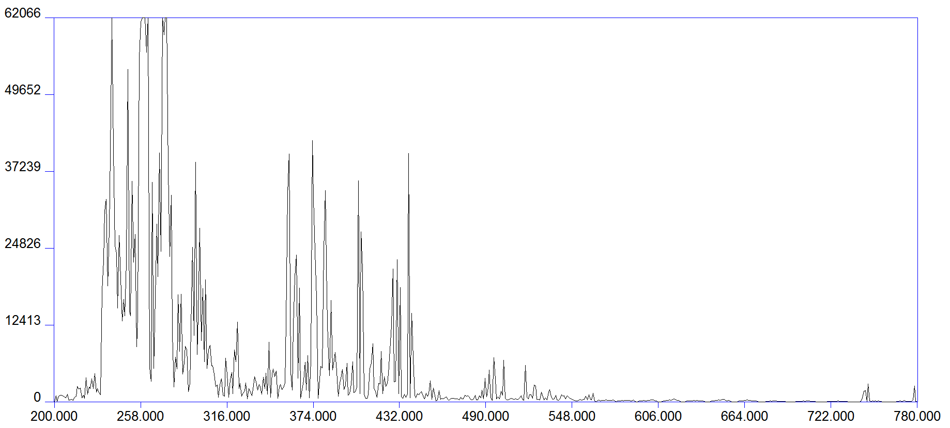
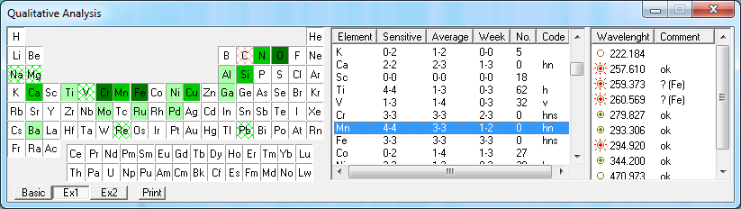
The Goal of LIBS Plasma Creation
to create an optically thin plasma which is in thermodynamic equilibrium (or LTE) and whose elemental composition is the same as that of the target/sample
  if achieved, atomic emission spectral line intensities can be related to relative concentrations of elements (sometimes absolute concentrations)
  typically these conditions are only met approximately.
steel LIBS spectrum

Slide 12
When we do a time-resolved spectroscopy of the plasma, we call it:
“Laser-induced breakdown spectroscopy”
or
LIBS
ICCD Observation Window
(10 μs)
Gate delay
LIBS emission intensity
LIBS
laser pulse
1 ns
10 ns
100 ns
1 μs
10 μs
100 μs
Elapsed Time After LIBS Pulse Incident on Target

Slide 13
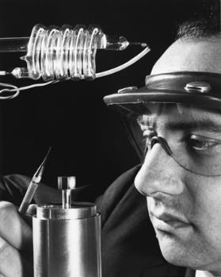
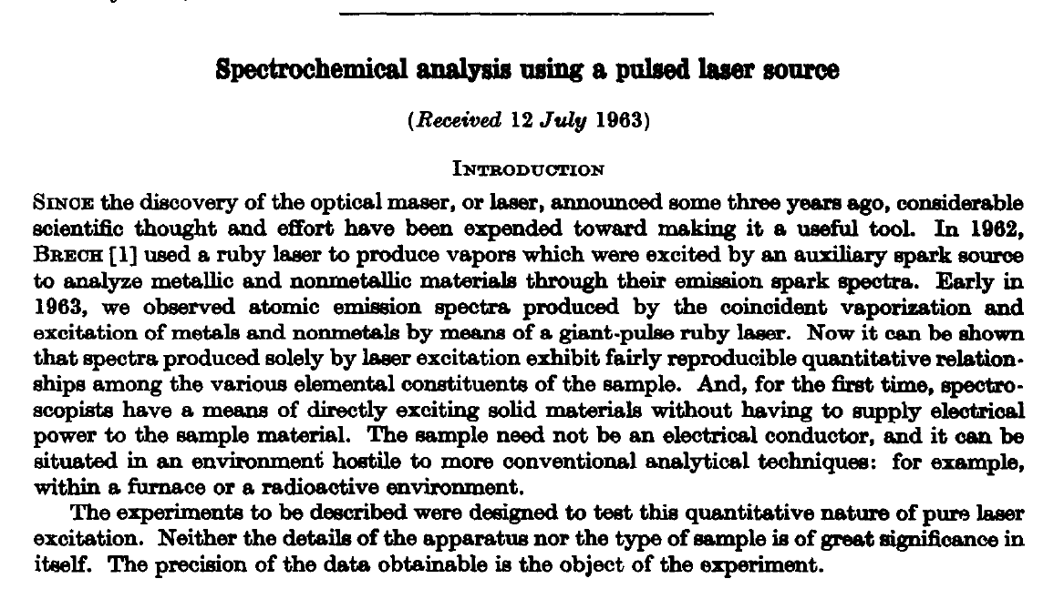
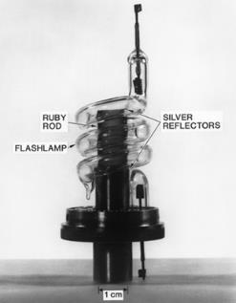
History
1964
Runger et al. First direct spectro-chemical analysis by LIBS
1960
Maiman: first ruby laser
1965
Zel’dovich, Raizer: First theoretical model for laser breakdown of a gas
1962
Brech, Cross: Birth of LIBS: detection of spectrum from ruby laser induced plasma

Slide 14
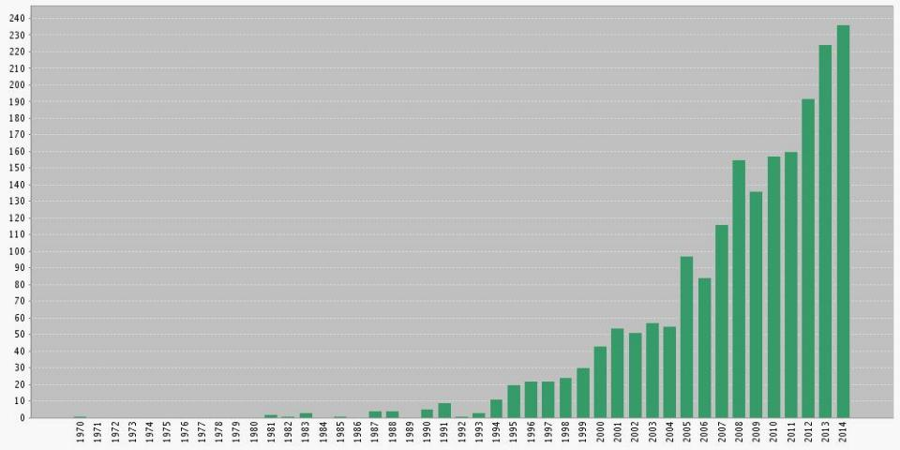
History
“laser-induced breakdown” and/or “laser-induced plasma spectroscopy” @ Web of Science (Thomson Reuters)
>2000 peer-reviewed papers have been published according to the Web of Science
Why the interest?
Applications & Advantages!
1962-64: First spectrochemical analysis of laser-induced plasma
LIBS coined at LANL

Slide 15
Applications of LIBS
No matter what your application is, you will be doing one of two things:
Attempting to quantify the amount/concentration of some element by analyzing peak intensities
Attempting to identify a target based on its unique elemental composition by analyzing the presence intensity of all/many lines

Slide 16
Outline
Introduction of the Method. Laser-induced breakdown spectroscopy (LIBS)
Advantages of LIBS over other analytic methods
Biomedical Applications of LIBS
  A new paradigm for rapid pathogen identification
  A real time assay for nutritional zinc deficiency
Concluding Thoughts

Slide 17
Keeping Track of the Elemental Inventory
(underlined elements reported in literature)
(■ Solids ■ Liquids ■ Gases ■ Artificially prepared)
1 H |  |  |  |  |  |  |  |  |  |  |  |  |  |  |  |  | 2 He
3 Li | 4 Be |  |  |  |  |  |  |  |  |  |  | 5 B | 6 C | 7 N | 8 O | 9 F | 10 Ne
11 Na | 12 Mg |  |  |  |  |  |  |  |  |  |  | 13 Al | 14 Si | 15 P | 16 S | 17 Cl | 18 Ar
19 K | 20 Ca | 21 Sc | 22 Ti | 23 V | 24 Cr | 25 Mn | 26 Fe | 27 Co | 28 Ni | 29 Cu | 30 Zn | 31 Ga | 32 Ge | 33 As | 34 Se | 35 Br | 36 Kr
37 Rb | 38 Sr | 39 Y | 40 Zr | 41 Nb | 42 Mo | 43 Tc | 44 Ru | 45 Rh | 46 Pd | 47 Ag | 48 Cd | 49 In | 50 Sn | 51 Sb | 52 Te | 53 I | 54 Xe
55 Cs | 56 Ba | 57 La | 72 Hf | 73 Ta | 74 W | 75 Re | 76 Os | 77 Ir | 78 Pt | 79 Au | 80 Hg | 81 Tl | 82 Pb | 83 Bi | 84 Po | 85 At | 86 Rn
87 Fr | 88 Ra | 89 Ac | 104 Rf | 105 Db | 106 Sg | 107 Bh | 108 Hs | 109 Mt | 110 Uun | 111 Uuu | 112 Uub |  | 114 Uuq |  | 116 Uuh
 |  |  | 58 Ce | 59 Pr | 60 Nd | 61 Pm | 62 Sm | 63 Eu | 64 Gd | 65 Tb | 66 Dy | 67 Ho | 68 Er | 69 Tm | 70 Yb | 71 Lu
 |  |  | 90 Th | 91 Pa | 92 U | 93 Np | 94 Pu | 95 Am | 96 Cm | 97 Bk | 98 Cf | 99 Es | 100 Fm | 101 Md | 102 No | 103 Lr
www.arl.army.mil/wmrd/LIBS

Slide 18
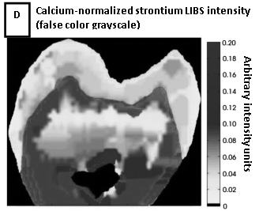
Advantages of LIBS - spatial resolution
Laser allows point sampling (1-100 micron)
Elemental “surface maps” can then be created
Courtesy of F.C. Alvira et al.
Courtesy of Ben Smith, Javier Laserna

Slide 19
Advantages of LIBS - depth profiling
Because laser only removes μg to ng of material, ablation crater only microns deep
Subsequent shots thus sample progressively deeper layers
Courtesy of Ben Smith
Courtesy of Ben Smith

Slide 20
Advantages of LIBS – sensitivity & speed
Concentrations of 1-100 ppm usually detectable in seconds using a standard LIBS apparatus

Slide 21
Advantages of LIBS - portability / standoff
Apparatus is compact, low weight; can be made man-portable
All optical technique, so can be done at a distance “stand-off”

Slide 22
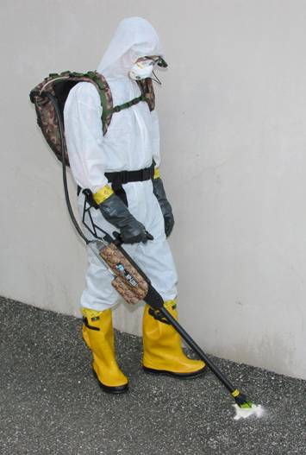
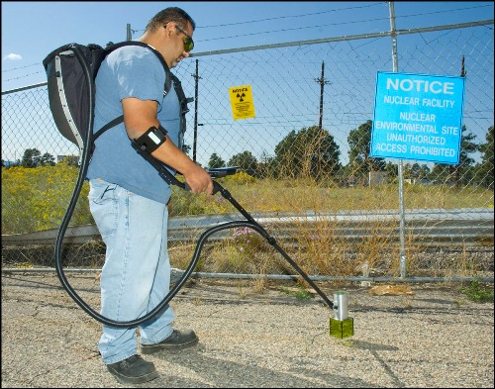
First responder CBRNE prototypes have been built…
Head’s-up display
Backpack contains broadband high-resolution spectrometer, laser power supply, computer, and battery
Hand-held probe contains laser, joystick for control, and focus optics
Microplasma/ LIBS Event
courtesy of Ocean Optics.

Slide 23
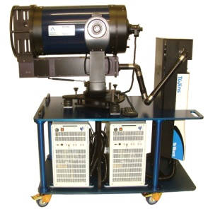
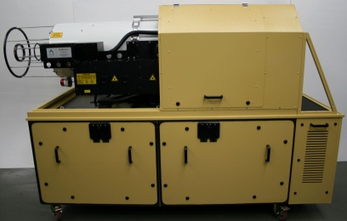
High-energy remote systems have been built…
Courtesy of A.J. Miziolek, A. Whitehouse

Slide 24
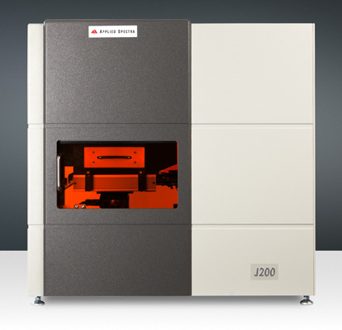
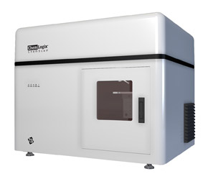
Commercial benchtop systems have been built…
J200 – Applied Spectra
ChemReveal LIBS Desktop Elemental Analyzer – TSO

Slide 25
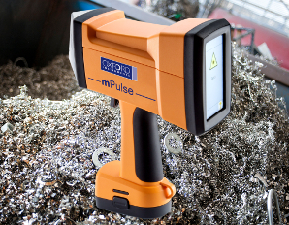
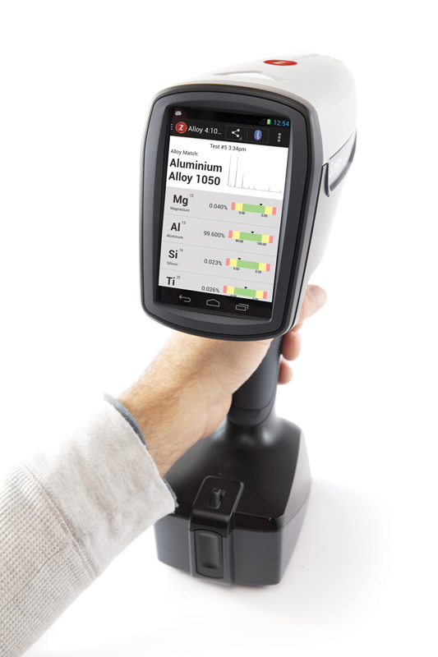
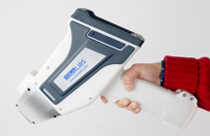
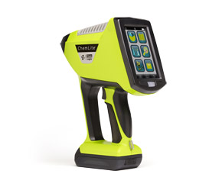
Hand-held systems have been built…
mPulse – Oxford Instruments
LIBZ – SciApps, Inc
NanoLIBS – B&WTek
ChemLite- TSI, Inc
EOS500 - Bruker

Slide 26


And a system has gone to Mars…

Slide 27
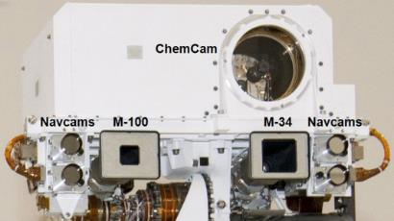
And a system has gone to Mars…

Slide 28
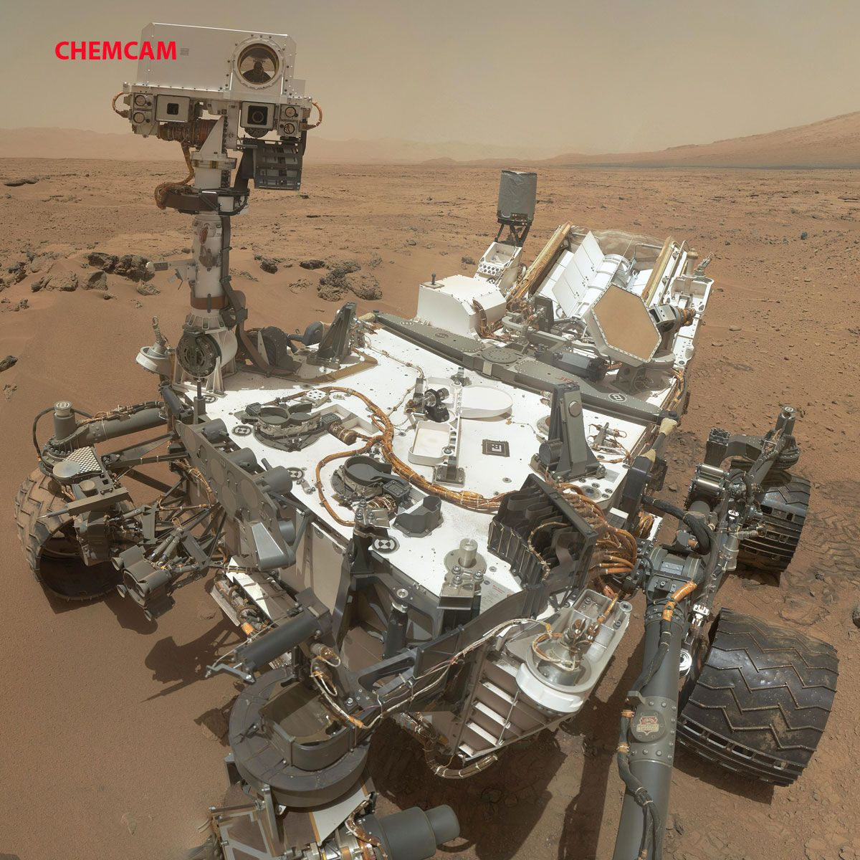
And a system has gone to Mars…
SELFIE ON MARS

Slide 29
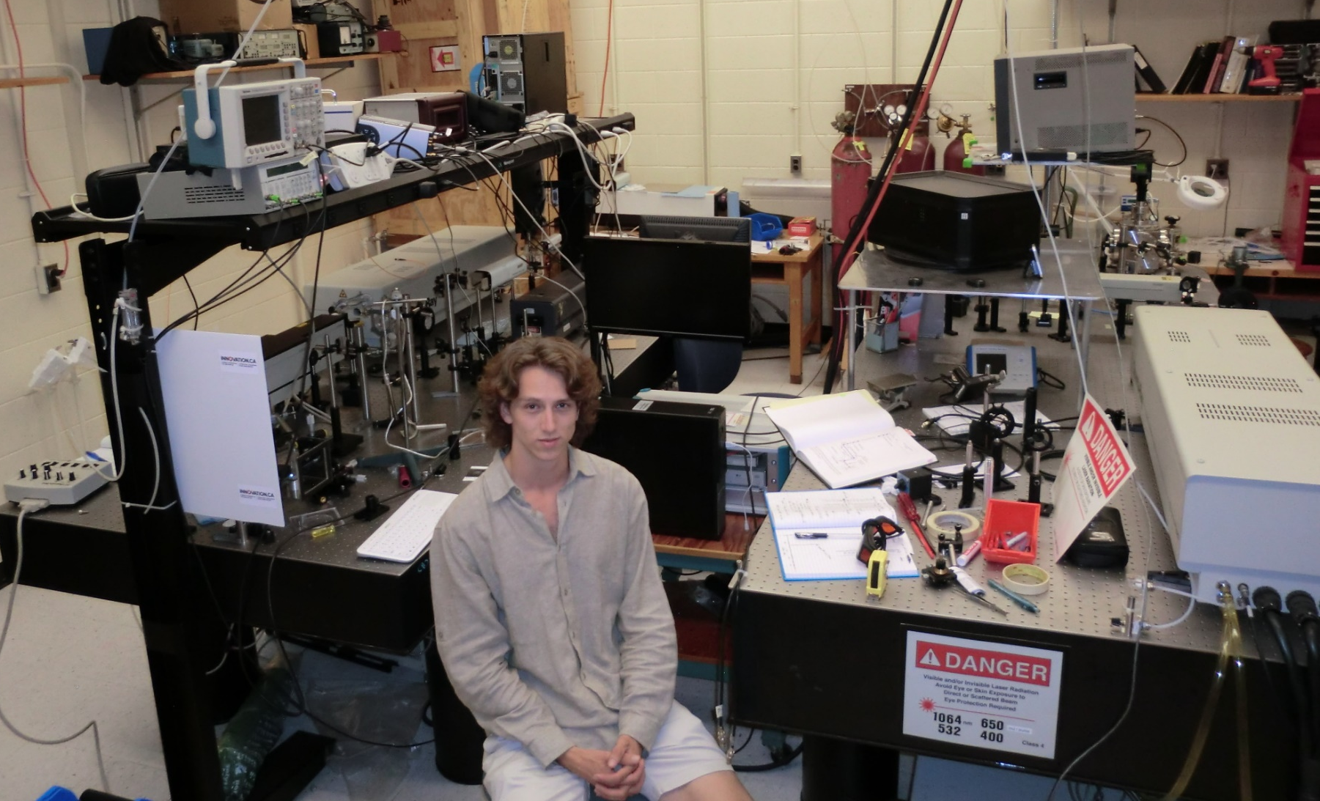
LIBS Table 1
1064 nm LIBS laser
355 nm OPO pump
Echelle spectrometer/camera
LIBS Table 2
Timing control
OPO
Photodiode for observing pulse timing
1064 nm LIBS laser
Argon chamber

Slide 30
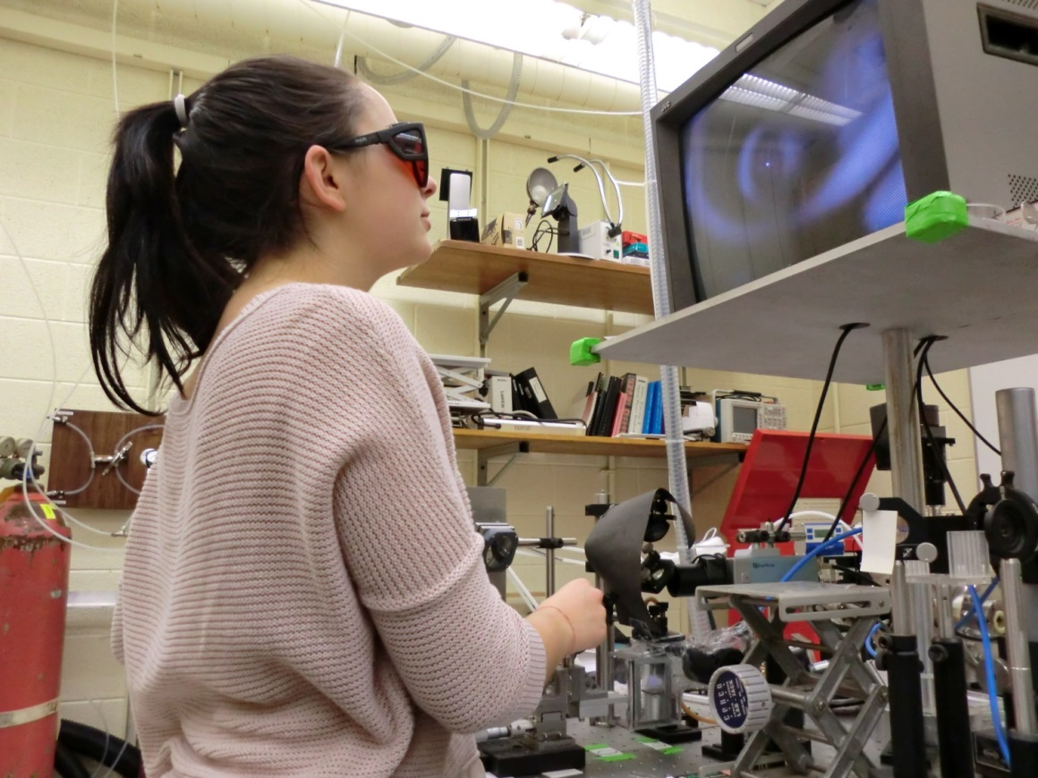
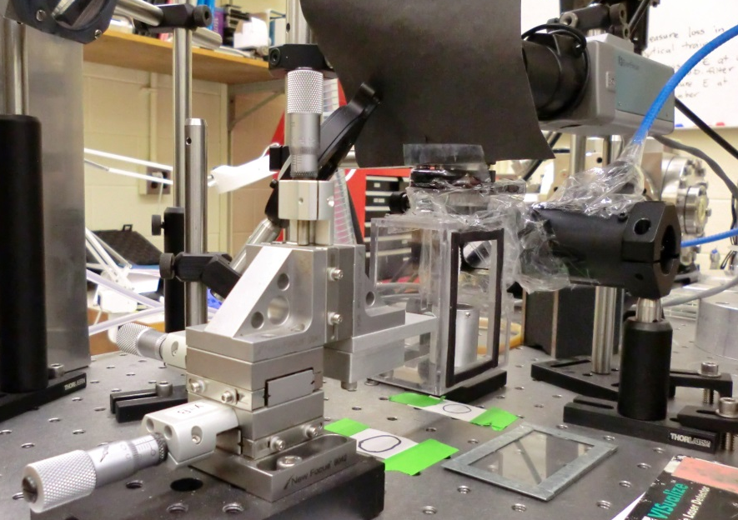

Slide 31
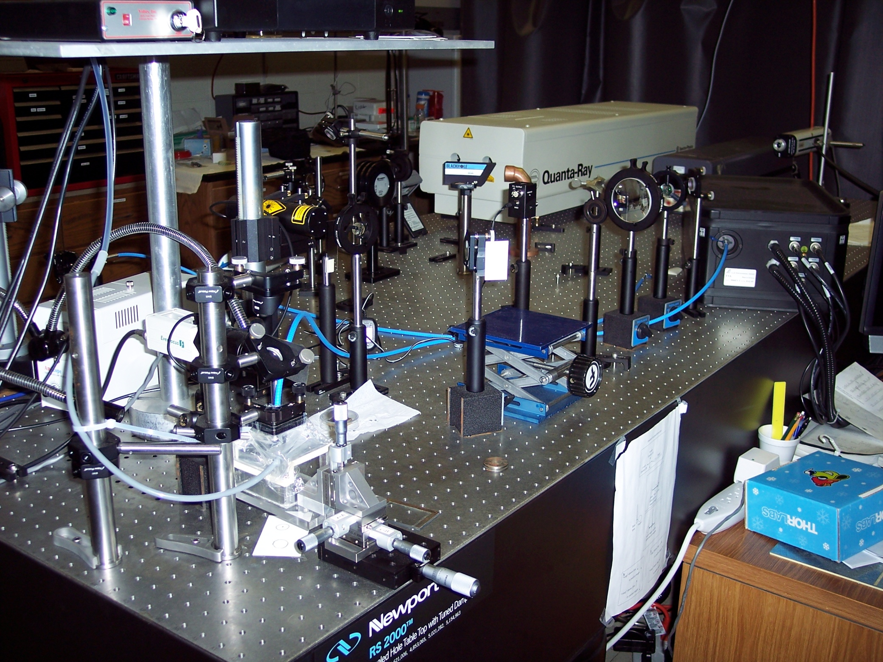
IR Nd:YAG laser
Echelle
spectrometer
microscope
assembly
sample chamber
(w/ purge gas)

Slide 32
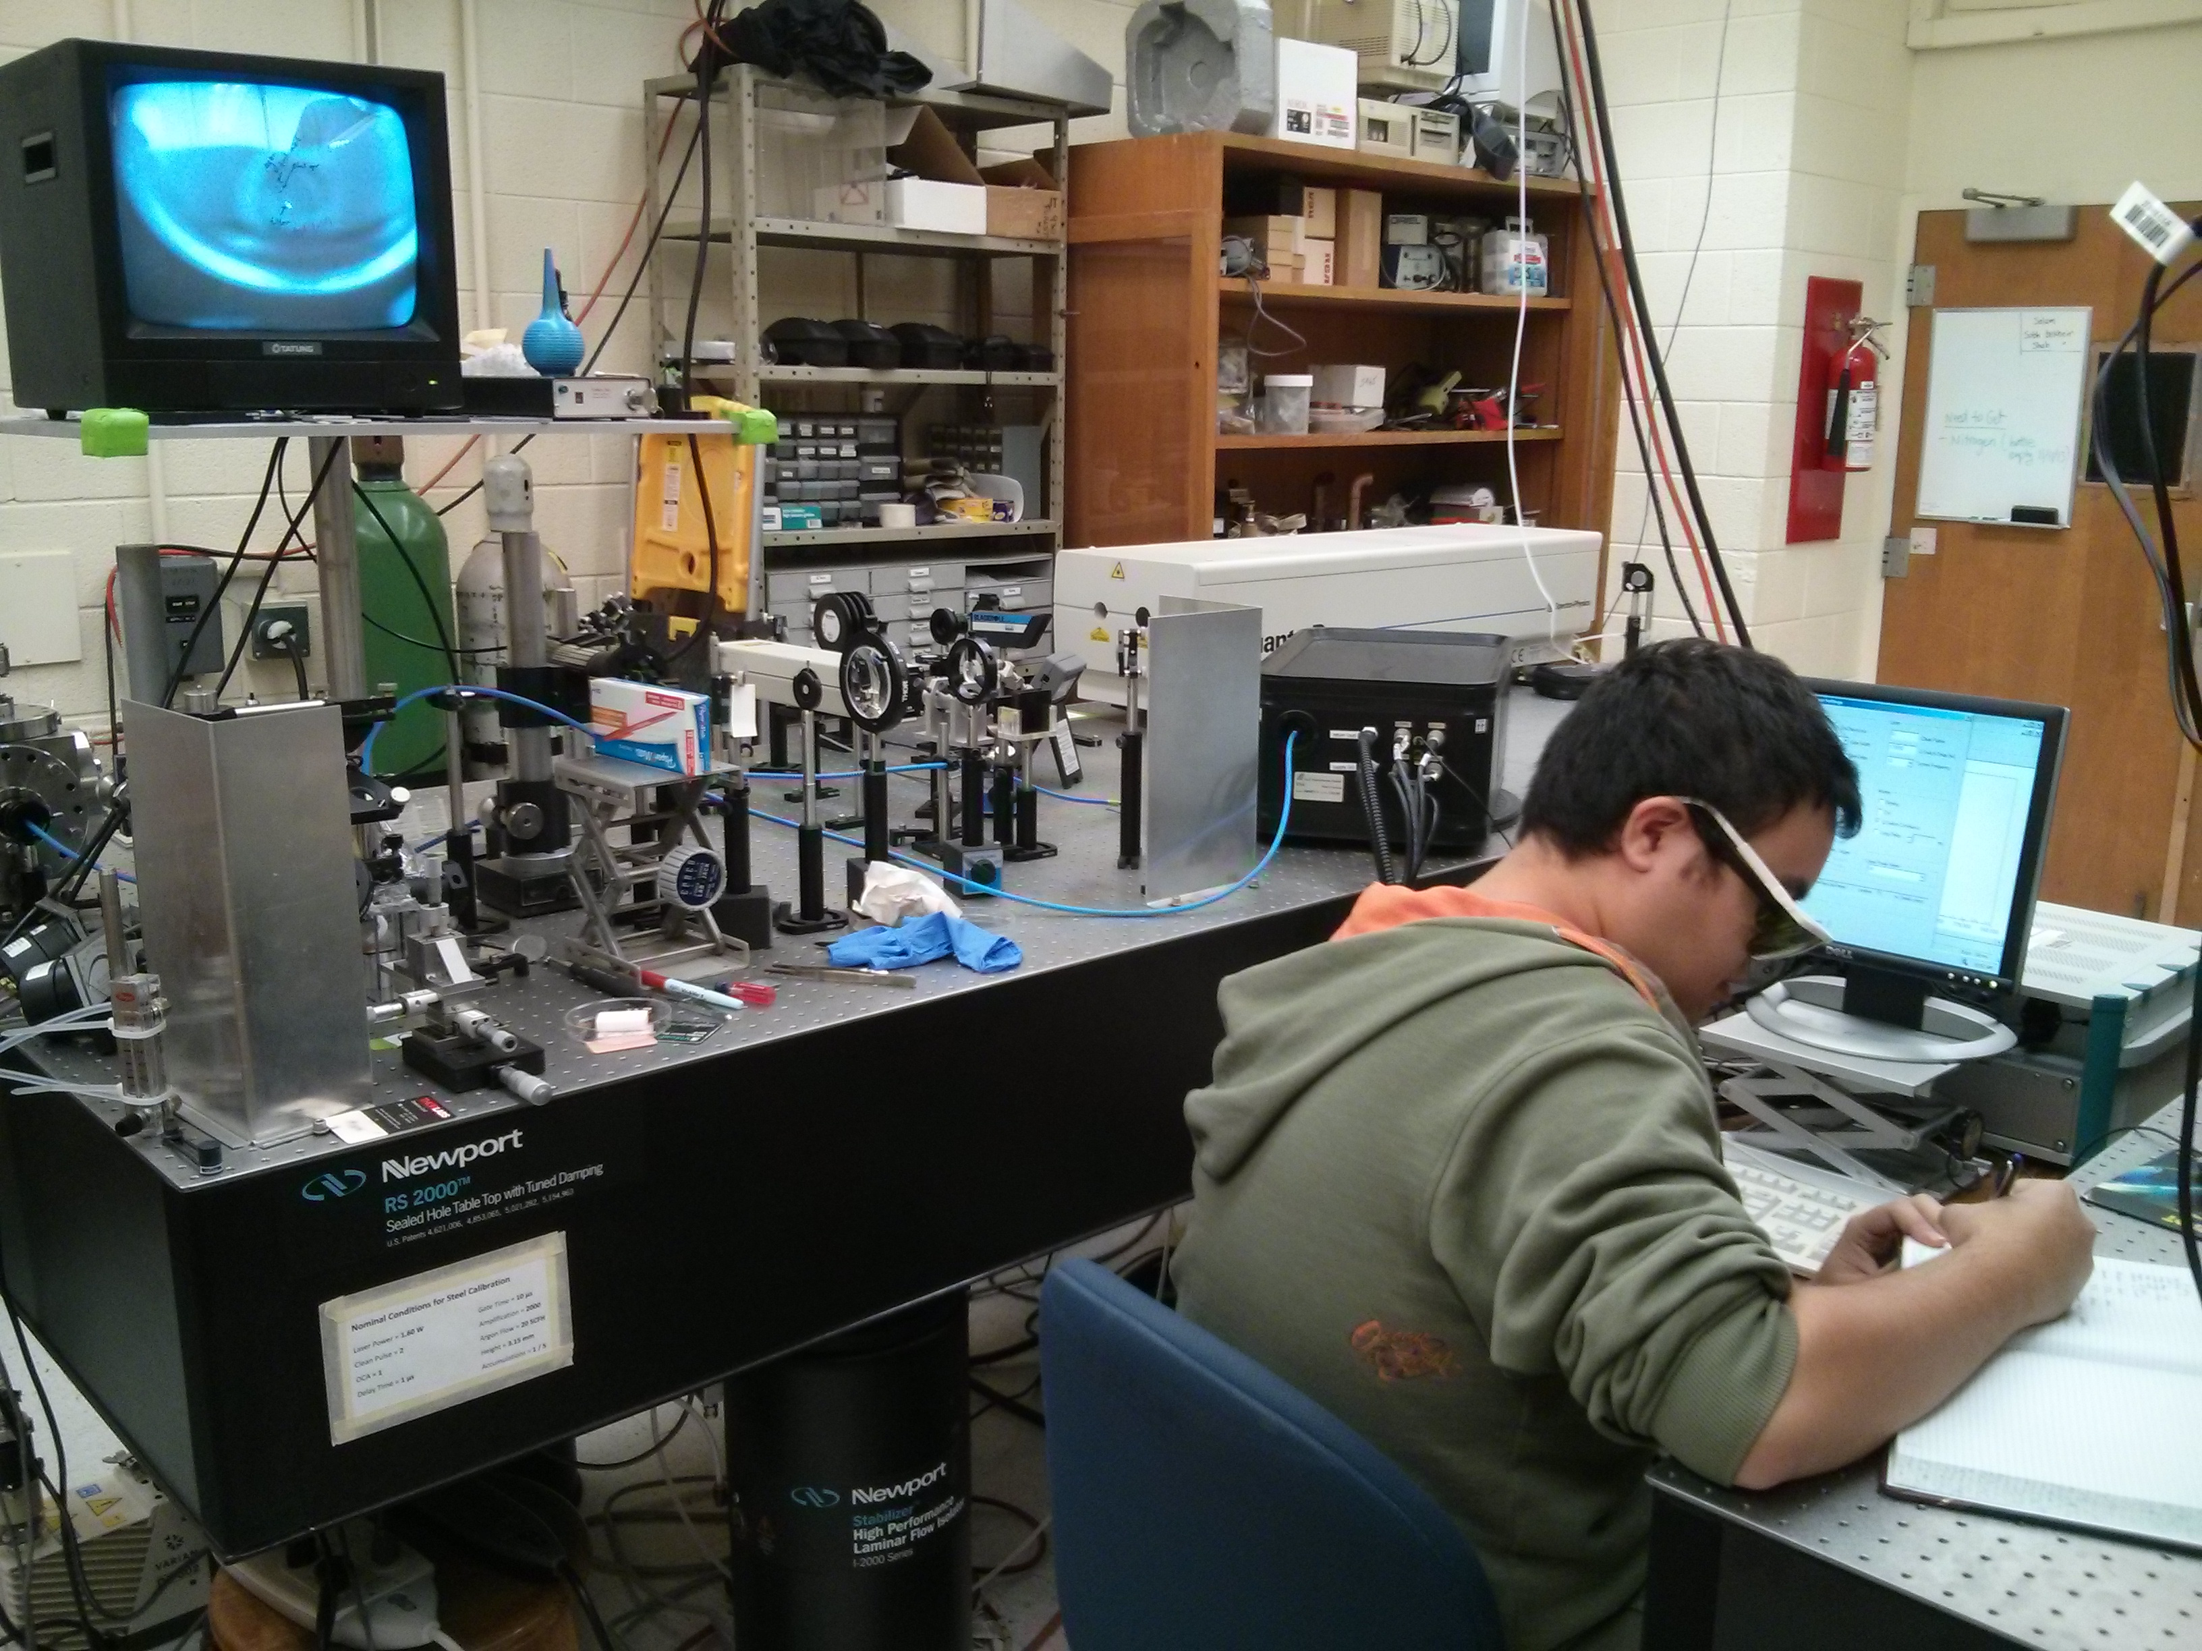

Slide 33
Outline
Introduction of the Method. Laser-induced breakdown spectroscopy (LIBS)
Advantages of LIBS over other analytic methods
Biomedical Applications of LIBS
  A new paradigm for rapid pathogen identification
  A real time assay for nutritional zinc deficiency
Concluding Thoughts

Slide 34
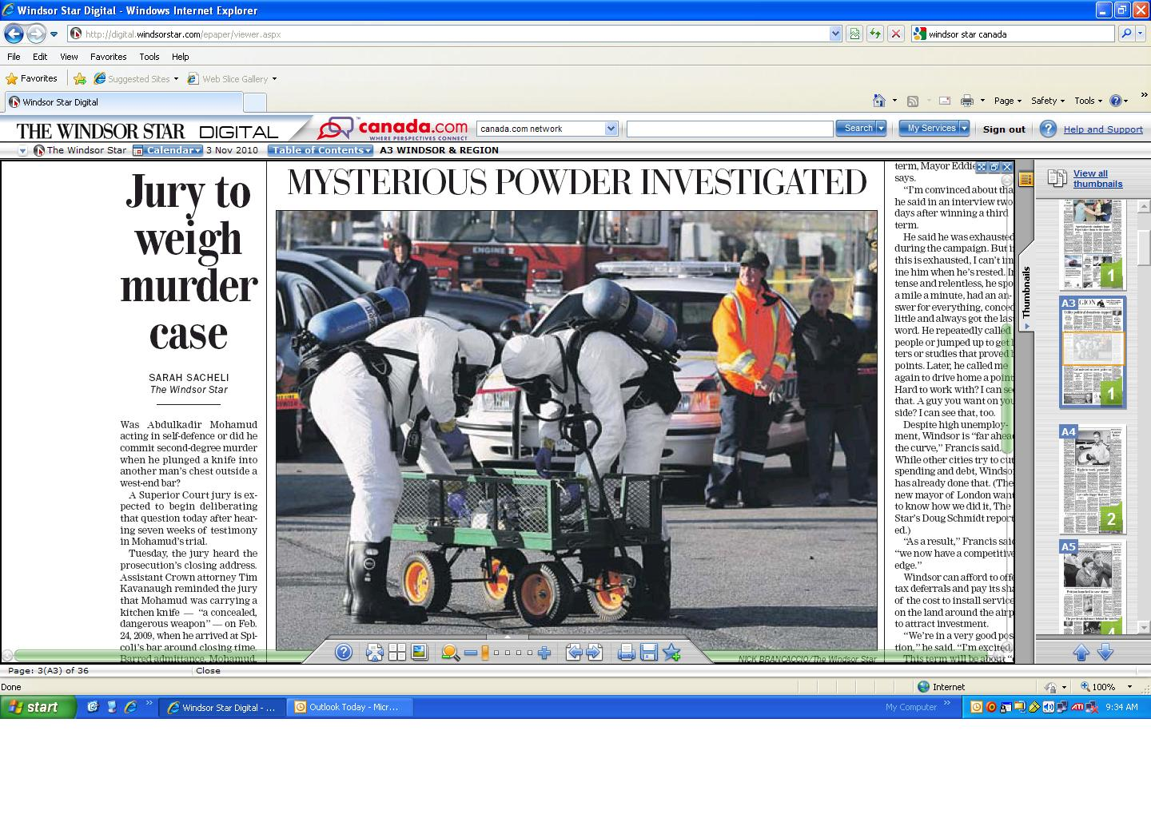
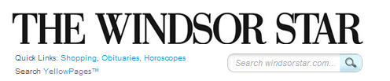
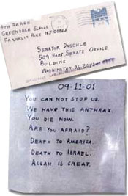
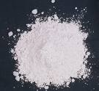
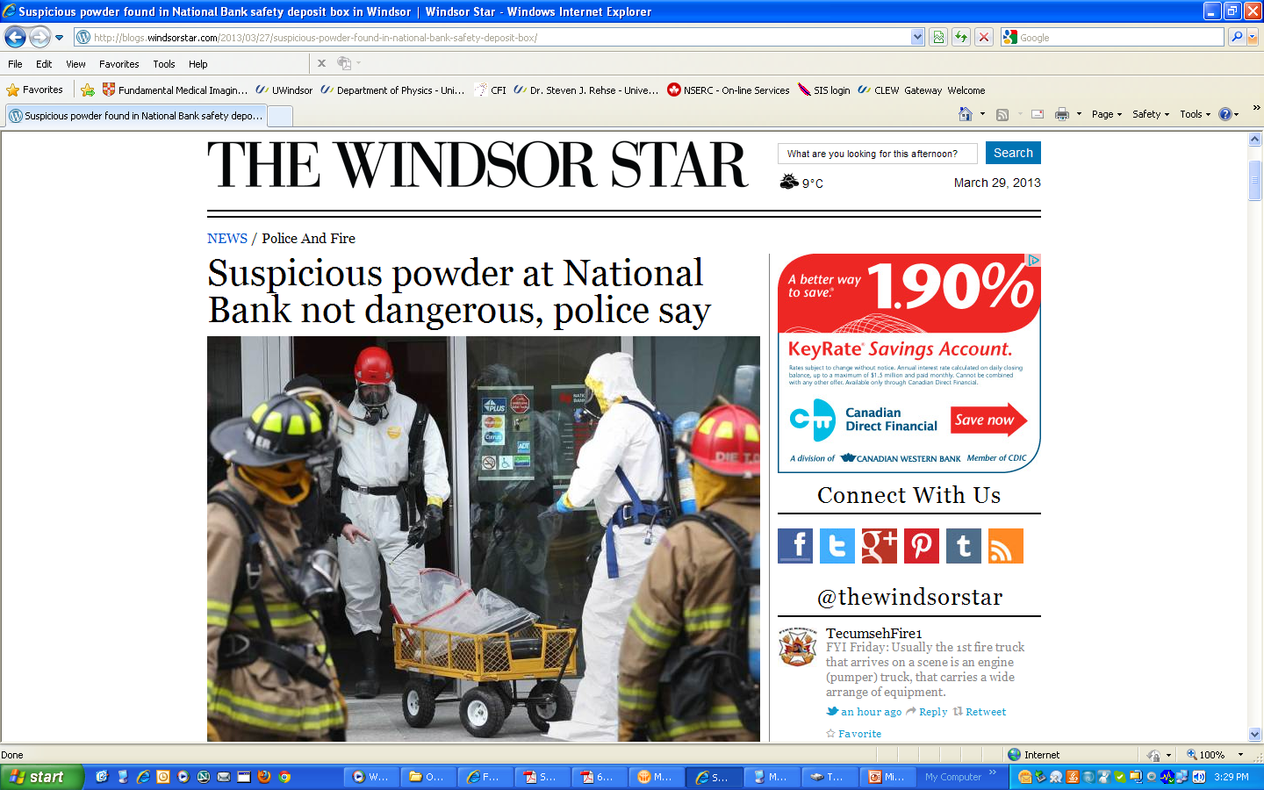
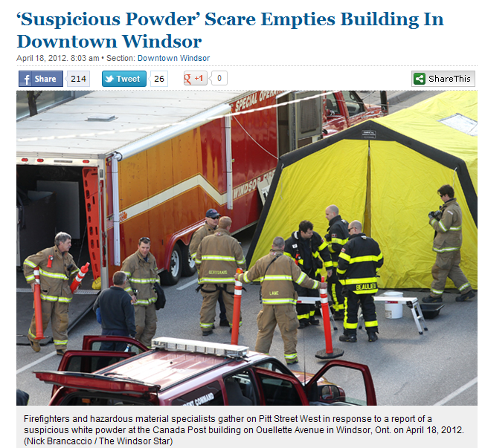
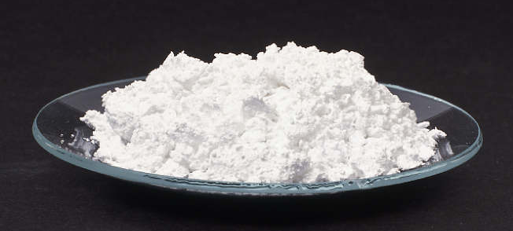
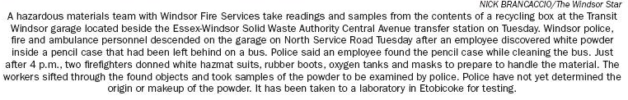

Slide 35
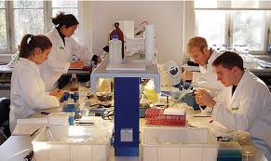
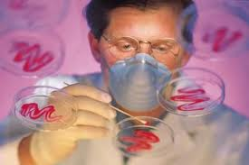
So why?
“It is well-accepted that the microbiological expertise and cost required to perform these identifications preclude their common use as a screening mechanism to prevent human infection.”¹
¹Tarr, P.I. 1995. Escherichia coli O157:H7: clinical, diagnostic, and epidemiological aspects of human infection. Clin. Infect. Dis. 20, 1-8.

Slide 36
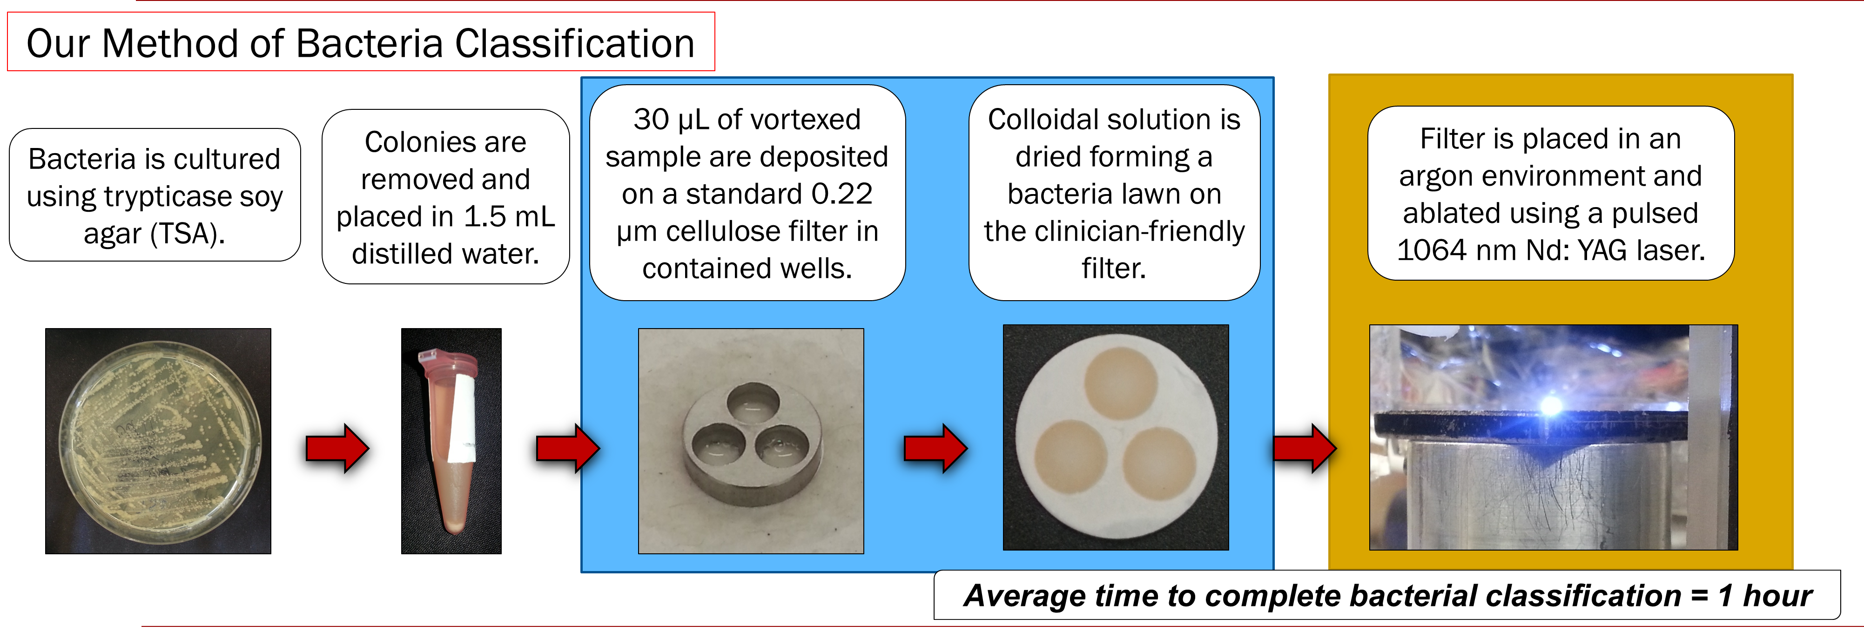
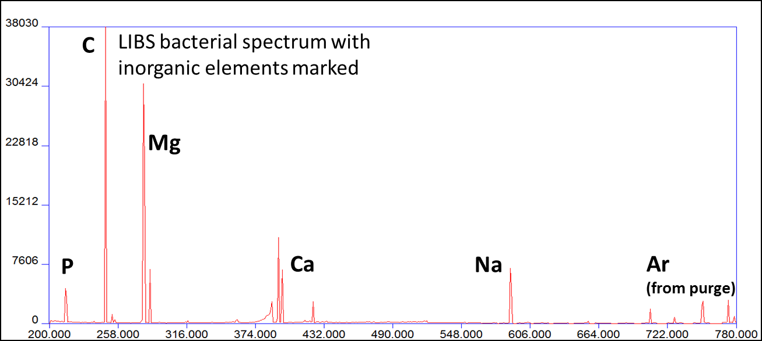
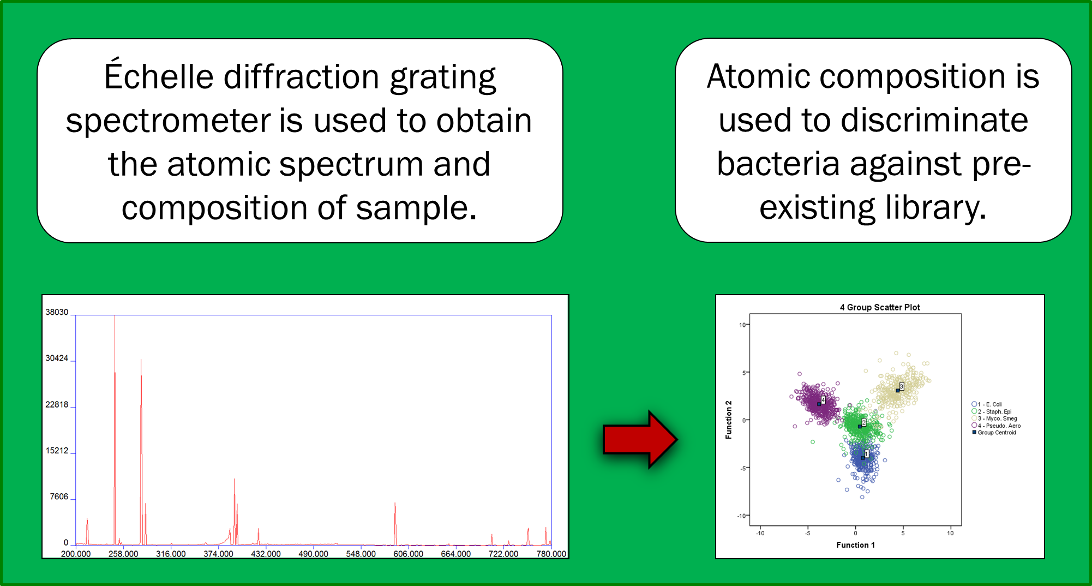
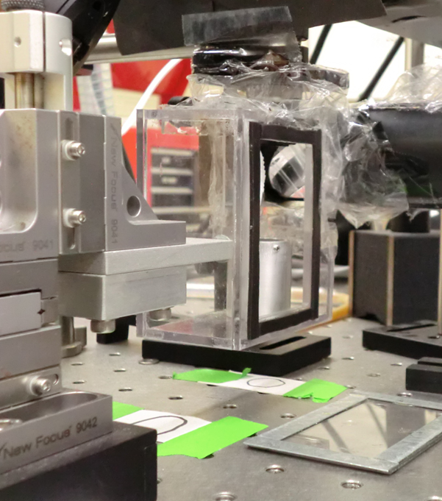
Current Method of Bacterial identification

Slide 37
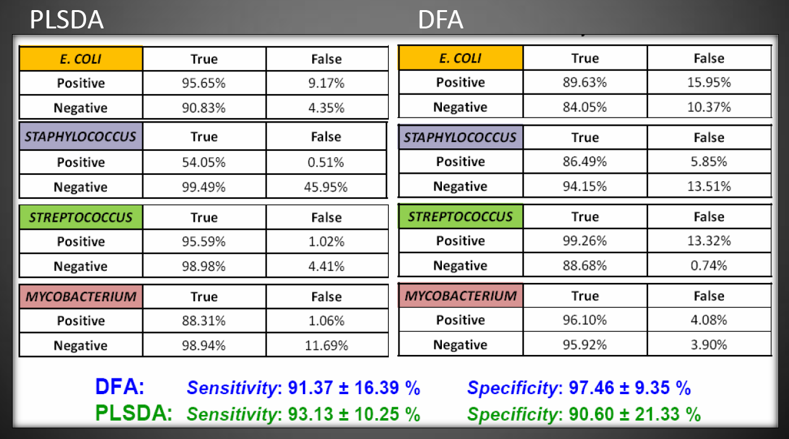
How unique is “unique”?
We can identify a bacterial species, certainly its genus, with high sensitivity and specificity (confirmed by others).
We can differentiate strains of E. coli (demonstrated by others in MRSA).
Multiple multivariate techniques effective at discriminating spectra.

Slide 38
Results: We have already demonstrated…
LIBS spectral fingerprint is a sensitive and specific (high rates of true positives, low rates of false positives) test to identify an unknown bacterial specimen or to differentiate between possible identifications
This spectral fingerprint is robust and reliable, and exists through time (multiple tests spanning years on same strains of bacteria)
In addition…
9 publications in Applied Physics Letters, Journal of Applied Physics, Applied Optics, Applied Spectroscopy, Spectrochimica Acta B, and others – confirmed by multiple other groups

Slide 39
Results: We have already demonstrated…
LIBS spectral fingerprint is:
  growth-medium independent
  independent of state of growth (how “old” the bacteria are)
  independent of whether the bacteria are live or dead (or inactivated by UV light)
  obtainable even when other types of bacteria or contaminants are present (mixed samples)
  obtainable from urine specimens
  capable of strain discrimination
  obtainable from about 500 bacteria
9 publications in Applied Physics Letters, Journal of Applied Physics, Applied Optics, Applied Spectroscopy, Spectrochimica Acta B, and others – confirmed by multiple other groups

Slide 40
Outline
Introduction of the Method. Laser-induced breakdown spectroscopy (LIBS)
Advantages of LIBS over other analytic methods
Biomedical Applications of LIBS
  A new paradigm for rapid pathogen identification
  A real time assay for nutritional zinc deficiency
Concluding Thoughts

Slide 41

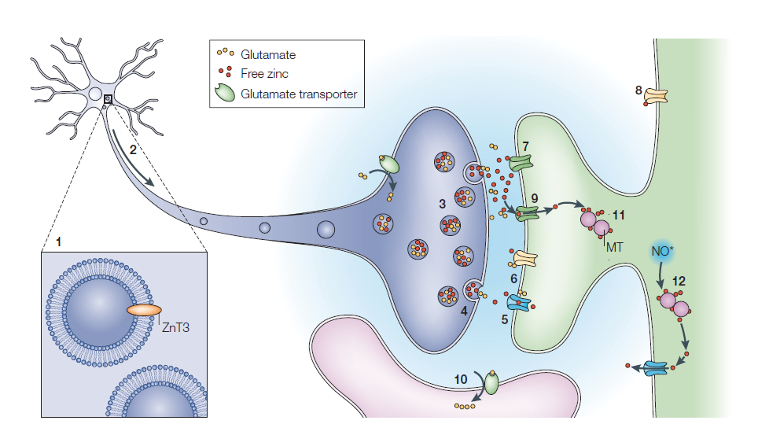
Motivation for this Project
~25 receptors
Zn2+
Zinc deficiency is a leading cause of death among toddlers worldwide.
It is also a leading cause of weakened immunity in the elderly.
Copenhagen Consensus (8 Nobel Laureates) says: Zinc supplementation is the number ONE most cost-effective move to improve world health. (2-3 billion people deficient worldwide).
Frederickson et al., Nature Neuroscience, 2003

Slide 42
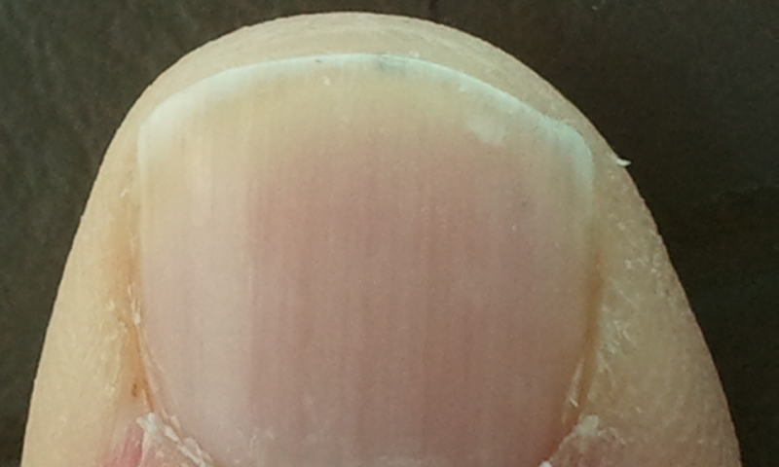

How do we diagnose and monitor zinc deficiency & remediation in
millions of people ?
Can LIBS do this?
Why not fingernail zinc?
Zinc in the fingernails has been shown to represent the overall zinc concentration in the body.
Need a real-time biomedical assay!

Slide 43
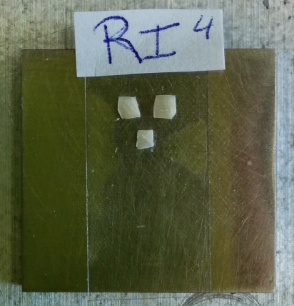

Preparation of Nails
Nail clippings of the index, middle and ring fingers (both right and left hands) of 5 subjects were taken→ a total of 6 nail clippings per subject.
Clippings were cleaned with acetone in an ultrasound bath for 10 minutes and allowed to dry for 20-30 minutes.
Clippings are cut into approximately 2 mm by 1 mm fragments to provide a flat target.

Slide 44


Typical Nail Components
Element | Mean (ppm) | ±Std.Dev.
Mg | 570.8 | ±511.5
Al | 837.4 | ±427.2
Si | 974.3 | ±594.1
P | 1035.2 | ±597.8
S | 24810 | ±8776
Cl | 1770.2 | ±1121.9
K | 831.9 | ±666.1
Ca | 2311.6 | ±1448.3
Fe | 128.6 | ±69.6
Ni | 5.1 | ±2.1
Cu | 20.8 | ±20.8
Zn | 151.7 | ±74.8
C247.9
Olabanji et al. Nuc. Instrum. Methods Section B: Beam Interactions with Materials and Atoms, 2005
Ca393.4
Ca396.8
Mg279.6
Mg280.3
Mg285.2
Zn202.5
Zn206.2
Zn213.8
Ca422.7
Ar
Ca315.7
Ca317.9
CN
Na589.0
Na589.6
Ar
Farren, Shayler, Ennos, The Journal of Experimental Biology, 2004
Wavelength (nm)

Slide 45



Observed Zinc Lines
ZnII 202.547
ZnII 206.2
ZnI 213.855

Slide 46

A Comparison of LIBS-Predicted Zinc Content vs. Actual Content
SIDMS: speciated isotope dilution mass spectrometry.
“Determination of the Zinc Concentration in Human Fingernails Using Laser-Induced Breakdown Spectroscopy,” Vlora A. Riberdy, Christopher J. Frederickson, and Steven J. Rehse, Applied Spectroscopy 71(4), 567-582, 2017

Slide 47
A Comparison of LIBS-Predicted Zinc Content vs. Actual Content
Other things we’ve studied:
Smoothness of surface
Hydration state of nail
Sampling location along growth direction
Sampling depth (# of laser shots)
Layered structure
Laser wavelength
“Determination of the Zinc Concentration in Human Fingernails Using Laser-Induced Breakdown Spectroscopy,” Vlora A. Riberdy, Christopher J. Frederickson, and Steven J. Rehse, Applied Spectroscopy 71(4), 567-582, 2017

Slide 48
Conclusions
LIBS provides an accurate, fast, spatially resolved, remote spectrochemical analysis of almost any type of target (solid, liquid, gas, powder)
High degree of versatility and robustness suggests its adoption in many different interdisciplinary fields
Experiments utilizing LIBS involve an exciting mixture of physics, laser science, and analytic chemistry (at a minimum)

Slide 49



Funding and Acknowledgements
We gratefully acknowledge funding for this project provided by:
A Natural Sciences and Engineering Research Council of Canada Discovery grant and a Research Tools and Instruments grant
A Canada Foundation for Innovation Leaders Opportunity Fund grant
An Ontario Research Fund Small Infrastructure Funds grant
University of Windsor Outstanding Scholars program
University of Windsor Faculty of Science

Slide 50






All Credit to the Students!
Dan Trojand
Allie Paulick
Khadijia Sheikh
Russell Putnam
Derek Gillies
Dylan Malenfant
Anthony Piazza
Siddharth Doshi
Vlora Riberdy

Slide 51

All Credit to the Students!
Paul Dubovan
Beau Greaves
Erica Rustico
Allie Paulick
Chris Heath
Courtney Jones

Slide 52
Thank you!

Slide 53


