Slide 1
Chemometric Data Analysis Strategies for Optimizing Pathogen Discrimination and Classification Using Laser-Induced Breakdown Spectroscopy (LIBS) Emission Spectra
Russell A. Putnam
Rehse Group
Department of Physics, University of Windsor
Windsor, Ontario, Canada
Notes:
I am Russell Putnam, Grad Student. Worked in the Rehse group for over the past 2 years.
One of the projects I worked on during my undergrad was our bacterial discrimination project.
My talk today will be on the “title”

Slide 2
Previous paper
2012
Notes:
Motivate study and explain old paper. Why is the point? Most comprehensive study to date.
To start of this talk we are going to take a look at the groups old paper and see where we have come from to get to this new study,
In the old paper our data set consisted of 5 genera of bacteria, with 13 unique species/strains, and 32 data sets.
The 32 data sets represent bacteria grown, cultured at different times, in different ways, as well as shot on different days.
DFA was used on this data set, 13 class DFA… what is interesting about this data set is that we did not tell DFA that 1-5 (red) where all E Coli, but as you can see they were all grouped together.
Now let’s shift gears briefly to the experimental setup used to acquire this data,

Slide 3
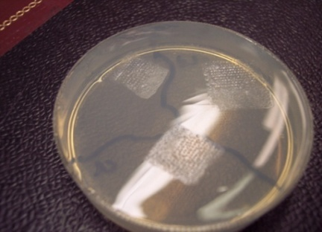

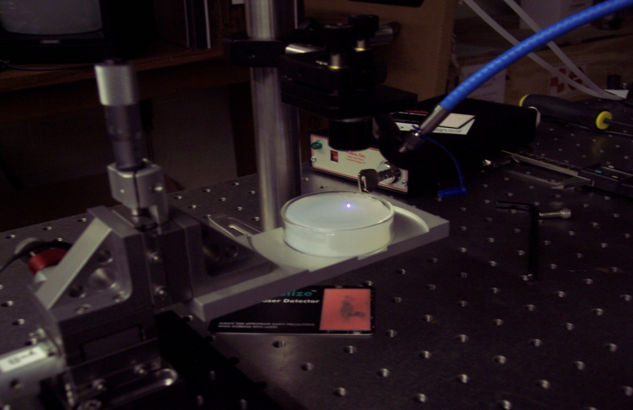
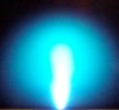
LIBS ON Bacteria
Notes:
Brieﬂy, 1064 nm infrared laser pulses 10 ns in duration were used to ablate the bacterial specimens mounted on a 0.7% nutrient-free agar substrate in an argon environment.
LIBS emission was collected 2 μs after the ablation pulse and dispersed in an Échelle spectrograph, (ESA3000, LLA Instruments, GmbH).
Pulse energies were approximately 10 mJ/pulse and each spectrum was averaged from spectra acquired at ﬁve sampling locations, each approximately 100 μm in diameter. Approximately 7500 bacterial cells in total
In the previous study the spectra were down-selected using the 13 strong emission lines as the independent variables for the Chemometric analysis. The lines with the superscript U indicates unused lines, such as the Ar lines which are due to being shot in an argon environment.

Slide 4
DFA on 13 emission lines
Notes:
Good results for most groups using DFA
We see some trouble in the Staph group with a low rate of true positives, meaning that the model had a hard time correctly identifying staph
but all genera has very high true negatives meaning the model rarely identified a bacteria wrongly as something that it was not.

Slide 5
New study
SAME DATA BUT WITH NEW TECHNIQUES AND NEW MODELS
RM0, RM1, and RM2
Principle Least Squares Discriminant Analysis (PLSDA) vs Discriminant Function Analysis (DFA)
The motivation for this work came from De Lucia et al. (explosives)
RM0 vs RM1 vs RM2
PLSDA vs DFA
Notes:
Now, this is where my work begins, seeing were the group has progressed
I used the same data taken back at Wayne State for a new study.
Same bacteria same spectra but with a new analysis.
This study was to compare down-selection techniques and to compare Chemometric analysis routines on our current data set.
The first step we did was to compare our down-selection techniques, RM0 or lines, and two new ratio models. Once we compared our models we used our best model to compare to Chemometric analysis routines, DFA and PLSDA.
This work was motivated by Gottfried and Miziolek previous work…
Compare models and then place a model in for our analysis comparison.
Let’s now take a look at the models to be compared in this analysis

Slide 6
The 3 models; rm0, rm1, and rm2
3 different down-selected models used as independent variables for our analysis
P (sum) | Mg/Ca
C (sum) | Mg/Na
Mg (sum) | Ca/Na
Ca (sum) | Ca/(P+Mg)
Na (sum) | Mg/(Ca+P)
P/C | P/(Ca+Mg)
P/Mg | Ca/(C+Na)
P/Ca | Mg/(C+Na)
P/Na | P/(C+Na)
C/Mg | (Ca+P+Mg)/C
C/Ca | (Ca+P+Mg)/Na
C/Na | (Ca+P+Mg)/(C+Na)
P213.618 (P1)* | P1/Na1 | P4/C | Mgii1/Na2
P214.914 (P2)* | P1/Na2 | P4/Mgii1 | Mgi/C
P255.326 (P3)* | P2/C | P4/Mgii2 | Mgi/Ca1
P253.560 (P4)* | P2/Mgii1 | P4/Mgi | Mgi/Ca2
C247.856 (C)* | P2/Mgii2 | P4/Ca1 | Mgi/Ca3
Mg279.553 (Mgii1)* | P2/Mgi | P4/Ca2 | Mgi/Na1
Mg280.271 (Mgii2)* | P2/Ca1 | P4/Ca3 | Mgi/Na2
Mg285.213 (Mgi)* | P2/Ca2 | P4/Na1 | Ca1/C
Ca393.361 (Ca1)* | P2/Ca3 | P4/Na2 | Ca1/Na1
Ca396.837 (Ca2)* | P2/Na1 | Mgii1/C | Ca1/Na2
Ca422.666 (Ca3)* | P2/Na2 | Mgii1/Ca1 | Ca2/C
Na588.995 (Na1)* | P3/C | Mgii1/Ca2 | Ca2/Na1
Na589.593 (Na2)* | P3/Mgii1 | Mgii1/Ca3 | Ca2/Na2
P1/c | P3/Mgii2 | Mgii1/Na1 | Ca3/C
P1/Mgii1 | P3/Mgi | Mgii1/Na2 | Ca3/Na1
P1/Mgii2 | P3/Ca1 | Mgii2/C | Ca3/Na2
P1/Mgi | P3/Ca2 | Mgii2/Ca1 | C/Na1
P1/Ca1 | P3/Ca3 | Mgii2/Ca2 | C/Na2
P1/Ca2 | P3/Na1 | Mgii2/Ca3 | Mgi/Mgii1
P1/Ca3 | P3/Na2 | Mgii1/Na1 | Mgi/Mgii2
RM0 – (lines) the 13 strong emission lines observed in the bacterial spectra (13 independent variables)
RM1 – sums the 5 elements observed and ratios of the sums (24 independent variables)
RM2 – the 13 strong emission lines and ratios of the lines (80 independent variables)
Whole spectrum analysis not performed
Over 54,000 channels (SPSS cannot handle)
Presence of Échelle spectral gaps
Notes:
Now to discuss the ratio models…
The first model for comparison was already completed using DFA in the previous paper study which was the lines model, where the 13 strong emission lines, P, Mg, Ca, Na, and C as the independent variables.
The second model, RM1, took the sum of the 13 strong emission lines as well as complex ratios of the sums of the lines. Summed all 5 elements into 5 variables and took ratios of these sums. Certain ratios were chosen with a priori knowledge based on there importance to the bacterial classification and the relevance to one another. (24 var.)
The last model, RM2, took no sums. It used the 13 strong emission lines as variables as well as taking various simple ratios of lines with one another. Again, specific ratios were taken with a priori knowledge. (80 var.)
The models as shown had 13, 24, and 80 down-selected independent variables that were used in the Chemometric analysis.
No whole spectrum model analysis was performed, only down-selection techniques were compared in this study.

Slide 7
DFA on 3 models
External Validation
Notes:
We used DFA to compare our 3 models and constructed truth tables of the results.
DFA uses the independent variables to construct N-1 discriminate function to maximize variance b/w groups and minimize variance within groups which results in the highest rates of true positives and lowest rates of false positives. Using the constructed DF’s DF scores are calculated for each spectrum that are used to classify a spectrum. The scores place it in the N-1 dimensional space and the group that it lies closest to will be the group that it is classified as.
This is seen in this graph where we have 5 different genera of bacteria placed on the graph based off their DF scores seen in different areas of the graph. One important thing to remember about DFA is that DF1 scores contain a considerable amount of the variance of the data and are more heavily weighted for the classification of bacteria and then DF1 to 3 contain nearly all the weight of the classification of the data.
In this study we did an external validation. Where when one of the 32 data sets was being tested it was removed from the library and was tested with a new model that did not contain spectra from the same day, bacteria culture and different data days for accusation. As example data set 7 is removed from the model and tested for a more robust test of the data.
Now coming back to the results we can see the improved classification from the lines model and then to RM1 and then to RM2 where there was much less improvement between the ratio models.
Calling out some of the specific changes we see a slight improvement in the true negatives rates in staph. Also looking at the strep test we see a much greater improvement in the true positive rate. In the rest of the truth table there was not much change in the results between models. RM2 was slightly better than RM1 and because of that it was chosen for the Chemometric analysis routine comparison.

Slide 8
Comparing PLSDA and DFA
PLSDA (Principle Least Squares Discriminant Analysis)
    2 class, YES or NO test
    1 predictor value
    Has a NO option
  DFA (Discriminant Function Analysis)
    5 class test
    N discriminant function scores
    Must classify each spectrum into a group
DFA
Notes:
So know let’s compare between the two routines for Chemometric analysis.
PLSDA – is similar to DFA in that it tries to maximize the between group variance as well as minimizing the within group variance but it does so by constructing latent variables( in our case 20 since a study conducted showed improved classification for all sample at 20 LV’s) used to calculate a discriminate value for spectra classification. Similar to DFA but different algorithms to construct the predictor values.
Discuss the graph of PLSDA 2 class
Now to compare the two routines we see that PLSDA discriminates between two groups at one time. It is a yes or no test where is uses one predictor value for the classification. So you a have a Myco test where everything below the line will be classified as Myco and everything above the line will be classified as not Myco. From this we can see that PLSDA has a no option. If you placed it into the 5 different tests for the 5 different genera of bacteria it could return the no option for all of the tests.
DFA – In DFA it uses N-1 predictor values to classify spectra, which means we can’t truly display the graph for that. And they are classified based off all the the predictor values. With one model it can also classify between many groups of bacteria but also does NOT have a no option. If you put an unknown spectra into the model it MUST be classified in a certain group, which ever one is the closest even though it may be a horrible match.
Now we can look at the results of the comparison using RM2. Calling out the Staph group, that has had consistently lower results in all models with DFA has shown great improvement where PLSDA was able to drastically increase the rate of true positives. We can also see that DFA though has a much better rate of false positives. PLSDA more often incorrectly identifies spectra as something they are not.
We can see this in the sensitivity and specificity where PLSDA has a higher sensitivity, higher true positives but a lower specificity, i.e. more false positives.
This leads to a few conclusions but not one that says one Chemometric routine is better than the other.

Slide 9
Conclusion
Both routines provide effective classification of unknown LIBS spectra shown by the high specificity and sensitivity
Both ratio models showed improved classification over the lines model, with RM2 (lines and simple ratios) showing slightly improved classification over RM1 (sums and complex sum ratios)
PLSDA proved to be more effective at differentiating highly similar bacterial spectra
DFA showed lower rates of false positives and could be the analysis of choice to discriminate between multiple genera of bacteria

Slide 10
Future work
Exhausted current data
In process of obtaining new data with a refined experimental method
Possibilities
    Sequential PLSDA for strain discrimination
    Multistep combination of PLSDA and DFA
DFA Specie Level Test
PLSDA Strep Test
DFA Genus Test
Data set
Strep
Yes, also strep!
Identification
Verification
PLSDA Sequential Specie Level Test

Slide 11
Thank you!
Chemometric Data Analysis Strategies for Optimizing Pathogen Discrimination and Classification Using Laser-Induced Breakdown Spectroscopy (LIBS) Emission Spectra
Questions?

