Slide 1
How do I add my pronouns on Uwinsite?
By Fei

Slide 2
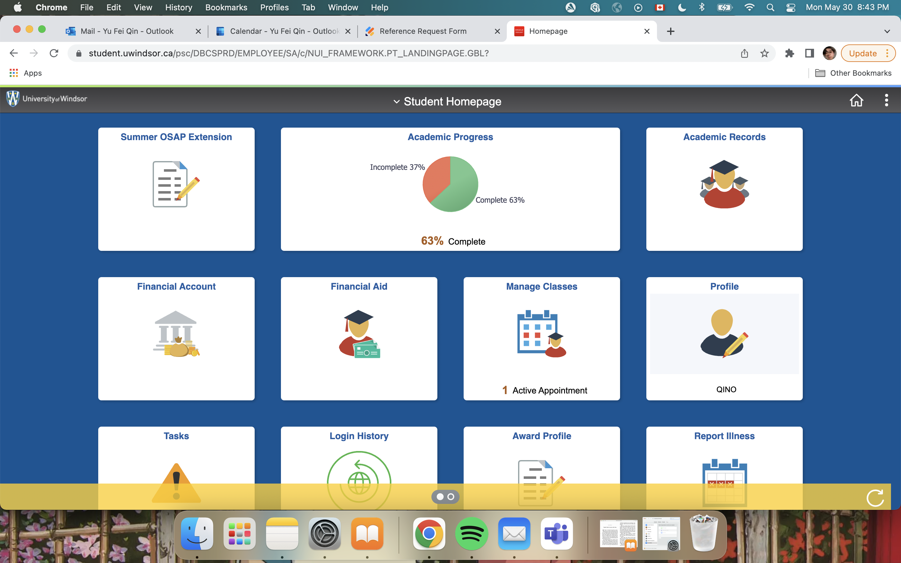

Slide 3
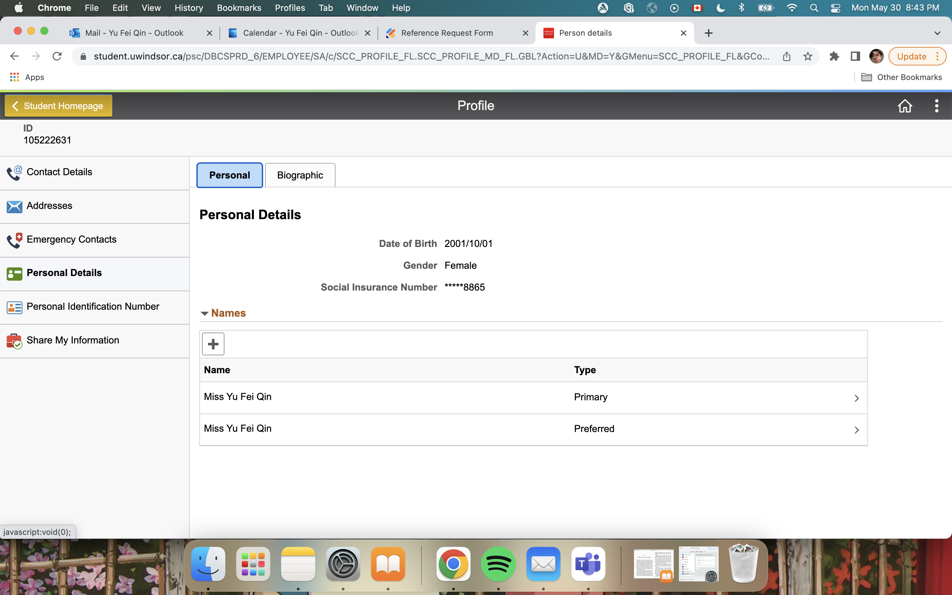

Slide 4
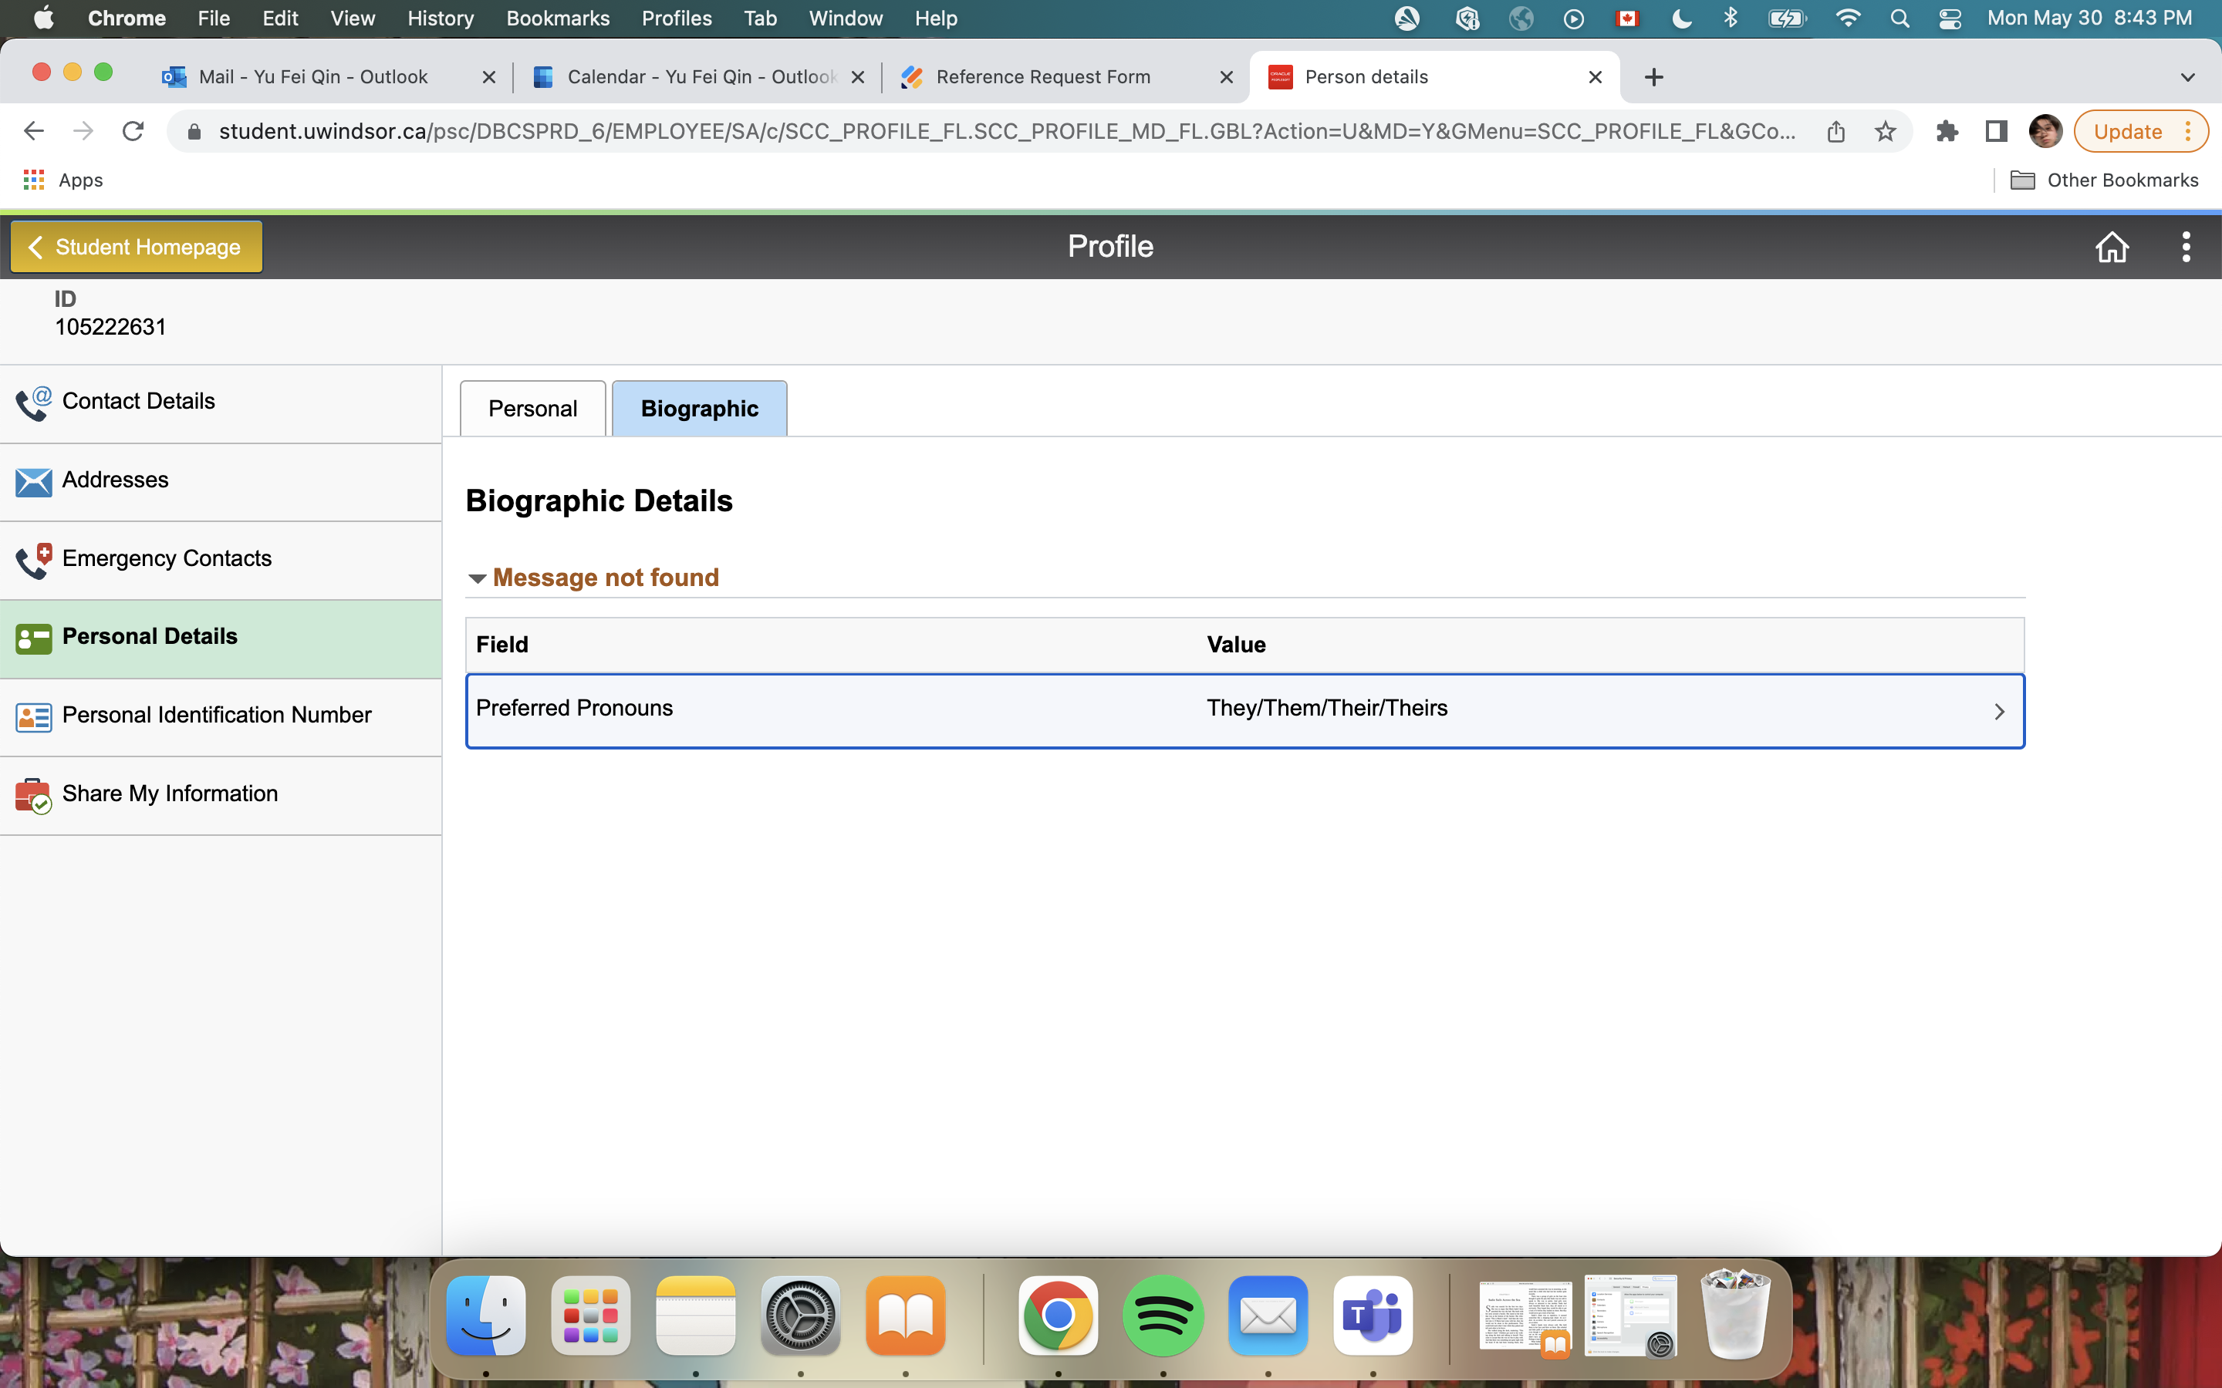

Slide 5
