Slide 1
Legal Research
For Mooting
And Mooters

Slide 2
What are we going to look at?
Types
Tools
Techniques

Slide 3
But First… Get Situated

Slide 4
What’s the Real Question?
Hardest part of research is knowing where to start
Interrogate the question
Do you actually have enough information to be able to know how to answer it?
Take time at the beginning to save time later
What is “the answer” likely to look like?

Slide 5
“I’ll know it when I see it…”
But will you?
Balance between pre-supposing what the answer may be, versus not knowing the answer when you see it
Do consider what *type* of answer you’re looking for…
Case
Legislative history
Numbers
Commentary

Slide 6
Questions Lead to Questions
Sometimes best to take the assigned question, poke it a few times, get a sense of things, then return
Narrow down to possible area(s) of law… “Is this a (criminal) issue?” “If this is in the context of torts, then are we interested in…”
This is often where Google comes into play
Not as a source, or even a way to find sources, but as a way to focus the scope of your research

Slide 7
Research Starting Points
What’s the general area of law?
Legal encyclopedias
Books and articles
Do you know of key or leading cases?
If there are leading cases, they can be noted up, plus you can use a book’s Table of Cases to quickly find commentary.
Is there governing legislation?
Note it up
Find current law
Explore legislative process/history/intent
Are there specific tools that might be helpful?

Slide 8
General Rule?
Browse, don’t search
Or
Browse, then search
Better a general search in a narrow pool, than a specific search of a broad pool

Slide 9
What’s the general area of law?

Slide 10
Legal Encyclopedias
Use a legal encyclopedia to see both how a topic fits into a broader area of law, and how it is split into narrower topics.
Canadian Encyclopedic Digest (Barristers and Solicitors (Ontario))
Halsbury’s (Legal Profession)

Slide 11
Stand on the Shoulders of Giants
Textbooks: Library catalogue, Proview (Fox on Copyright)
Situate a topic in the broader area of law
Provide key words​ and concepts
Index
Set out how an area of law fits together
Table of Contents
Offer suggestions of further readings​, key cases​, and relevant legislation​
Table of Cases
Table of Legislation
Journal articles: Heinonline and the Index to Canadian Legal Literature
Timely materials when researching a recent change
Narrower focus, in comparison with textbooks
ICLL: zealous defence

Slide 12
Caselaw

Slide 13
Case Law - Topical Research
Digests
Lexis+ = All Canada Digests (Canada Legal Profession Digest)
“Contains all Canada Digest topical sources. The summaries currently date back to the late 1800's, and are organized according to a detailed classification scheme. All Canada Digest contains summaries of cases from all jurisdictions including Quebec, the Supreme Court of Canada, the Federal Court and Federal Court of Appeal, and various federal and provincial administrative boards.”
Westlaw = Canadian Abridgement/Browse Legal Topics (Professions and occupations)
Same tree structure, appears to be same cases, but searchability differs
“Covers virtually every case reported in Canada since 1803, and every reported or unreported case received from the courts since 1986, with the exception of Quebec civil law cases.”
Notes:
CA: “search within” searches digests, BLT “search within” searches actual cases
Always browse as much/as deep as possible

Slide 14
Facts v Legal Issues
Fine balance between what matters and what doesn’t
Don’t be distracted by interesting but irrelevant details
Analogies, similar situations, sometimes ok, sometimes not
Avoid fixation on specific fact patterns… they rarely can be matched!
If there there is 100% congruence, there’s not much to talk about

Slide 15
When You’ve Found a Case
Work it backwards
What cases does your starting case cite? Focus on the paragraph(s) that deal with the topic(s) most of interest to you.
What cases does the judge refer to in their reasoning process?
Beyond caselaw, are there articles/reports/texts cited by the judge? Make a list of all the items that seems to be useful.
Work it forwards
Note up your case and make a list of cases that seem promising.

Slide 16
Noting Up
Noting up
The process of determining whether a particular case is still “good law,” and finding other cases that deal with similar legal topics or fact patterns
Two primary questions to ask:
Has it been overturned on appeal?
Have subsequent cases criticized it, overruled it, limited its application, extended its application?
Precedent
Binding v persuasive
Not as straightforward as it appears

Slide 17
Noting Up: How
2004 SCC 13
Lexis+ = Quickcite
Shortcut cit:
Or find first, and then Quickcite
Westlaw = Keycite
Always find first, then Citing References
Ideally by citation (case law), otherwise “Find and Keycite” tab
Find and KeyCite a Case by Name

Slide 18
Noting Up: How - Filtering
Manipulation of results
Filtering reduces number of results shown
Filtering results
Westlaw = Keycite
“Citing References” - essential point, limit to “Cases and Decisions” first
Canadian Abridgment codes
Filters
Search within
Lexis + = Quickcite
Filters
Graphical view

Slide 19
Legislation

Slide 20
Legislation
Does any apply?
Whose?
Whole act (reg) or section?
Now or then?
Precise date or general?
Just the legislation or the “why” around it?

Slide 21
Legislation
Federal, provincial, municipal
Constitutional distribution of powers
Statutes/acts
Regulations
Subordinate legislation
(Bylaws)

Slide 22
Legislation: Annual v Revised v Consolidated
Annual
Refers to legislation as it was passed (acts) or made (regulations).
Acts: annual statute volumes. Regs: Gazette.
Source Law on Elaws, Annual Statutes on Justice Laws, older on Heinonline.
Federal regs only through Canada Gazette
Notes:
Statute citations start with S and an abbreviation for the jurisdiction, followed by the year. Regs vary: OReg or SI/SOR.

Slide 23
Legislation: Annual v Revised v Consolidated
Revised
All of the statutes, regulations, or both in force in a jurisdiction at a given time, with all amendments applied.
New collection re-organized, re-numbered, re-published as a set of bound volumes.
Final Revised Statutes/Regulations of Ontario (RSO/RRO) were in 1990, final Revised Statutes of Canada (RSC) was in 1985, final revised regulations of Canada, slightly inaccurately named the Consolidated Regulations of Canada (CRC) was in 1978.
As sets, Heinonline.

Slide 24
Legislation: Annual v Revised v Consolidated
Consolidated
Like a revision, consolidated law "folds in" all the amendments since the legislation was made/revised.
Unlike a revision, this process occurs on an act by act (or reg by reg) basis, when an amendment happen and does not result in renumbering.
Justice Laws and E-laws, office consolidations.

Slide 25
Legislation - Finding Current Consolidated Law
On Westlaw and Lexis+ and Canlii but… Go to the official sources
Ontario: E-laws
Federal: Justice Laws
Greyed out text
Justice Laws: sections of original act not in force
E-Laws: sections of original act OR amendments not in force
Versions: Point (period) In Time
How act/reg looked before/between amendments
Regulations
Notes:
Again, browse, don’t search

Slide 26
Legislation: Process/History/Intent
Where (when) particular legislative language originated, and *why*: legislative intent
Statutory interpretation
Figure this out by looking at legislative history
Have to understand legislative process

Slide 27
Legislative Process
First reading: bill is introduced.
Second reading: bill is justified with a speech sponsor, debated, and then voted on.
Committee: Clause by clause discussion by a standing or special committee interested.
Third reading: little or no debate, final vote
Ontario: process complete.
Federal: bicameral system​. Bills are introduced in House of Commons or Senate​, go through three readings in each house.
Bill becomes an act upon Royal Assent.
Do all bills actually make it through the legislative process? No.
What about regulations? Subordinate legislation, not debated​. Regulatory impact statements (federal Gazette, Ontario Regulatory Registry)
Notes:
However, you may be able to find a Regulatory Impact Analysis Statement or Proposed Regulation in the Canada Gazette (Federal)​ or in the Regulatory Registry (Ontario).

Slide 28
In-Force Information
An act has to "come into force" before it has force or effect. Look at the end of the act to find out how it comes into force. Note, omnibus bills may have in-force information at the end of individual schedules​.
On Royal Assent​: the date on which the act received RA.
Deemed date​.
Might be dependent on something else.
On proclamation​: "This act comes into force on proclamation." There is no way to know when this might happen.
Retroactive​
Some combination​ of above: in force dates can cover a whole act or sections (or subsections!)​.
Watch out for omnibus acts (individual schedules usually = individual in force dates)
Talk to a librarian!
Regulations? In force on filing unless otherwise specified.
Notes:
omnibus bills (bills that create or amend many acts)
Coming into force information can be complex and complicated. Get help to either verify your research, or be guided through the research process.

Slide 29
Everything I just told you is a lie

Slide 30
Legislative Histories For Legislative Intent
When a change to a section of an act was created, or when/where current language originated: To determine legislative intent, usually for the purposes of statutory interpretation.
When was this change made?
Why was this change made?
What was the intent of the legislators in making this change?
Why was this particular language used?
Trace the entire history of a particular act or section since its inception, to see how it evolved, and when each change to it was made (and perhaps, why).
Notes:
by then going to look at the debates around the adoption of that language.
The process of working through a legislative history can range from simple and easy (section of an Ontario act introduced last year) to the deeply complex (pre-Confederation Federal legislation, which might have originated in England). Therefore, while I'm going to set out the basic process, and point to some useful tools, this is definitely a task where getting help is likely to be a real time and frustration saver.

Slide 31
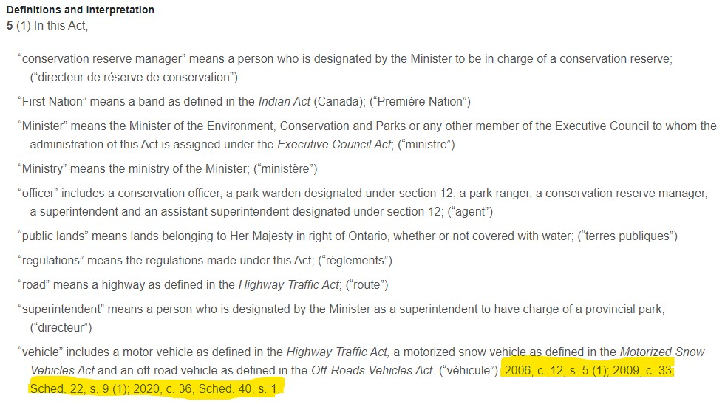
Legislative Histories: Predecessor Sections
Predecessor sections: notations at the end of every section or subsection in the current consolidation, a revision, and possibly in an originating act

Slide 32
Legislative Histories: Basic Process
Follow predecessor sections back until:
Notation New as a pseudo-predecessor section on new sections or clauses OR
A) no predecessor section information and B) no repeal of an act that deals with similar material (at the end of the amending act).
Use Heinonline: all annual statutes and revisions, primarily arranged by statute
Expect the section number to change.
If you think you've tracing a section back as far as possible, but you're in a revision? Keep looking!
Don't be shocked to see legislation go back to before the 1900s.
Ask a librarian
Notes:
If you're tracing a section back before the current revisions (Federal: 1985, Ontario: 1990) Revisions, which used to be a regular occurrence, would usually result in renumbering of acts.
There is nothing new in a revision, so it had to originate somewhere else. Talk to a librarian at this point.
or even to Confederation (1867), or beyond.

Slide 33
Legislative Intent: The Debates
Determine the bill number. Why? A statute will go through the legislative process as a bill, and be indexed that way.
Table of Contents in annual volume lists statutes with their bill numbers.
Note the year that act was made.
Find the Debates (Hansard)
Ontario Hansard since October 1975 at https://www.ola.org/en/legislative-business/house-documents OR http://hansardindex.ontla.on.ca/​. Older debates in print
Federal Hansard is available online since Confederation.
1994-2004 https://www.ourcommons.ca/DocumentViewer/en/35-1/house/hansard-index​ (includes index)
1994 to current: https://www.ourcommons.ca/PublicationSearch/en/?PubType=37​. (no index)
From 1867-1994, digitized debates: http://parl.canadiana.ca/browse?show=12.
Use index volume for each session to find page numbers for relevant material,
Notes:
(or in the annual statutes section of Justice Laws and E-laws) includes not just a list of the acts in the volume, but also their bill numbers, which is super handy.
as you'll have to map the year of the annual volume to the parliament and session, as that's how the debates are organized (one calendar year can be split over multiple parliaments/sessions, and one parliament/session can encompass multiple years). Every session starts with a new Bill 1, so knowing the date is essential!
At this point, for a simple legislative history, you have enough information to trace the bill that created your act through the legislative process, and find the debates around it. If any of this information isn't findable, or the process becomes more complex, come talk to a librarian.
as "search within" works poorly or not at all (due to the limitations of Optical Character Recognition).

Slide 34
Noting Up
Determine how a piece of legislation (whole act or section) has been applied and/or interpreted by the courts​
Similar to case law, depth can range from cursory mention to pursuant to legislation​
Help understand meaning and intent of legislation​
Courts can:​
Clarify the meaning
Extend the meaning
Declare section(s) or entire act to be unconstitutional
Only in the jurisdiction of the court

Slide 35
Insurance Act, RSO 1990, c I.8, s 233
Lexis+ = Quickcite
Find first, and then Quickcite on right of screen
Westlaw = Keycite
Always find first, then Citing References
“Find and Keycite” tab
Find and KeyCite a Statute or Regulation by Name

Slide 36
Other Tools

Slide 37
Other Tools
Quantum services
Tables of Concordance
Temporal
Jurisdictional

Slide 38
Quantum Services
“How much”
Spousal/child support; money (and sometimes time)
Criminal sentencing; time
Wrongful dismissal; time that is money
Personal injury; money
Browseable, searchable
Westlaw: Litigator
And CriminalSource, FamilySource, EmploymentSource
Lexis+: Under Secondary Materials

Slide 39
Tables of Concordance
https://guides.library.queensu.ca/legislative-concordances
Jurisdictional
Is the local way typical or an outlier?
Noting up: find additional case law that contemplates particular language
Temporal
Easier than a whole legislative history
Noting up: find additional case law that contemplates particular language

Slide 40
Who Cares?
Government departments, lobbying groups, professional organizations (think: John Howard Society, LEAF, Canadian Bar Association etc)
Reports, discussion papers, all sorts of pre-done research for you

Slide 41
Questions?
lawreference@uwindsor.ca
meris@uwindsor.ca

