Slide 1
UWinsite Finance | Fiscal Year End Training

Slide 2
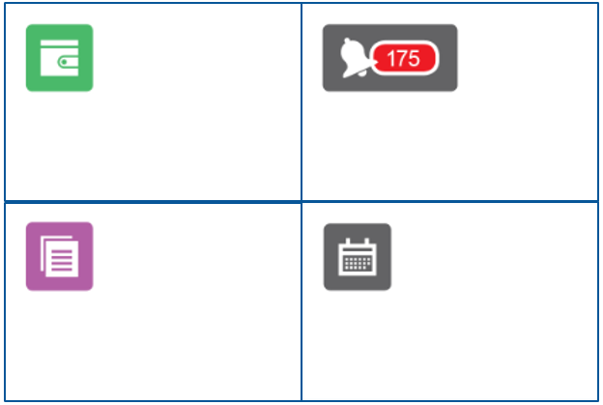
FISCAL YEAR END OVERVIEW
THE WAY TO HAVE A SUCCESSFUL YEAR END IN 2024 IS TO ENSURE REVIEWERS HAVE REVIEWED EXPENSE REPORTS, PO’S AND PAYMENT REQUESTS BEFORE THE END OF APRIL.
Submit your travel and Expense Reports for payment as soon as possible
Approve any Expense Reports, Requisitions, and Payment Requests before April 26, 2024
Receive any goods or services you’ve ordered in the system before April 30, 2024. There is no longer an extended date as this has caused cut-off issues in the past
Review your April month-end statements and request adjustments before May 10, 2024
Notes:
Jen
Good morning everyone and welcome to our annual Fiscal Year End Training presentation. We are happy to have such great attendance at this training, once again this year.
The purpose of today’s session is to go over the key year end deadlines for the campus as we move towards the April 30th fiscal year end date and the preparation of the financial statements for 2023/2024. Adherence to the timelines outlined in our presentation will be critical to Finance to ensure we are able to meet our financial reporting requirements.
As always our Finance team is here to guide you through this process and answer any questions you may have along the way.
We hope this presentation today will provide you a better understanding of the fiscal year end process and what is required from you during this busy time of year.
We also hope you use this session as an opportunity to ask any questions you may have. We have an hour and a half scheduled for the session and do have quite a bit to cover. To ensure we are able to get through everything we need to cover in a timely manner, we do ask that you hold off on asking questions throughout the presentation, as we have reserved some time at the end to address them. Anything we are not able to address in the allotted time can be sent to those listed as resources at the end of the presentation. Please feel free to also use the chat and we will answer during the question/answer period.
Before we begin with the presentation, I would like to take some time to introduce the Finance team who will be guiding you through the training session this year.
My name is Jenifer Gritke, Acting Controller and ultimately responsible for the preparation of the financial statements. Miguel PeBenito is our Senior Accountant, responsible for overseeing the Fiscal Year End process this year. He will really be your point of contact for any questions related to the accounting side of the house and will be the one coordinating all the efforts for the fiscal year end, as well as our liaison with KPMG our external auditors. He will be the one who keeps us on track and makes sure all the deadlines are met!
Karen Gorospe-Perry is also joining us today as the Sr. AP Clerk. Karen will spend some time today talking about travel expense reports and invoices and any deadlines for our Accounts Payable team.
We also have a vacancy in our Corporate Card and Supplier assistant role so Lili Smallwood Dagraca will be presenting in place as our Procurement Assistant. Lili is here today to talk to the deadlines and requirements from the Purchasing Card side and will provide you insight on what you need to know about these topics to be successful through the 2023/2024 fiscal year end. Dario Pavia, corporate buyer, is joining us to walk us through the PO, payment request and procurement side.
You will all be receiving a copy of these slides after the presentation. Just a reminder to mute your mics and raise your hand for questions. Teams allows us to see questions in the order the hands were raised.
With this I will turn it over to Lili who will begin our presentation with a discussion on the Purchasing Cards.

Slide 3
SCOTIABANK VISA PURCHASING CARD
STATEMENT CYCLE ENDS
Transactions incurred between April 16 and April 30 will be recorded in the next fiscal year's general ledger
Keep transactions between April 16 and April 30 to a minimum
Large purchases are to be communicated to the Procurement Department so the necessary accruals can be arranged
APRIL
15
CENTRE SUITE COSTS DEADLINE
Any costs needed to be moved to Centre Suite for the statement cycle ending April 15, must be moved by April 19
APRIL
19
NOTE: IF YOU’VE MADE A PURCHASE FROM ONE VENDOR AND IT IS LUMPING AS ONE SUM IN YOUR ACCOUNT ANALYSIS, USE THE FOLLOWING CALCULATION TO COME UP WITH THE COST. TAKE THE AFTER TAX AMOUNT, DIVIDE BY 1.13 AND MULTIPLY BY 1.0341
ADDITIONALLY: IF YOU MAKE PURCHASES THAT SHOULD BE NON-TAXABLE SUCH AS GIFT CARDS OR GRATUITIES, PLEASE NOTIFY FINANCE BEFORE THE END OF THE MONTH IN WHICH THE PURCHASE WAS MADE
Notes:
Lili
Statement Cycle Ends
As a reminder, only transactions that have been incurred between March 16 and April 15 will hit this year's budget.
Transactions incurred between April 16 and April 30 will be recorded in the next fiscal year's general ledger
Keep transactions between April 16 and April 30 to a minimum
Large purchases are to be communicated to the Procurement Department so the necessary accruals can be arranged
CentreSuite Costs Deadline
Any costs needed to be moved to Centre Suite for the statement cycle ending April 15, must be moved by April 19

Slide 4
SCOTIABANK VISA PURCHASING CARD
RECORD RETENTION AND APPROVAL
Year end is a great time to review purchasing card statements to ensure all statements have been signed and back up for all purchases has been retained
Cardholders should remain compliant with the above retention and approval processes
Electronic files can be retained for supporting documentation
Statements are received electronically through email
Invoices for transactions are received digitally
Statements and supporting documentation can be emailed to the one-up approver for review and approval
Proof of one-up email approval should be retained electronically with copies of the statement and invoices for audit purposes
Submit a Team Dynamix Ticket to have a department, program, or project account added to your Centre Suite allocation options.
Notes:
Lili –
Year end is a great time to review purchasing card statements to ensure all statements have been signed and back up for all purchases has been retained
Though most of you usually keep paper files for your purchasing card backup, we encourage cardholders to keep electronic files on OneDrive of their statements and any supporting transactions. Statements are emailed to you or can be downloaded directly from CentreSuite. Most invoices come electronically for online orders. If you have hard copies of invoices, try taking a photo of them on your phone and emailing them to yourself to be saved electronically.
Having the files electronically then allows us to easily email the documents or even share the OneDrive folder where there saved, with your one-up approver. The One-up approver can then provide an approval through email once they have reviewed the documents. Please remember once the statements are approved via email, to save a copy of the approval email with your purchasing card files for audit purposes.

Slide 5
PURCHASE REQUISITIONS & PAYMENT REQUESTS
PR’s and Payment Requests
All Purchase Requisitions and Payment Requests should be approved on the system by the Procurement department by end of business day to ensure budget funds are encumbered
Purchase Requisitions received after this date may be applied against next year’s fiscal budget
APRIL
26
UWINSITE TIPS FOR SUBMITTERS
UWINSITE TIPS FOR APPROVERS
- - - - - - - - - - - - - - - - - - - - - - - - - - - - - -
- - - - - - - - - - - - - - - - - - - - - - - - - - - - - - - - - - -
Before April 26, check in the Purchase Requisitions Module to ensure all of your requisitions show a Funds Status of “Approved”.
Check the Notification Bell and act on any expense reports by approving or rejecting in advance of April 26.
NOTE: PURCHASE REQUISITIONS MUST BE APPROVED FOR THEM TO APPLY AGAINST THE CURRENT YEARS BUDGET
Notes:
Dario
All Purchase Requisitions and Payment Requests should be approved on the system by the Procurement department no later than end of business day April 26 to ensure that budget funds are encumbered in fiscal the 2023-2024 year end. What does this mean: This means that Purch Reqs and Payment Requests must be submitted by the requester and approved by the approver no later than April 26.
A Purchase Requisition must be approved, for it to apply against your current year budget. Any Purchase Requisition received after this date may be applied against the next year’s fiscal budget.
If you are a requestor submitting a payment request or purchase requisition, just a reminder that Before April 26, check in the Purchase Requisitions Module (Green Shopping Cart) to ensure all of your requisitions show a Funds Status of “Approved”.
If you are approver of payment request or purchase requisition: Please make sure you are Checking your Notification Bell and act on any requisitions, by approving or rejecting them, in advance of April 26.
I also want to take some time to clarify what will occur from after the April 26th deadline and onward, for common situations related to Requisitions, Payment Request and Invoices:
For example: Your Requisition or Payment request was on the system prior to May 1, but you have not yet “received” it (on the system) or sent the invoice to AP (apinvoices@uwindsor.ca).
If the goods/services were physically received or provided to you in the 2023/24 fiscal year, please “receive” them with an effective date of April 30th or earlier. Regardless of when you send in the invoice for payment, your invoice will applied against the 2023/24 budget and the expense will be properly reflected in our audited financial statements.
What to do with Payment Requests/Invoices Before May 14:
For example, You have an invoice related to 2023/24 fiscal year in hand. No Payment Request was on the system before April 30th related to this invoice (i.e.: you missed the cut off date).
Please go about the normal process (create a Payment Request, “receive” the payment request, and email the invoice to apinvoices@uwindsor.ca). Unfortunately, the system will not allow you to “receive” the invoice with a date earlier than the date the Payment Request was created, so the invoice will not be automatically applied to 2023/24.
However, until we close AP for the year on May 14th, we will review all invoices sent to apinvoices@uwindsor.ca and, regardless of when they were “received”, AP will change the GL date to the 2023/24 fiscal year if the goods/services relate to this fiscal year. Please help us by writing on the invoice that it applies to the 2023/24 fiscal year. Finance will review and will apply to the correct fiscal period based on accounting standards only.
At this point, we plan to close AP on May 14th. If this date changes, we will inform the campus; please monitor our website for continuous updates surrounding year end.
What to do with Payment Requests/Invoices AFTER May 14
For example, you have an invoice related to the 2023/24 fiscal year in hand. No Payment Request or Purchase Requisition was on the system before April 30th related to this invoice (i.e.: you missed the cut off date).
After May 14th , invoices cannot be applied to 2023/24 without a manual accrual done by the Finance team. If the invoice relates to a Capital or Repair project, please inform Jenifer Gritke, Assistant Director, Financial Reporting immediately with a copy of your invoice.
If the invoice relates to any other type of account (operating, trust, research grant), please email Miguel Pebenito, Senior Accountant with a copy of your invoice, if it is over $10,000.
All of these invoices will be reviewed on a case by case basis for manual accrual.
A Purchase Requisition was submitted before April 30th, but it was rejected because of errors/issues. But you require the requisition to be applied to the 2023/24 fiscal budget (this should be a rare scenario).
Please work our Procurement directly (Rita and Dario) to get a requisition issued. We cannot back date requisitions, but we commit to working with the Budget office to ensure that the funds required are carried forward to 2024/25.

Slide 6
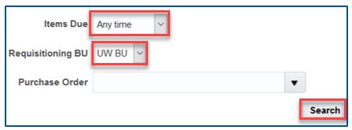
RECEIVING GOODS & SERVICES
Please review your “My Receipts” space on the system to ensure that you receive anything you have got before the year end deadline.
When receiving the goods or services, please ensure that you choose a Transaction Date of April 30 if the goods or services were actually supplied on or before April 30.
APRIL
30
UWINSITE TIP
- - - - - - - - - - - - - - - - - - - - - - - - - - - - - - - - - - - - - - - - - - - - - - - - - - - - - - - - - - - - - - - -
1. From the Home Screen, click on My Receipts
2. Set Items Due to Any Time
3. Set Requisitioning BU to UW BU
4. Click Search to see anything outstanding for receiving in your account.
Notes:
Dario
Again, For invoices to be applied against purchase orders and payment requests, it is critical that goods and services be received in the system (click “My Receipts”) before end of business day April 30. When receiving the goods or services, please ensure that you choose a Transaction Date of April 30 if the goods or services were actually received or supplied before April 30th.

Slide 7
PURCHASE ORDERS
BLANKET PURCHASE ORDERS
All Blanket Purchase Orders for fiscal 2023/2024 will be closed
If departments wish to have new blanket PO’s issued, they should initiate these by submitting a Purchase Requisition in May 2024.
APRIL
30
REGULAR PURCHASE ORDERS
Any amounts still open (meaning not yet “received” in the system) on Regular Purchase Orders, after the Accounts Payable cut off date of April 30th, will remain open on the system as at April 30, 2024 and carried forward to the next fiscal year.
The budget dollars will also be carried over to next year for that commitment.
APRIL
30
MAY
01
Notes:
Dario

Slide 8
PAPERLESS BILLING
PAPERLESS BILLING AND INVOICES
Reminder for all faculty and staff who are not already doing so, to register for paperless billings with suppliers. This includes invoices and monthly statements (i.e. Shred-it, Brinks, phone bills, etc.)
Please contact any suppliers you are expecting invoices from and have them email invoices to apinvoices@uwindsor.ca. This will ensure that the invoice is received by Accounts Payable and processed before April 30, 2024.
Notes:
Karen
Payment runs by cheque are occurring once per month whereas EFT payments are biweekly, and Visa Payables Automations (VPA) payments are weekly. With VPA, suppliers who choose to opt in will receive a credit card account and an email notification for each payment informing them of the amount to process using their Point-of-Sale device or software.
Suppliers have the advantage of getting paid timelier and not having to have an individual process payments manually at their location.

Slide 9
TRAVEL EXPENSE CLAIMS & NON-TRAVEL EXPENSE REIMBURSEMENTS
REIMBURSEMENTS VIA EXPENSES MODULE
All travel and non-travel reimbursements pertaining to the current fiscal year should be submitted and approved at both approval levels - one up approval and budget owner approval - before end of business
Expense reports not approved by this date may be changed against next year’s budget
APRIL
26
TRAVEL ADVANCES
Travel advances that apply to travel that would have occurred before the University’s fiscal year end must settled by the claimant before April 30, 2024.
Unused travel advances related to travel that has been cancelled or postponed should be settled with the University as soon as possible.
Further details on how to handle cancelled travel and travel advances can be found on the Finance website.
UWINSITE TIPS FOR SUBMITTERS
UWINSITE TIPS FOR APPROVERS
- - - - - - - - - - - - - - - - - - - - - - - - - - - - - -
- - - - - - - - - - - - - - - - - - - - - - - - - - - - - - - - - - -
Before April 26th, check the Expenses Module (Green Wallet) to ensure any open reports are showing a status of “Pending Expense Auditor Approval”
Check the Notification Bell and act on any expense reports by approving or rejecting in advance of April 26th.
Notes:
Karen
All travel expenses and non-travel reports pertaining to the current fiscal year should be submitted and approved before end of business April 26. Remember that some of you have two levels of approval before an expense report is formally APPROVED, including One-up approval and also the Budget owner approval, so the process may take longer.
Any expense reports not approved by April 26 may be charged against the next year’s budget.
Just a reminder, if you are a submitter of the expense reports please make sure that Before April 26, you check in the Expenses Module (Green Wallet) to ensure any open reports are showing a status of “Pending Expense Auditor Approval.” (this status means that they have been approved by your one-up and have made their way to Accounts Payable for their final review and processing.
Just a reminder, if you are an approver of the expense reports please make sure that you are Checking your Notification Bell and act on any expense reports by approving or rejecting in advance of April 26.
Travel Advances:
Travel advances that apply to travel dates that would have occurred before the University’s fiscal year end, must settled by the claimant before April 30, 2024. Settled means that an expense report for the travel expenses is submitted to clear the travel advance.
If you had travel booked that was cancelled, any unused travel advances related to this travel should be settled with the University as soon as possible, and before April 30, 2024 if the travel was to have occurred before year end.
For example, If you applied for a travel advance from Accounts Payable to pay for a flight and conference fee, and the conference has now been cancelled and you received a refund in cash from your Travel Provider for the flight and conference fee, you will be required to refund the University these funds in order to settle the travel advance outstanding. To do this you can simply issue a cheque to the University for the amount of the advance received. Send the cheque to the University of Windsor, ATTN Accounts Receivable (note: please include the Travel Advance Expense Report number on the memo line of the cheque). Once received Accounts Payable will ensure that your cheque is applied to the correct travel advance and that the Travel Advance is settled.

Slide 10
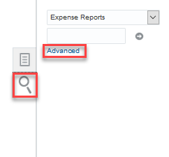
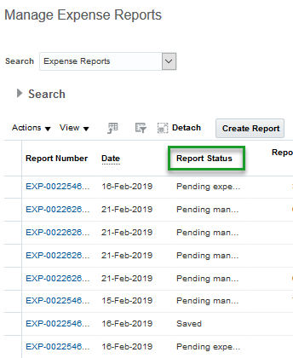
TRAVEL EXPENSE CLAIMS & NON-TRAVEL EXPENSE REIMBURSEMENTS
To see an inventory of all of your Expense Reports in any status (Saved, Submitted, Approved, Pending):
From the Home Screen, click on Expenses
In Expenses Module, click the Magnifying Glass
Click Advanced
Manage Expense Reports page will be displayed
NOTE: IF SOMEONE HAS DELEGATED TO YOU, YOU CAN DO THIS FOR THEM AS WELL. ENSURE YOU CHOOSE THEIR NAME FROM YOUR DROP DOWN MENU BEFORE CLICKING THE MAGNIFYING GLASS
Notes:
Karen
This slide just shows you how to look up the status of your submitted expense reports.

Slide 11
ACCOUNTS RECEIVABLE INVOICE REQUESTS
REQUESTS FOR BILLING
Goods or services rendered in fiscal 2023/2024 must be received via email at arinv@uwindsor.ca before May 6, 2024
MAY
6
CASH RECEIPTS DEPOSITED CENTRALLY
DEPOSITS VIA DISTRIBUTION SERVICES OR ACCOUNTS RECEIVABLE
This should be rare, but if you do have cheque or cash deposits, please arrange to drop off to distribution services to be sent to A/R prior to April 24th.
NOTE: cheques do become stale-dated.
If you are on campus for any reason and still have a petty cash fund, these have been discontinued. Please send in those monies to AR if you are onsite. Arrangements can be made directly through Gail Puskas
APRIL
24
Notes:
Miguel

Slide 12
DEPOSIT SUMMARIES FOR DEPOSITS MADE BY DEPARTMENTS
All funds received as revenue in April and not previously deposited must be prepared for deposit before April 24th.
All Deposit Summaries must be submitted to the Accounts Receivable department by end of business day May 8th
If you need to make arrangements for any cash or cheque deposits sitting on campus, please contact Gail Puskas in Accounts Receivable.
MAY
08
Notes:
Miguel

Slide 13
JOURNAL ENTRIES & BUDGET TRANSFERS
JOURNAL ENTRIES FOR PROCESSING
Journal entries related to 2023/2024 submitted for processing via Team Dynamix Tickets should be submitted before May 10th
Please check your entries to ensure you’ve selected an accounting date of April 30th or earlier
MAY
10
BUDGET TRANSFERS FOR PROCESSING
Budget transfer entries related to 2023/2024 should be submitted before May 17th
17
NOTE: THERE IS A NO TOLERANCE POLICY FOR LATE JOURNAL ENTRIES IMPACTING TRUST FUNDS (04/06/07/09). ANY ENTRY NOT POSTED BY THE DEADLINES CANNOT BE POSTED TO 2023/2024
Notes:
Miguel

Slide 14
PRELIMINARY MONTH-END REPORTS
DEPARTMENTAL REVIEW
You will receive a preliminary April month-end report for departmental review
MAY
06
REVIEW RESUBMIT
Please review the preliminary month-end reports to identify any missing entries and complete entries as required before end of business day
MAY
10
IF YOU REQUIRE ASSISTANCE, PLEASE CONTACT YOUR BUDGET ANALYST
Notes:
Miguel

Slide 15
INVENTORIES
A MEMO OUTLINING SPECIFIC YEAR END INVENTORY PROCEDURES HAS BEEN FORWARDED UNDER SEPARATE COVER TO THOSE DEPARTMENTS HOLDING INVENTORY
Notes:
Miguel

Slide 16
Recent Updates and Process Reminders From Finance

Slide 17
JOURNAL ENTRIES AND ACCOUNTS RECEIABLES
SUBMITTING A JOURNAL ENTRY
A TDX ticket is to be used for submitting a journal entry.
It has built-in workflow and real time status updates
Ticket location: Finance > UWinsite Finance
POS TERMINAL RENTALS
If you require a POS terminal to accept debit/credit transactions, an application form needs to be completed and returned to finance for approval.
Form location: https://www.uwindsor.ca/finance/763/cashless-campus
TDX form for POS terminal rentals coming
ACCEPTING CASH
We understand that there may be circumstances in which cash transactions need to take place in order to conduct business effectively
Departments are required to be approved for cash transactions by finance at minimum 5 business prior to event
Notes:
Miguel

Slide 18
TEAM DYNAMIX AND FINANCE FORMS
SUPPLIER REQUEST FORM
A self-service Supplier Portal was launched in February 2022.
To request a new supplier, campus users will submit a UWinsite Finance Ticket through Team Dynamix. (Ticket: UWinsite Finance, Request Type: Add a New Supplier)
Using the UWinsite Finance Team Dynamix ticketing system has significantly streamlined the Supplier Request process, with built-in workflow and real-time status updates
OPEN A TRUST
A TDX ticket is to be used for opening a new trust. It has a built-in workflow and provides real-time status updates
Ticket location: UWinsite > UWinsite Finance – Open or Modify a Trust Account
INCOMING DONATIONS
A TDX ticket is to be used to process incoming donations. This is for any cheques received or online donations received or planned to be received
Ticket location: UWinsite > Advancement/Gift Processing Ticketing System
PCARD/BTA/TRAVEL CARD CHANGE REQUESTS/APPLICATIONS
TDX Ticket process now live
Any requests for new cards, changes or increases please use the following ticket system to enter your requests TDX Ticket
Notes:
Jen

Slide 19
CAPITAL ASSET AUDITS & PRINT/STATIONARY
CAPITAL ASSET AUDITS
A new audit procedure has been implemented whereby capital assets on campus need to be identified, photographed and tagged
The first audit was done at Odette in March. Please consider who your contact would be for your particular building/department/area and pass that information on to Jenifer Gritke, Acting Controller for ease of contacting for future audits
A list of equipment will be sent out prior to the audit and a time convenient for both Finance and the department can be worked out to do the physical review
PRINT & STATIONARY
The government of Ontario passed a bill in 2016 that requires corporations to report all materials in which our logo is present and could end up in a blue box
For example, flyers we print, envelopes we send out, campaigns we run for donations, etc.
Similar to PDF funds (professional development funds), a new classification code is being created that would allow this type of purchase to be classified. The new code is REC for Recycling
If you purchase recyclable products that will bear our logo on it, please change your GL strings on your purchase orders to include this classification code (ex. 01.2700.27100.000000.82220.REC.00.000
Alternatively, a journal entry to reallocate to this classification code can be done similar to PDF funds
Notes:
Jen

Slide 20
How to Create a Journal Entry

Slide 21
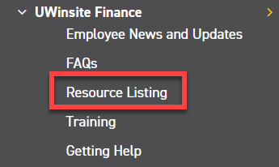
HOW TO CREATE A JOURNAL ENTRY
Journal Entries are the record for transactions taking place such as:
Reimbursements/transfers between departments
Internal charges between departments within the University
For example, parking charging for services
From the University of Windsor, Finance Department webpage (www.uwindsor.ca/finance), click on Resource Listing – located in the left hand column under UWinsite Finance

Slide 22
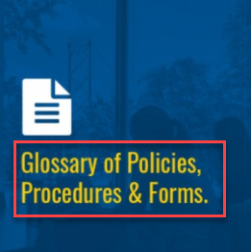
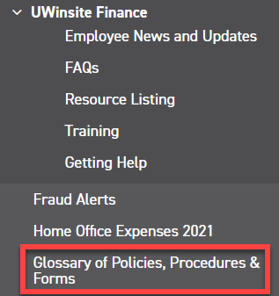
HOW TO CREATE A JOURNAL ENTRY
2. In a new tab open the University of Windsor, Finance Department webpage (www.uwindsor.ca/finance), click on Glossary of Policies, Procedures & Forms – from the button on the front page or in the left-hand column

Slide 23
HOW TO CREATE A JOURNAL ENTRY
3. In the Forms, Policies & Reference Guides page, under the Forms section, click General Accounting
4. Click GA01 – Journal Entry Template (Finance & Campus Users) to download

Slide 24
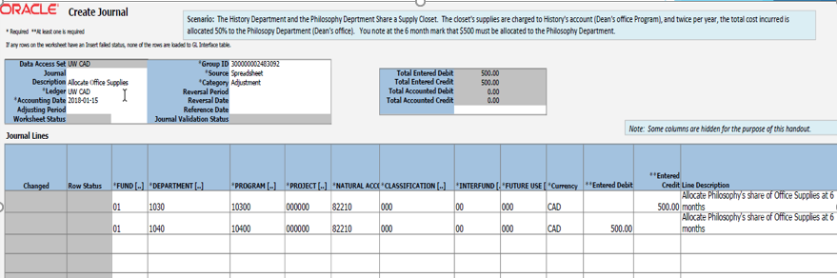
HOW TO CREATE A JOURNAL ENTRY
5. Fill in all necessary fields
Fund – 2 numbers
Department – 4 numbers
Program – 5 numbers
Project – 6 numbers
Natural Account – 5 numbers
Classification – 3 numbers
Interfund – 2 numbers
Future Use – 3 numbers
Currency, Entered Debit/Credit and Line Description (not mandatory but highly recommended)
NOTE: Projects and programs are mutually exclusive, if you have one, you cannot have the other
Each Line should have Either a Debit OR a Credit

Slide 25
HOW TO CREATE A JOURNAL ENTRY
6. Once completed, save spreadsheet and back up.
NOTE: What Constitutes Proper Backup?
Emails from departments approving a charge and/or providing an account number
Meeting minutes
Working copy of spreadsheets calculating amounts
Invoices/receipts
Any internal forms you may have
External system reports (external to UWinsite Finance such as Forte or Bookware)
System Generated Account Analysis Report
Or simply a detailed description of what the entry is trying to accomplish
7. Open a ticket through Team Dynamix
NOTE: For any additional help:
Visit the knowledge-based article: https://uwindsor.teamdynamix.com/TDClient/1975/Portal/KB/ArticleDet?ID=146078

Slide 26
Matching Natural Accounts
to Internal Charges

Slide 27
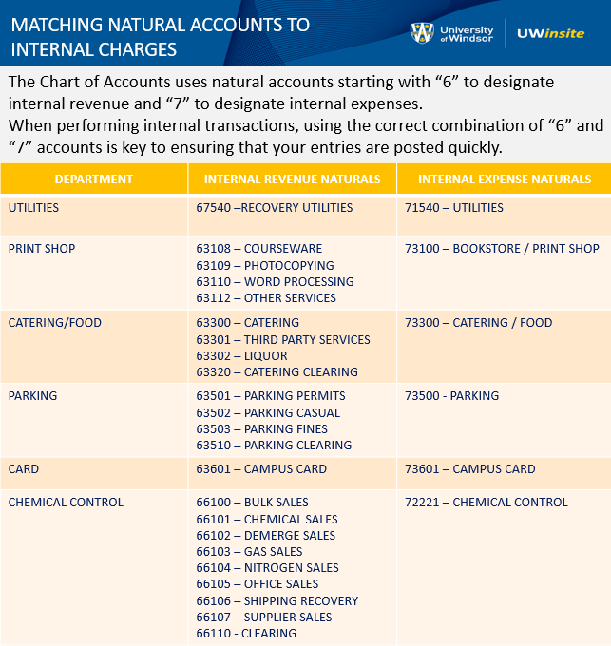

Slide 28
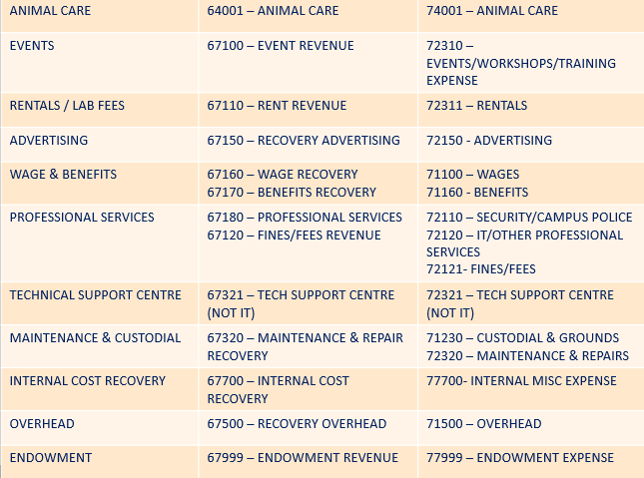

Slide 29
How to Request an Invoice

Slide 30
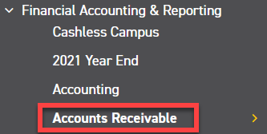
HOW TO REQUEST AN INVOICE
NOTE: ALL invoicing done for the University of Windsor must go through the Finance Accounts Receivable office. No unauthorized department should be issuing invoices without the sole permission of the Financial Controller or Senior Accountant.
From the University of Windsor, Finance Department webpage (www.uwindsor.ca/finance), click on Accounts Receivable– located in the left hand column under Financial Accounting & Reporting. Alternatively, you may go directly to http://www.uwindsor.ca/finance/cash-and-accounts-receivable.

Slide 31
HOW TO REQUEST AN INVOICE
2. On the Accounts Receivable page, scroll down until you reach the AR Invoice Request section. Click Invoice Request Form (Excel format). An excel worksheet should download
3. Click on Enable Editing in Yellow at the top of the excel workbook

Slide 32
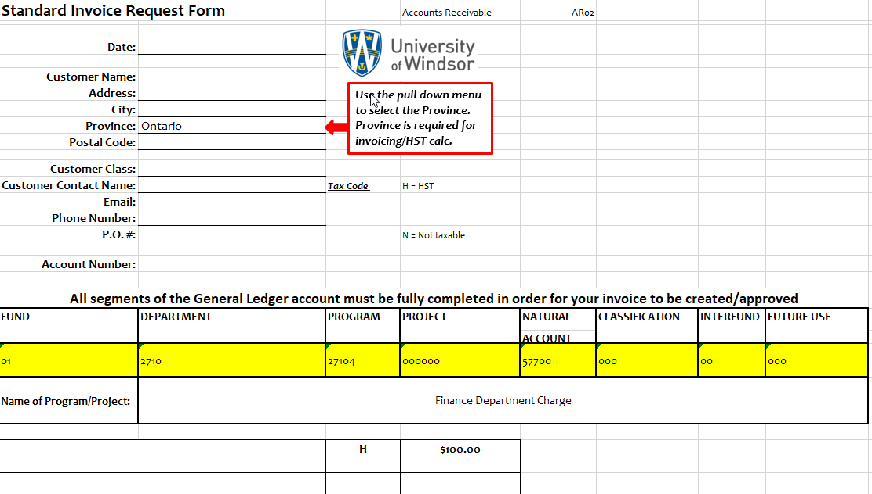
HOW TO REQUEST AN INVOICE
4. Fill out all available information in the request form. The items highlighted in yellow are your GL string that you want your sales to go to. Unless this is a direct reimbursement of expenses, your natural account should begin with a 5 series. Under no circumstance can your Natural account begin with a 7 or a 6. In order for the numbers to display proper, put an apostrophe ( ‘ ) before typing the number. That way the zeroes will show properly.
Ensure if your item is HST exempt you put N where the H is. If the item is taxable you may put an H on each line item. You may have as many line items on one invoice as you wish. If you want to have these line items go to different natural accounts just highlight the row underneath “Fund” and right click > Insert Row.
5. Lastly, email your completed request form to arinv@uwindsor.ca.

Slide 33
How to Process a Payment to UW

Slide 34
HOW TO PROCESS A PAYMENT
NOTE: If you receive a payment for a previously requested invoice, please ensure these are sent directly to Accounts Receivable noting the invoice number. A Deposit form is not necessary for a payment towards an invoice already done in the system.
For all non-invoiced receipts, from the University of Windsor, Finance Department webpage (www.uwindsor.ca/finance), click on Accounts Receivable– located in the left hand column under Financial Accounting & Reporting. Alternatively, you may go directly to http://www.uwindsor.ca/finance/cash-and-accounts-receivable. There is a lot of valuable information posted on this site including our cash handling policy.

Slide 35
HOW TO PROCESS A PAYMENT
2. On the Accounts Receivable page, scroll down until you see the section “Here are 4 ways Revenue is recorded:” Go to Number 2 (Receipts) and click on Deposit Funds. Fill out the form with all information indicated.
3. Send the completed form with your cheques to CHT 4th Floor Accounts Receivable through internal mail.

Slide 36
For up-to-date information about the 2024 year end, please visit:
http://www.uwindsor.ca/finance/year-end

Slide 37
Trusts, Endowments, Donations: Jenifer Gritke, Assistant Director, Financial Reporting jgritke@uwindsor.ca; Paige Sowerby, Manager, Restricted Funds paige040@uwindsor.ca
Research Finance: Paige Sowerby, Manager, Restricted Funds paige040@uwindsor.ca
General Accounting, Journal Entries, Chart of Accounts: Miguel Pe Benito, Senior Accountant miguelp@uwindsor.ca
Accounts Payable & Vendor Payment Requests:
Karen Gorospe, Senior Accounts Payable Coordinator karen.gorospe@uwindsor.ca
Accounts Receivable Billing and Receipts: Gail Puskas, Accounts Receivable Clerk gpuskas@uwindsor.ca
Purchasing Card: pcard@uwindsor.ca
Procurement: procurement@uwindsor.ca
If you are having any trouble accessing UWinsite Finance, please open a ticket: UWinsite Helpdesk Ticket

