Slide 1
Teaching with Online and Hybrid Classes
July 26th 2021
Access the slides at: https://rebrand.ly/NFO_2021

Slide 2
Asynchronous vs Synchronous
Announcements, email, messages, discussion forums
Low bandwidth
Work at own pace
Low pressure
Good for collaboration, communication, in different time zones, working, parenting, sick, rural and remote, poor internet access
Collaborate, MS Teams
High bandwidth required
Everyone has to be available at the same time
High pressure
Good for real-time collaboration, demonstrating complex concepts, software, dialogue

Slide 3
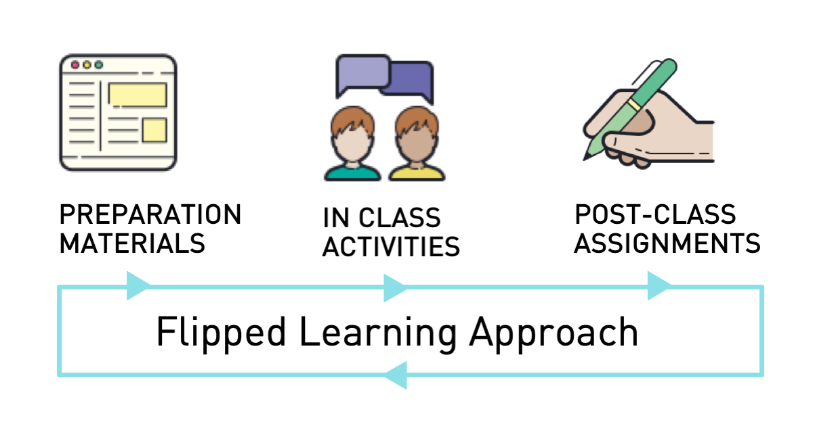
What about the flipped?
Before class
Watch pre-recorded mini-lectures
Complete readings / preliminary activities
Live class
Collaborative problem solving / Active learning / Exploration of complex concepts
After class
Reinforce learning with quiz, minute paper, reflection etc.
Prepare for next class

Slide 4
What platform to use?
Blackboard Collaborate Ultra (Virtual Classroom)
Hosted directly in course site
Instructor playlist: https://www.youtube.com/playlist?list=PLS2OXDDTttS2CFb1ao47FcgBaXa-SPCey
Teams
Auto captions possible

Slide 5
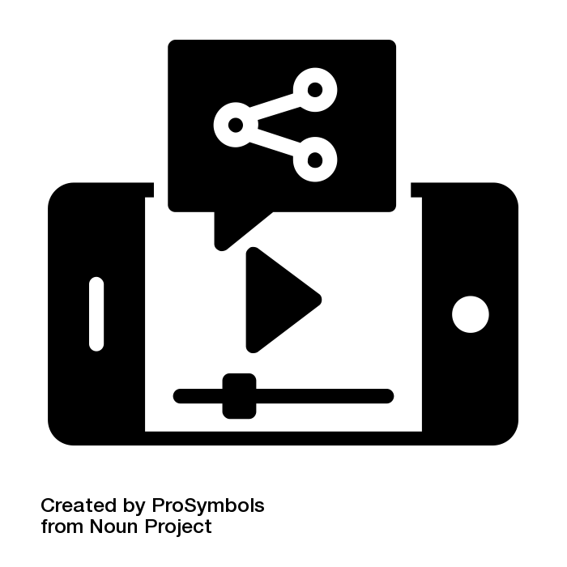
Steps to Creating a Microlecture/video
Plan
Record
Host
Share
Plan what you want your students to get out of the video
Is a video the best choice for this content?
What do you want to say?
What do you want to record: Screencast, voice over PPT, webcam
Where will you record? What tools do you need?
Plan for short chunks of content - preferably 15-30min
Select a video recording tool e.g. PowerPoint, YuJa, MS Teams/Stream, Collaborate, Zoom, APowersoft
Do a test recording and watch back - check for sound particularly and lighting
Record your lecture
Export or publish recording: Depending on what you recorded in may need to upload to service
Where will you store your video e.g. MS Stream, YouTube?
HINT: Don’t upload video files to Blackboard Learn, but linking from a streaming service is OK
MS Stream and YouTube will automatically create captions (may need to be edited for accuracy)
If using MS Stream, create class Group first to share video with
Create a content area on Blackboard for microlectures
Copy link from streaming service
Create an Item or Weblink, give it a descriptive title e.g. Lecture 1: Torts and paste in link
If using MS Stream, have to share with whole institution or a group
Planning by Iconstock from the Noun Project
video service by Seanau from the Noun Project
video sharing by ProSymbols from the Noun Project
Adapted from California Virtual College Online Education Initiative: http://tiny.cc/b0vlqz
Notes:
Record with: Virtual Classroom, MS Teams, APowersoft, Loom, Zoom, PowerPoint, your phone/tablet
Store: OneDrive, UView, YouTube, Vimeo, MS Stream - NOT uploaded to Blackboard (linking/embedding from streaming service is fine)
What to use it for: Explaining concepts, short lectures, engaging students, tutorials, follow up to questions
Considerations: Chunk into small concepts - 5-10 min, generally keep it short and simple, does not need to be a Hollywood production! Always do a short (few seconds) test run before recording for longer
New tools coming for video creation and management

Slide 6
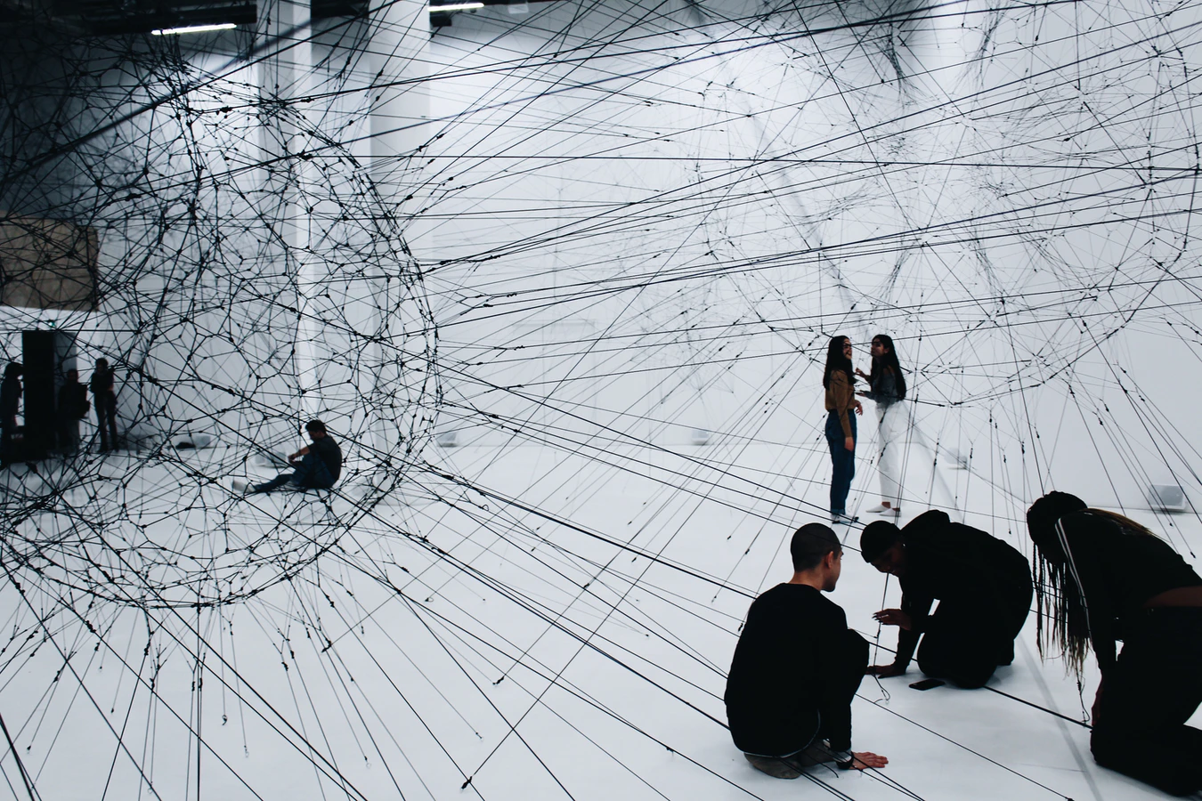
Think of Blackboard as your learning hub
Photo by Alina Grubnyak on Unsplash

Slide 7
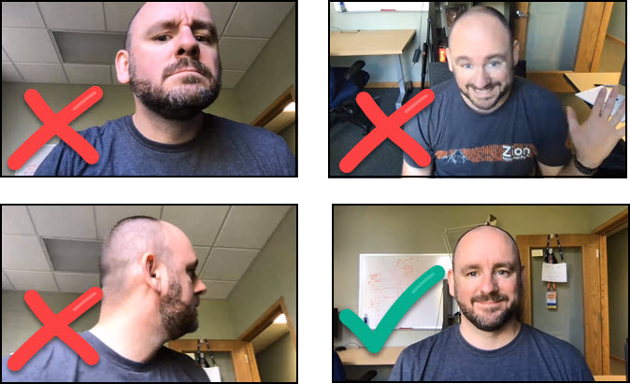
Equipment
Always test first
May want to buy a microphone- see recommended equipment

Slide 8
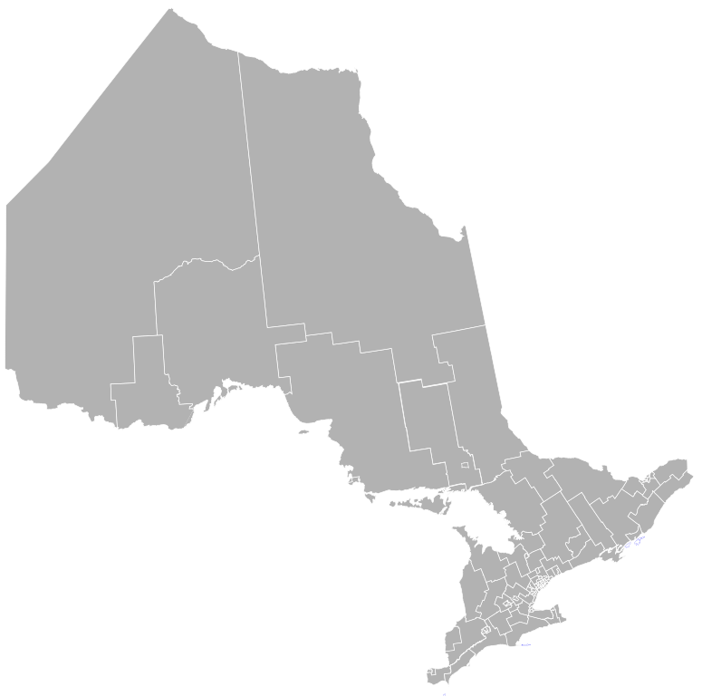
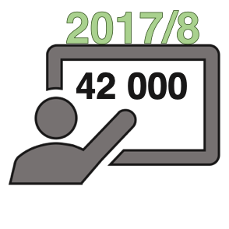
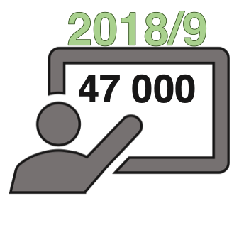
In the Province of Ontario, there are over 40,000 students in universities registered with accessibility services.
(Ministry of Training, Colleges, and Universities, 2018)

Slide 9
Engaging online students
Regular check in - Communication and assessment
Online allows for Multimodal learning experience
One option for building free interactions: https://h5pstudio.ecampusontario.ca/
Polling: https://www.mentimeter.com/
Free “gamified” questioning: https://kahoot.com/

Slide 10
Quality metrics for online courses
Quality Matters Emergency Online Teaching Checklist: http://tiny.cc/QM
Preparing for success
Guiding students and their learning
Teaching effectively in a new environment
Memorial University Course Design Checklist: https://blog.citl.mun.ca/instructionalresources/course-design-checklist/
Notes:
http://tiny.cc/QM

Slide 11
More Blackboard Support
ONLINE SELF-HELP PAGES - HTTP://WWW.UWINDSOR.CA/BLACKBOARD
ONLINE SELF-PACED, NON-FACILITATED COURSES HTTP://WWW.UWINDSOR.CA/BBONLINE
ONLINE SYNCHRONOUS HELP - BB CAFE VIRTUAL HELP DESK
MON/FRI 8:30 AM-- 4:30 PM (HOURS MAY CHANGE IN FUTURE)
ESSENTIALS VIDEOS - HTTP://WWW.UWINDSOR.CA/BBVIDEOS
OFFICE OF OPEN LEARNING HTTPS://CTL2.UWINDSOR.CA/OPENLEARNING/WORKSHOPS/
BLACKBOARD’S SUPPORT PAGES HTTP://HELP.BLACKBOARD.COM
SUBMIT A SERVICE REQUEST FOR CUSTOMIZED ANSWERS HTTP://WWW.UWINDSOR.CA/BBHELP
ONLINE SYNCHRONOUS BB WORKSHOPS HTTP://WWW.UWINDSOR.CA/BBWORKSHOPS
Access the slides at: https://rebrand.ly/NFO_2021

