Slide 1

Better Living Through…
The Deadhead Sessions
Tuesday, July 17

Slide 2
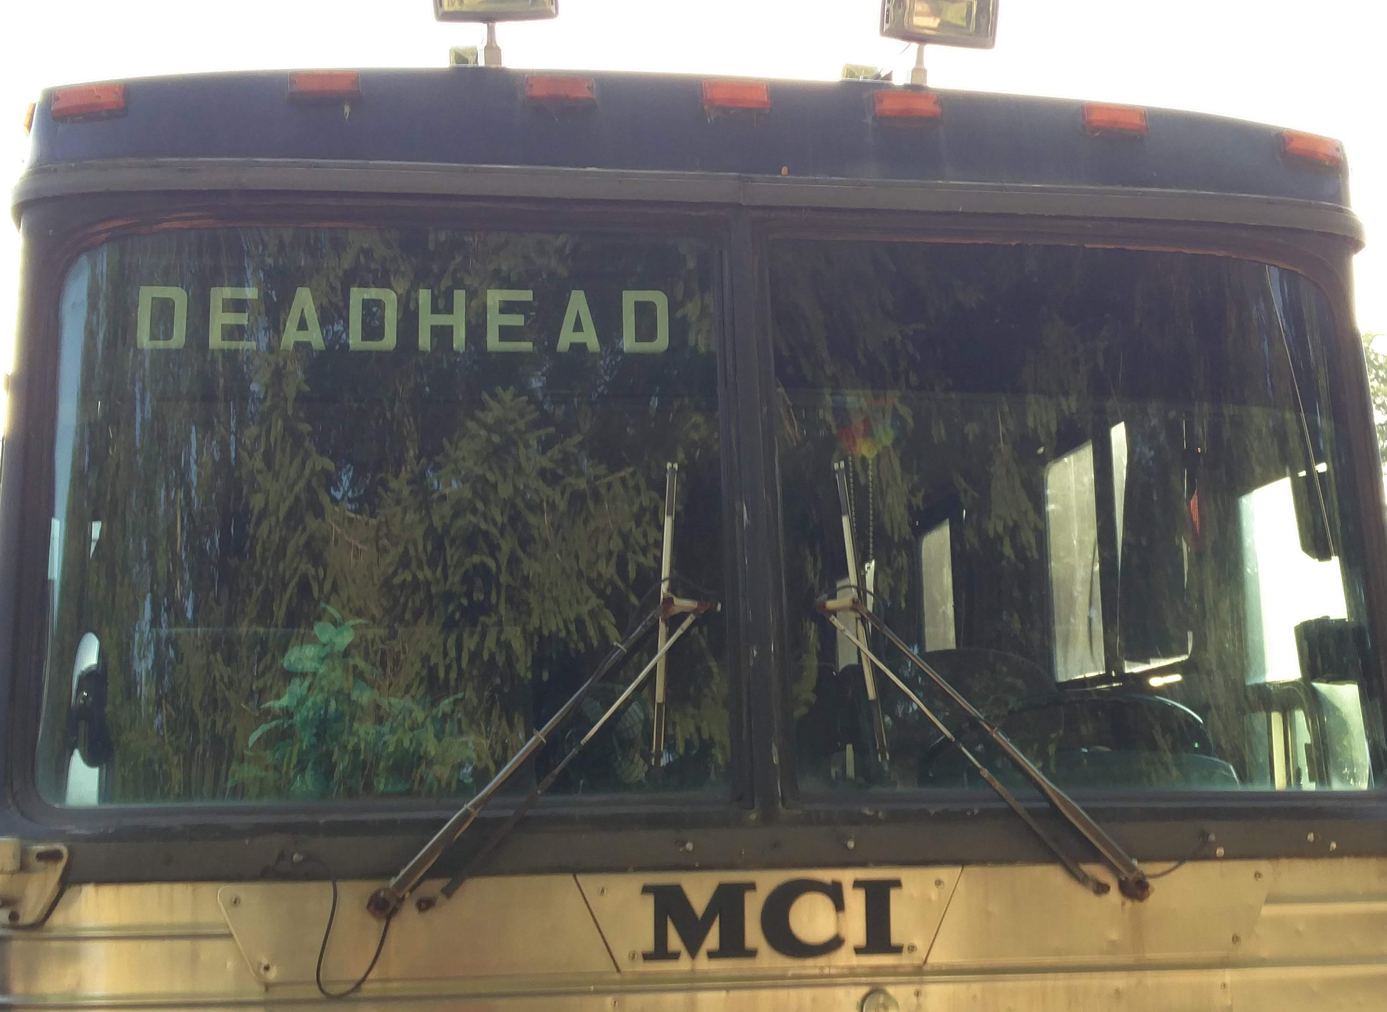
JEFF BERRYMAN
INTRODUCTORY REMARKS

Slide 3


Why Change is Slippery Work
Jessica Raffoul & Bev Hamilton

Slide 4
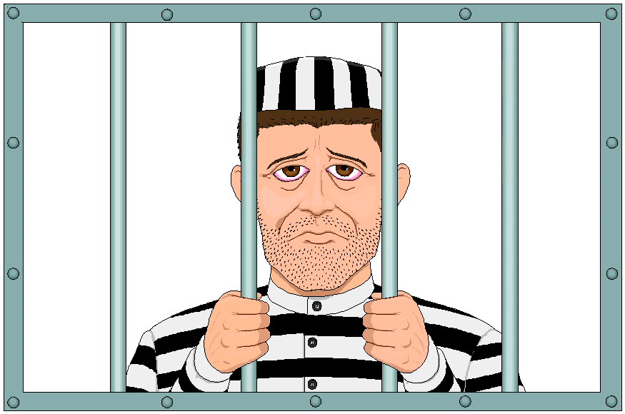
A normal day at the office…

Slide 5

What strategy do you use to break this news?
Notes:
Deadheads deal with a lot of change. Some of it dropped on their heads from above, some of it things they’d like to achieve, some of it the result of things other people are doing. Sometimes demands for change that are mutually exclusive. Recently one of you told me that he spends most of his time listening to people reacting to evolving situations, and trying to persuade people to engage with things that have to get done… What does that process look like at an institution? What are some of the common ways resistance operates?
Here’s a dozen – I doubt any of them are unfamiliar. I’m pretty sure I’ve used a lot of them myself.

Slide 6
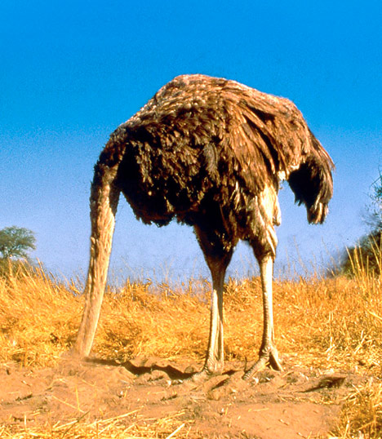
Wait them out.

Slide 7

Bury them in procedure.

Slide 8

Blame the hierarchy.

Slide 9
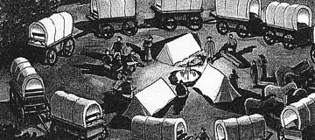
Circle the wagons.

Slide 10

Defend academic freedom.

Slide 11

Prey on the weak.

Slide 12

Establish a good conspiracy theory.

Slide 13
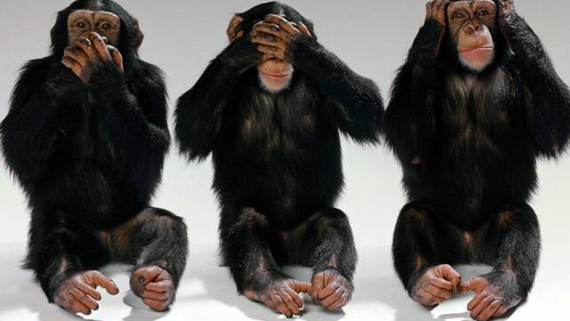
Dismiss the “facts.”

Slide 14




Express concern for the University’s reputation.

Slide 15

Hide the bodies.

Slide 16
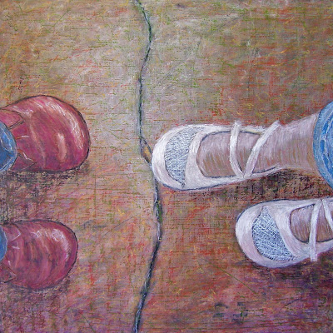
Obey the letter of the law.

Slide 17
And last, but not least…

Slide 18

Compare it – Unfavourably – to what U of T does.

Slide 19
Protecting your Own
Stewardship
Disciplinary protection
Academic freedom
Community and student advocacy
Disciplinary peer pressures
Reputation
Career
Risk reduction
Caution

Slide 20
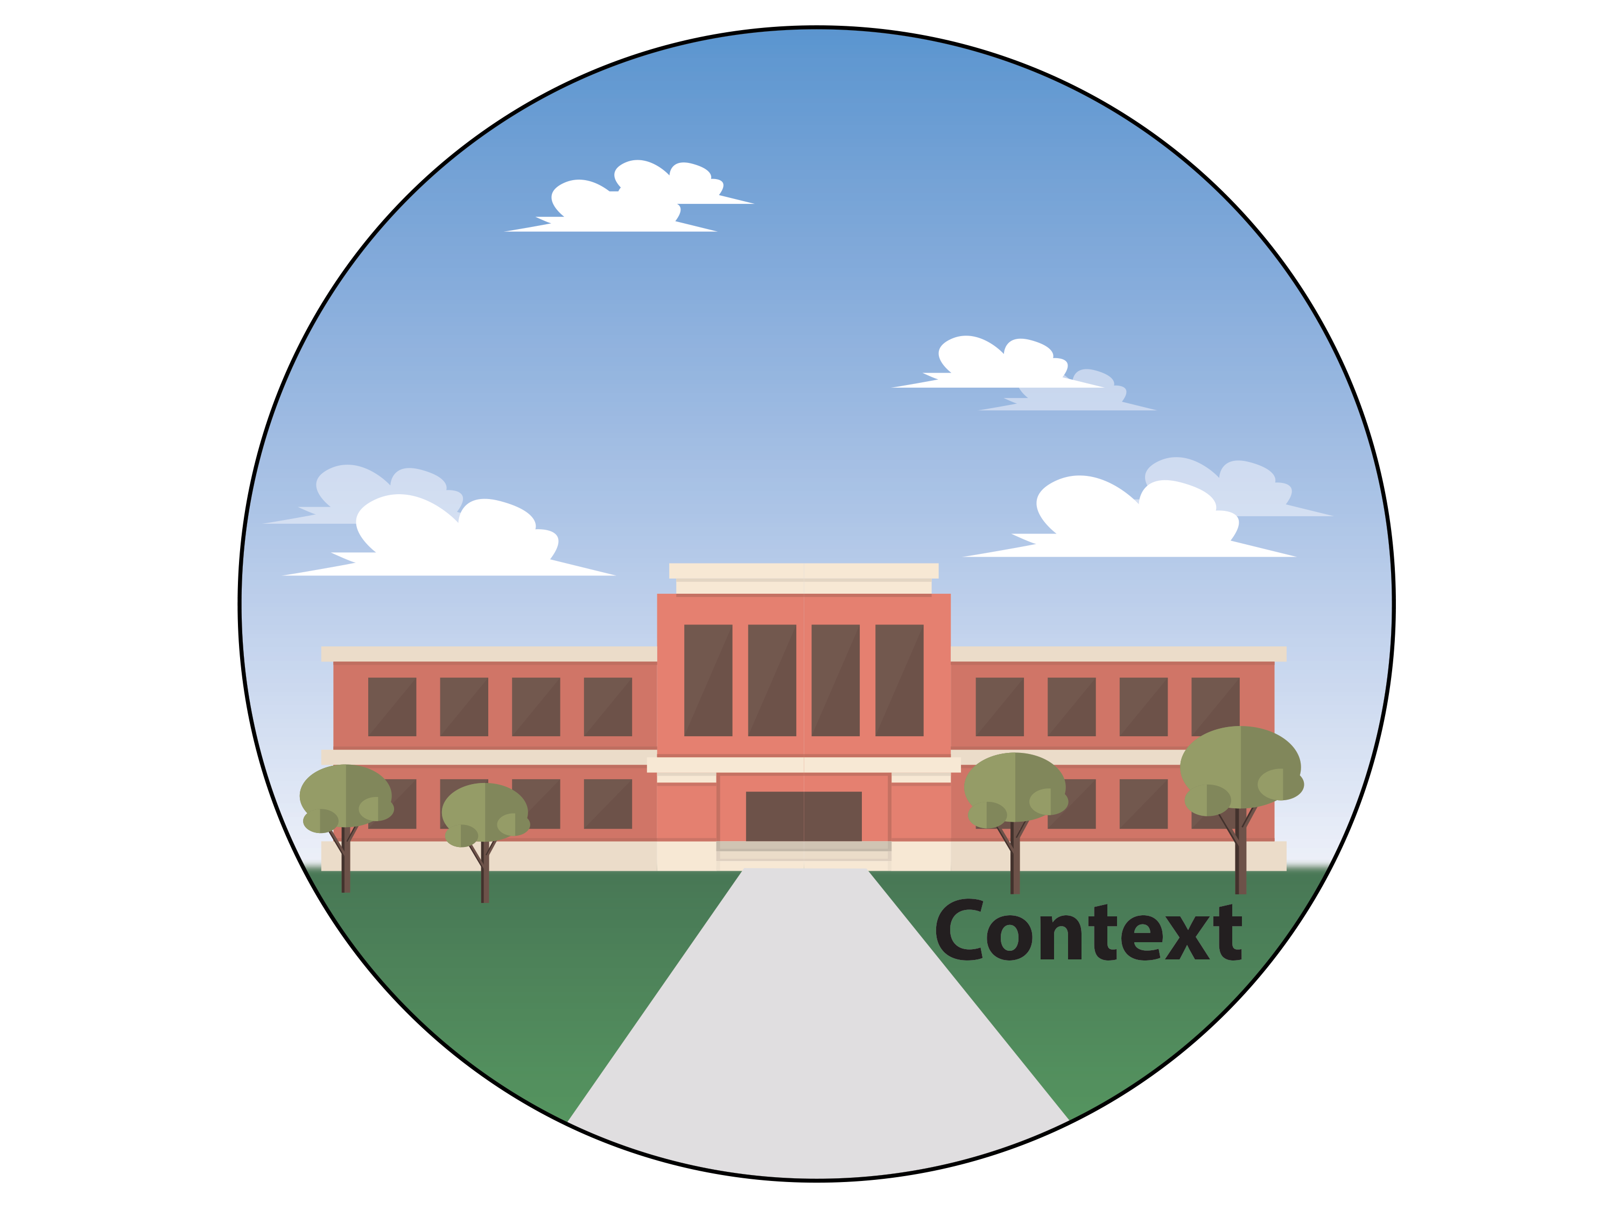


Notes:
Some factors are related to the nature of the idea itself.
Some factors have to do with the university context.
And some have to do with how identities operate in that context – and therefore who is involved.

Slide 21

Hard to grasp
Unfamiliar
Counterintuitive
Complicated
#provincialfundingformula

Slide 22

Highly visible or risky for some or all of the people involved - particularly in the implementation
#RTPcriteria

Slide 23

Decentralized practice
Centrally required, decentrally owned and managed
Centrally valued, but not departmentally
Interacting, interdependent, potentially invisible parts
#IQAP

Slide 25

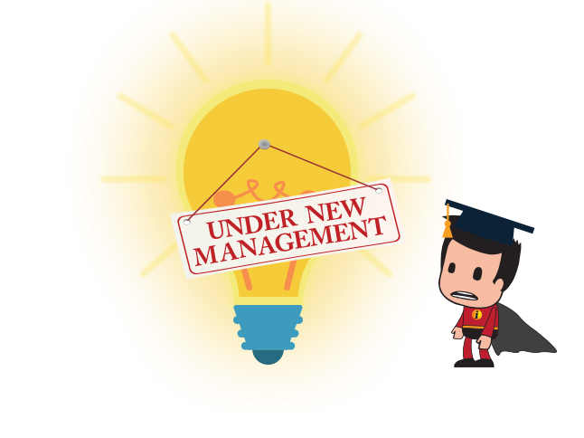
Multiple initiatives…
#soundsfamiliar

Slide 26
Rapidly changing conditions
Institutional amnesia
  Staff changes
  Shifts in provincial priorities
  With time, the purpose is no longer clear
Lack of co-ordination/transparency
#newdean #newpresident #newprovost #newday #dougford

Slide 27
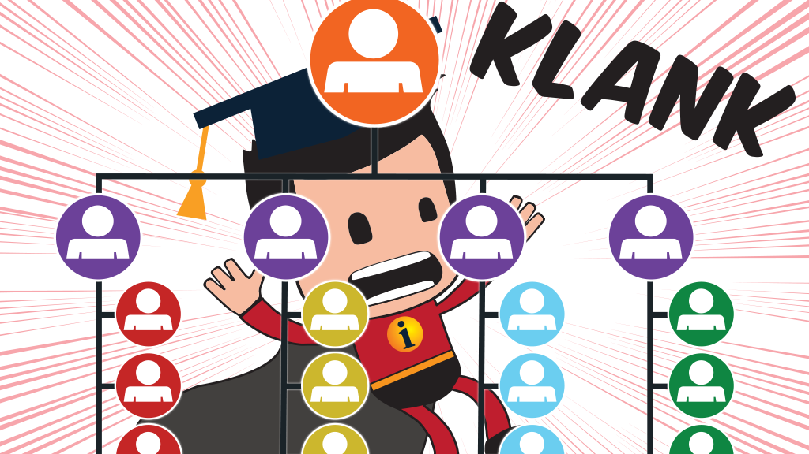
Hierarchies #programapproval #brokentelephone

Slide 28

Conflicting Layers of Interest
#curriculumre-design
Notes:
The institution is made up of multiple stakeholders – students, faculty, sessional instructors, staff, administrators, community members, donors, and so on. Each layer is trying to maximize achievement of their interests and minimize their perceived threat. So an initiative that seems like a good idea from one point of view can appear very threatening to the interests of another.
For example, curriculum re-design seems like a great idea if you’re interested in making programs more efficient, or more coherent for students, or if you’d like to see something new or different offered that’s more in line with how you see the discipline’s most important areas – but can seem like a terrible one to a faculty member who sees that as “wasting” faculty time on teaching that they could be using to enhance their research. Or to one who has courses they’re taught for a long time that they don’t want to see disrupted, or to one who is trying to protect specific disciplinary fields. It may be popular with students – but it may also bring in a whole lot of things they see as harder, more group work, more active learning…. The dean might be totally on board with some directions of re-design – but not with others….
And so on, and so on. It’s worth mapping those kinds of benefits and threats out when you’re thinking through a new initaitive….

Slide 29
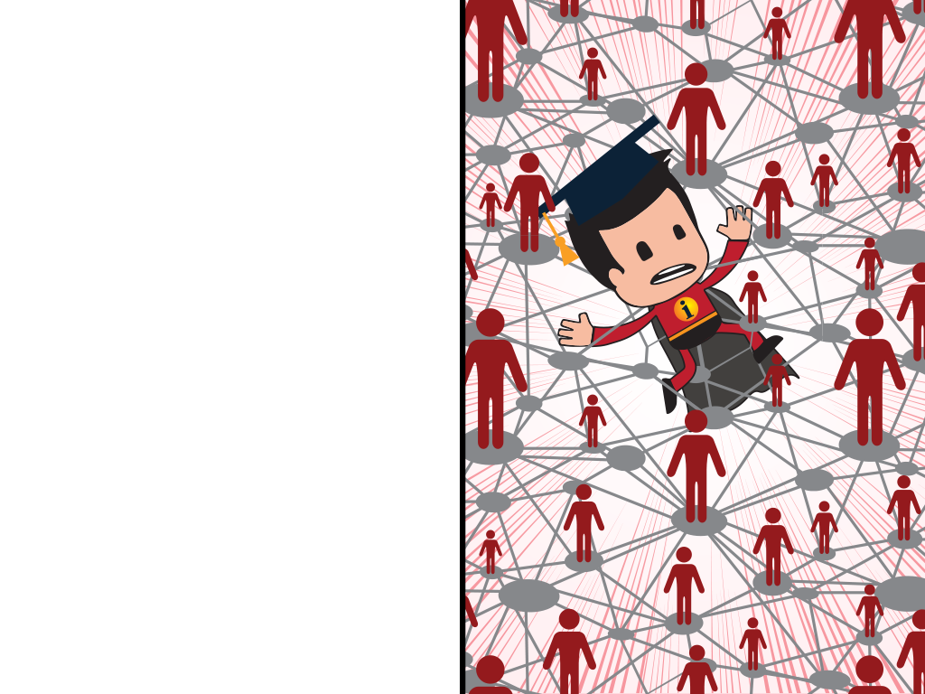
Networks
Information flows through networks
People in networks produce meaning together based on their history, culture, identity, values
Because of how meaning is produced, the way people understand the purpose and nature of an initiative is unpredictable
#whatjusthappened

Slide 30
Normal: Acting in your own best interests
Normal: Acting in the interests of your identity group(s)
Normal: Using the resources available to you to forward those interests

Slide 31
Reflecting on Your Project(s)
Using the handout, consider whether any of the factors we’ve discussed are part of why one of your own projects has been tricky to move forward
Identify all that apply….

Slide 32
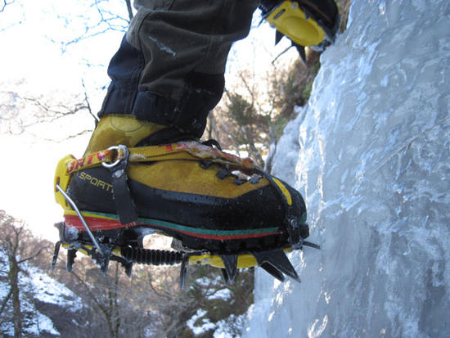

Strategies?
Traction
Balance

Slide 33
Traction
Core values and goals
Seek and use evidence
Small stages
Profit and threat
Scholarly values
Big-picture, grass roots
Trust and capital

Slide 34
Adjust to evolving conditions
Expect and listen to opposition
Make mistakes
Take history into account
Compliance vs. change
Waiting is an action
Make it valuable
Core values and goals
Balance

Slide 35
JAMES GAULD
FACULTY DEVELOPMENT
CASE IN POINT

Slide 36

BREAK
Let’s Take a Break

Slide 37

Making Learning Likely: Mentorship’s Many Forms
Bev Hamilton and Erika Kustra
Notes:
Erika

Slide 38
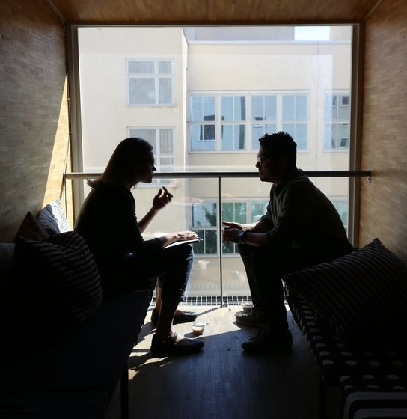
Your Experiences…
Think back to a mentorship relationship you experienced or observed.
What were the
benefits of the
relationship?
(Mentor or mentee)
Notes:
Erika

Slide 39
From the Literature
A guiding relationship in which a more experienced person assumes a supportive role towards a less experienced person
Provides an environment of support
Encourages reflection and learning
Advises and coaches within the context of the culture and expectations of an organization
Angelique, Kyle & Taylor, 2000; Zeind et al., 2005; Waddel et al., 2016
Notes:
Erika

Slide 40
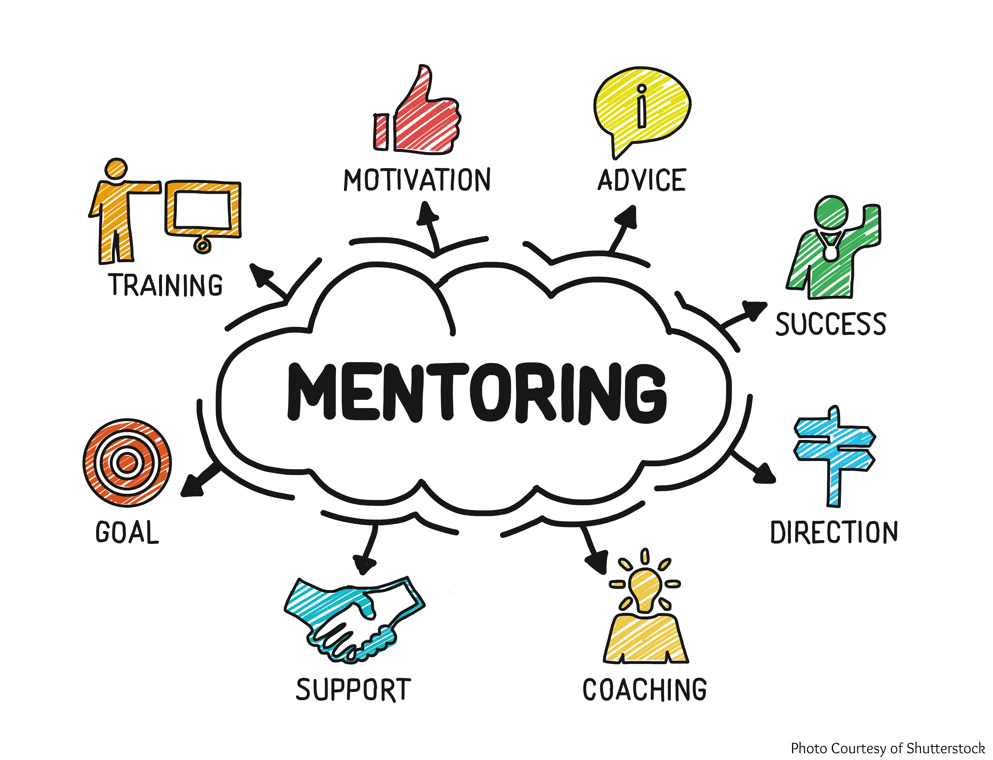

LISTENING AND
REFLECTING
Notes:
Erika
These are some of the standard elements of mentorship that generally seem to from a part of the bigger picture – this is a much used diagram on the Interwebs… To note, though, an important features does seem to be missing from this rather action oriented model – click.

Slide 41
Many Models of Mentorship
Spontaneous mentoring relationships
Formally paired
  expert with novice
  colleagues with smaller difference
  specific characteristics
Small Group/Circle Mentoring/Mosaic
Co-learning Opportunities
LISTENING AND
REFLECTING
Notes:
Erika

Slide 42

Does It Work?
Yes…
For mentees:
Improved job satisfaction
Enhanced sense of “fit”
Greater faculty productivity
Higher faculty retention rates
For mentors:
Respect and recognition
Renewal and re-energizing
Staying current
Leadership development
Boeren et al., 2015; Cartwright, 2008; Dandar et a.l, 2011; Law et al., 2014; Waddell et al., 2016
Notes:
Eirka

Slide 43

Does It Work?
Yes…
But…
Effectiveness highly dependent on successful matching
Can have negative consequences
Mentors need a degree of support to be effective
Can’t be cookie cutter
Time and resources
Boeren et al., 2015; Cartwright, 2008; Dandar et a.l, 2011; Law et al., 2014; Waddell et al., 2016
Notes:
Eirka

Slide 44

Slippery Bits
What are the challenges?
Why doesn’t mentoring happen more often?
What prevents it from being effective?
Notes:
Bev -- What make this difficulty

Slide 45
Differences in Perception
Head | Early Career | Importance to Success
1= | 9 | Good communication between management & faculty
1= | 12 | Feedback from manager about academic performance
3 | 2 | A Head committed to early career faculty success
4 | 3 | Support from Head to apply for promotion/tenure
5 | 8 | Regular contact with senior colleagues in same dept.
6 | 6 | Senior colleagues are interested in early career faculty progress and well being
7 | 4 | Availability of resources for conducting research
 | 1 | Opportunity to make decisions about the direction of my own research and teaching
Sutherland, K.A. (2018)

Slide 46
Best Predictors of Success
Planned and structured mentoring
Clarity of expectations
Regular meetings
Commitment by individuals who have mutual respect
Group mentoring/Mosaic mentoring
Kanuka & Marini (2004)
Notes:
Bev
Kanuka & Marini (2004)
Empowering Untenured Faculty Through Mosaic Mentoring

Slide 47
Structural Factors
Incentivizing mentors
Mentor support/training
Confidentiality
Coordination assistance
On- and off-campus resource knowledge
Mentors in and outside department
Recommended on a time-limited basis with renewal
RPT guidelines can inform elements as well
Law et al., 2014
Notes:
Incentives – formal mentorship as part of service load, yes, but on a smaller scale a small fund for covering mentorship coffees or lunches would be a helpful token of support…

Slide 48
Identifying Mentors
Characteristics of a mentor:
Available and enthusiastic
Optimistic and realistic
Respectful, appreciative of difference
Community & network builder
Questioning and listening
Celebratory
Lee, A., Dennis, C., & Campbell, P. (2007) Nature’s guide for mentors. Nature, 447, 791-797.
Notes:
Bev –finding good mentors…

Slide 49

Mentor Matching
Conversations
Career goals
Current needs and concerns
Chemistry
Commitment
Multiple?

Slide 50

Mentoring Across Difference?
Gender
Seniority
Age
Role
Culture
Discipline
Notes:
What are some of the challenges and opportunities you see here?
Discuss with each other.
Do you have a couple of points you’d like to raise here?

Slide 51
Learning Across Difference
Gender
Seniority
Age
Role
Culture
Discipline
Notes:
Power differentials
Diversity of experience
Differences in how identities impact the way things work for people
Not making assumptions
Opportunities to learn…
Interests and preferences of mentee

Slide 52
Creating Learning-Oriented Contexts
Becoming an organization that is skilled at creating, acquiring, and transferring knowledge, and where practices and behaviours change to reflect new knowledge and insights
Garvin, 1993
Notes:
Often described as a learning organization which, ironically, few universities – in terms of institutional practice, not in terms of research – have really engaged.
Effective institutions are characterized by “positive restlessness”: a belief that we can do better than we are doing now…
Felten et al., 2017

Slide 53
Why?
Progress
Faculty renewal challenges
Early career faculty engagement
Leadership development
Sense of identity
Learning… the opposite of bitterness?

Slide 54

Entry Points
Access and use of data
Project teams
Learning communities
Pilot projects
Internal grants
Project sharing
Cross-AAU knowledge exchange
Making it okay to fail
Notes:
e.g. Vincent’s pizza and pd; Science curriculum planning retreats; CLIF grants; CD grants projects… engaging early career as NON-LEADER participants. Roles for mid-career and senior faculty members…
There is WHAT you need to learn about, and THAT you need to learn \cp laerning

Slide 55

Making it Happen
What kinds of mentorship and learning do we need more of?
What would help that happen?
Notes:
Erika

Slide 56
ANNE FORREST
CONVERSATIONS ABOUT TEACHING
CASE IN POINT

Slide 57

Performance Review
Some Best Practices
Mitch Fields and Jeff Berryman

Slide 58
Putting it In Perspective
Performance Reviews are part of a Performance Management Process
Opportunity to provide feedback
Designed to be a helping process
In early career reviews – a chance for early intervention

Slide 59
Performance Management
A Three Part Process

Slide 60
Performance Management
Performance Management
Coaching, Counseling, Developing
Facilitate Setting Goals
Performance Review

Slide 61
PERFORMANCE MANAGEMENT PART I
COUNSELLING, COACHING,
AND DEVELOPING

Slide 62

PERFORMANCE MANAGEMENT PART II
SETTING GOALS AND OBJECTIVES

Slide 63
PERFORMANCE MANAGEMENT PART III
THE PERFORMANCE REVIEW

Slide 64
THERE SHOULD BE NO SURPRISES
AT THE FORMAL PERFORMANCE REVIEW

Slide 65
Performance Reviews
Two main functions of a performance review
Administrative Functions
  Traditional approach
  Administrative decisions need to be made (i.e., RPT)
Developmental Functions
  Focus on the future, counsel, coach, advise
  Set goals
  Build on strengths, overcome potential concerns

Slide 66
Preparing for The Review
Do your homework in advance
Review the collective agreement and senate by-laws
3. Review the individual's record against objective criteria
4. Have specific examples ready to back-up statements
5. Allow sufficient time to cover the proposed ground
6. Allow the member to prepare in advance (e.g., self-appraisal).

Slide 67
Conducting The Review
Outline the purpose of the review
Clarify objectives and criteria at the outset
Set a free and open climate
Review the individual's record against objective criteria
Be prepared for potential resistance
-Handle points of disagreement
-Be flexible but consistent with criteria
-Where appropriate, offer concrete suggestions for improvement
Take notes and maintain documentation
End the meeting with summary of follow-ups

Slide 68
AAU Heads Resources
AAU Heads Webpage
http://www.uwindsor.ca/aauheads/resources/performance-reviews.html

Slide 69
Performance Reviews
Senate Bylaws
Bylaw 22.4.3.1
  Untenured faculty member – 2nd , 4th , and 6th year of employment before October 1st of that year.
  Untenured faculty member may request performance review prior to September 15th of any year (22.4.3.4)
  Tenured faculty member – performance review every three years (22.4.3.2)
  AAS and Librarian with Permanence – every three years (Collective Agreement 5.32)

Slide 70
Performance Reviews
Senate Bylaws
After completion of performance review, faculty member given copy and right to respond within 5 working days (normally before October 8th).
  Both original performance review and faculty member’s response placed in personnel file to be made available to RTP committee (22.5.1)

Slide 71
Performance Review
Consequences
Tenured faculty, AAS and Librarians with permanence – If review ‘unsatisfactory’ member placed on annual reviews until such time as performance review moves back to satisfactory.
Two consecutive ‘unsatisfactory’ performance reviews results in denial of PTR increments in the following year, and until performance returns to ‘satisfactory’ (Collective agreement Article A.1.[a].)

Slide 72
Performance Reviews
‘Should write themselves’ – With clear criteria, a person should be able to readily determine whether they are meeting or exceeding what is the level of required performance.
‘Should be factually accurate’ – clearly state what the person has attained in terms of research/creative activity, teaching and service during the period of review.

Slide 73
Performance Reviews
‘Should express an opinion’ – where the head’s conclusion is to indicate an ‘unsatisfactory’ performance review, that should be clearly stated with supporting reasons.
Take home – The easiest and best way to create an effective performance review is to have clear criteria and standards.

Slide 74
Performance Reviews
I need YOU to create your RPT Criteria Now.
Check out PROVOST’S WEBPAGE, Initiatives, RPT.

Slide 75

Lunch!

Slide 76


















Conversational Guide for Faculty Mentorship: Windsor Edition
Bev Hamilton and Erika Kustra

Slide 77
Resources
Surveyed deadheads were often not aware of the resources or opportunities for mentees
Sutherland, K. (2018)

Slide 78


Slide 79
Conversational Guides
Teaching
Research
Supervision
Service and Leadership
Notes:
Erika

Slide 80
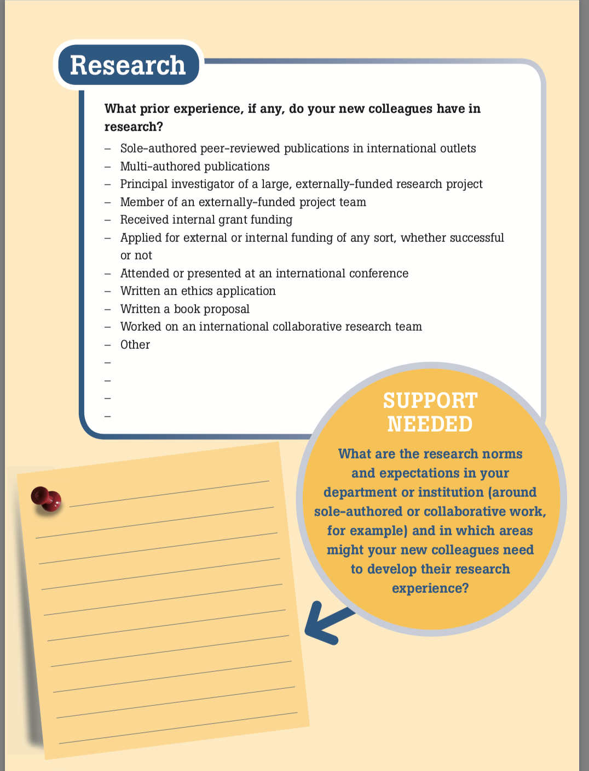
Components
Prior experience
Support needed
Just in time policies and procedures
Support, training, and professional development opportunities
Notes:
Erika

Slide 81
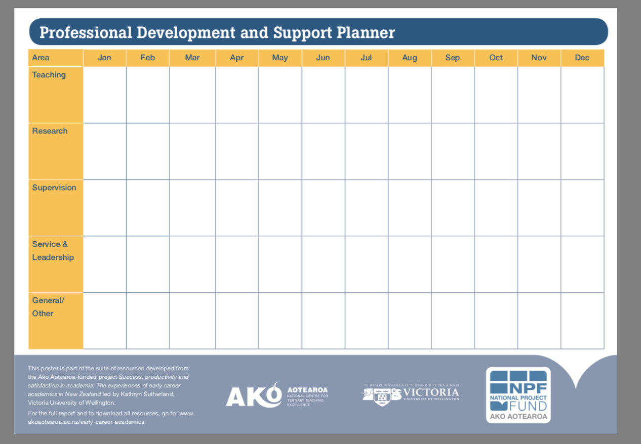
Professional Development and Support Planner
Notes:
Erika

Slide 82
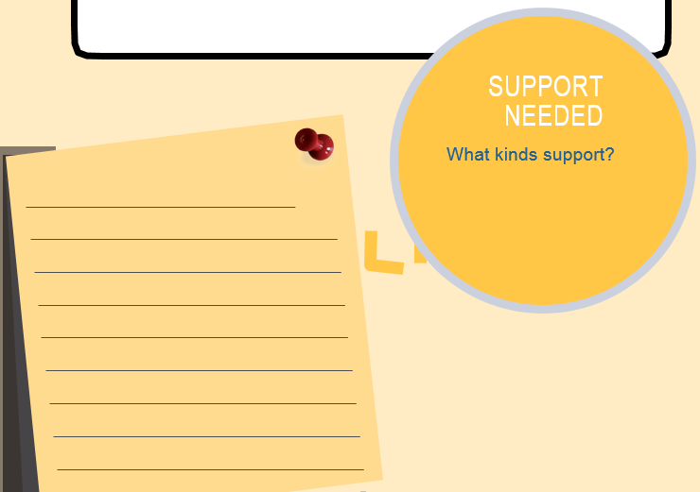
Developing Windsor Resources
Choose a group:
Early Career Faculty
Library Faculty
Experienced Faculty
Identify questions and resources that would be useful for mentoring your population.
Resources in your email!
You may modify the Sutherland resource
Notes:
Erika

Slide 83

Windsor-Specific Resources
Early Career Faculty
Library Faculty
Experienced Faculty
Notes:
Erika

