Slide 1
Transitioning to Year 3 at UWindsor!
Kathryn Corby, RN, MScN
Student Success Coordinator
Andrea Reddam, RN, MN
Manager & Clinical Placement Coordinator
Katharine Maclean, RN
Clinical Placement Coordinator
Susan Rotondi-Moore
Clinical Placement Secretary
A
Notes:
The University of Windsor sits on the traditional territory of the Three Fires Confederacy of First Nations, comprised of the Ojibway, the Odawa, and the Potawatomi (http://native-land.ca/). I respect the longstanding relationships that Indigenous Nations have to this land, as they are the original caretakers.
Introductions!

Slide 2
Presentation Outline
Save the Dates
Registration & Student Account
Academic Advising & Resources
Year 3 Clinical Placements
UWindsor Clinical Policies
Synergy Pre-Clearance Requirements

Slide 3
Save the Dates!
Transitions Welcome Day Friday June 14th, 2024 Toldo Health Education Building Room TBA
Mandatory Transitions Orientation Thursday, August 29th, 2024 9:30-12:00 Virtual – Microsoft Teams
Mandatory Year 3 Lab and Clinical Orientation Tuesday September 3rd, 2024 1:00-3:00 pm Virtual – Microsoft Teams

Slide 4
Faculty of Nursing Student Services
Nursing Office: nurse@uwindsor.ca
Clinical Learning Centre
Peer Mentors & Clinical Lab Manager: Lacey.Rivest@uwindsor.ca
Education Resources – textbooks, anatomy models, etc.
Nursing Student Support Centre:
Counselling Services, Clinical Therapist: scc@uwindsor.ca
Academic Advising (Student Success Coordinator):
Kathryn Corby corby1@uwindsor.ca (until May 2024)
Fran Meloche fmeloche@uwindsor.ca (after May 15th, 2024)
Clinical Placement Team
Clinical Placement Coordinator: Katharine Maclean -kmaclean@uwindsor.ca
Clinical Placement Secretary: Susan Rotondi-Moore srotond@uwindsor.ca
Course Professors / Faculty
Reach out via e-mail and office hours
Notes:
Your experience as a university student may be a mix of: feeling challenged, stressed out, and/or feelings of exhilaration as you gear up towards finishing your BScN! We are here to support you with a variety of services to help you set a course for your future. Don’t be afraid to let us know what your learning needs are. We are all here to help.
Clinical Learning Centre: You’re Invited! Come to the lab and see what is there; Peers mentors can work with groups or one-on-one - skills, medication calculations – helping to prep for online math testing; work on any skills that you want to work on for future learning plans; Brightspace Clinical Learning site- has all the resources that you may need including templates for clinical worksheets and lab demonstration videos. Appointments in the summer are limited until mid-August but are still available if we have the resources to operate the lab in the summer.
Nursing Student Support Centre: On the 2nd floor of Toldo, opposite to the Clinical Learning Centre, we have a suite of offices called the Nursing Student Support Centre. Inside in that physical space we have Laura Little, our clinical therapist; Student Success Coordinator/Academic Advisor, Fran Meloche, our Clinical Placement Coordinator, Andrea Reddam, and our Clinical Placement Secretary, Susan Rotondi-Moore.
Course Professors: Establish connections!! Get to know your course professor – drop in during office hours, they are available and want to meet you! Some course professors have smaller study groups that aim to help you reach your learning goals.

Slide 5
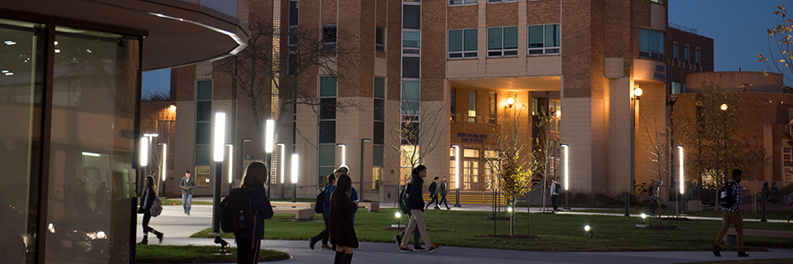
Summer Course Registration
Your transfer application form was due March 1st to the Office of the Registrar (transcripts@uwindsor.ca).
Summer course validation opens early April
Summer course registration opens mid April
Summer courses: June 24th – Aug 6th + final exams Aug 10th – 19th
If you have indicated on the transfer application form that you want to take a summer course, you will receive an email prompting you to set-up and activate your student account. You will then be able to start planning and registering for your summer courses.
Notes:
Validate courses - planning period – add courses to the shopping cart – you do this prior to your registration time and date
Not validating? Please tell someone!! Take a screen shot and send to nurse@uwindsor.ca
Just because you validate the courses, doesn’t mean you are able to register necessarily – the course may be full. Please have a “back up”
Students who are taking summer courses receive their account activation email before students who are registering for fall courses. Please do not be surprised by this.
It is not advisable to take intersession/spring courses because of the conflict with consolidation.
Start date June 24, 2024
End date August 6, 2024
Final Exam Period: August 10th-19th, 2024

Slide 6
Summer Course Offerings
NURS 3830 Adult Health & Health Alterations III
Year 3 Fall semester core nursing course
M & W 8:30-11:20; In person Toldo 202 (hy-flex delivery/ exams in-person only)
NURS 4951 The Human Meaning of Death
Year 4 Nursing Specialty Option
M & W 11:30-2:20; Synchronous online
NURS 4999 Indigenous Health
Can take in lieu of PHIL-1350 Culture & Health on Turtle Island
T & Th 9:00-11:50 am; Synchronous online
Notes:
Not validating? Please tell someone!!
Just because you validate the courses, doesn’t mean you are able to register necessarily – the course may be full. Please have a “back up”
Need books? Go to the bookstore website and you can look up the course code and see what books you will need.
Stats- if you did not take stats yet for any reason, it is needed before continuing to year 3 fall courses. Please contact me directly if you need to take stats at the University this summer.

Slide 7
Fall Course Registration
Students register for fall courses mid-June (approximately)
NURS-3830: Adult Health & Health Alterations III
NURS-3940: Nursing Care of Infants, Children, & Youth
NURS-3950: Nursing Research
NURS-3960: Community Health Nursing
NURS-3542: Clinical Practicum IV
NURS-3551: Experiential Learning Lab IV
Notes:
Experiential learning labs are in person every other week. Plan is the for some of the 3rd year courses will be offered in a hybrid or hyflex offering (online section)
Course overload is not advised. Course overload is only possible if you have a cumulative average of 85% OR with special permission from the Dean’s Office.
If you are planning to minor in another program at the University of Windsor, please seek academic advising.
If you have taken courses previously or are taking courses out of sequence, please seek academic advising.
UWinsite Student Resources (Registration): http://www.uwindsor.ca/registrar/resource/student

Slide 8
Transfer Credits and Understanding your Transcript
Non-nursing courses will have a “T” - not a specific grade. They will not be counted in your cumulative average at the University; however, these grades are a part of your education and are on your transcript from the College.
Nursing courses will appear on your transcript showing your grade as a percent.
There are no open arts options. All students are required to take PHIL 1350 – or an approved Nursing Indigenous alternate course.
Notes:
Program start fall 2020 – art option / PHIL 1350/ English course pre-health sciences may transfer as art option
Program start fall 2021 – bridging pathway – needs PHIL 1350

Slide 9
Registration & Account Activation
Step 1: Receive email from the Office of the Registrar.
Step 2: Follow instructions to activate student account (uwinsite & email).
Step 3: Check your registration time on your student account: http://www.uwindsor.ca/registrar/uwinsite-student
Step 3: Plan & register for your courses
Step 4: Check your schedule and keep it for your records
Step 5: Check your UWindsor email account for information re: Brightspace login
Notes:
Planning & Registering for Courses.
Remember to always have a back up plan for your schedule as there are various sections of the same course and you may not get the first section you want
Clinical: You will be pre-placed in your clinical group. Consolidation will automatically appear on your Winter 2022 schedule.
Visit: http://www.uwindsor.ca/registrar/resource/student
Videos and Reference Sheets
How to Guides

Slide 10
Registration Resources
Registration:
https://www.uwindsor.ca/registrar/515/registration-information
Timetable Information:
https://www.uwindsor.ca/registrar/541/timetable-information
Important Academic Dates:
https://www.uwindsor.ca/registrar/events-listing
Student Account (uwinsite):
https://www.uwindsor.ca/registrar/uwinsite-student
Student Information Gateway:
https://ask.uwindsor.ca/
Student Awards & Financial Aid:
https://www.uwindsor.ca/studentawards/osap

Slide 11
Academic & Career Advising
Student Success Coordinator: Kathryn Corby/Fran Meloche
Individual & Group Advising
Early Intervention Program; Academic Planning; Peer Tutor Match Program
Referrals to Faculty of Nursing & Campus Services/Supports:
Student Success & Leadership Centre (campus); Study Tips
Student Accessibility Services
Student Counselling Services
Library/ Research Support
Career & Employment Services (Resume & Interview prep)
Financial Aid & Awards Office & MUCH… MUCH MORE!
Notes:
Student Success Coordinator (Nursing)- advising appointments available – appointments by email

Slide 12
Counselling Services
Clinical Therapist: Laura Little
The Student Counselling Centre (SCC) at the University of Windsor provides free, confidential counselling to registered University of Windsor undergraduate and graduate students. Please see https://www.uwindsor.ca/studentcounselling/ for information about our services.
E-mail scc@uwindsor.ca to get started
Notes:
All students must first register with Student Counselling Centre main office, CAW Student Centre, 2nd floor. All appointments are a mix of in person and online right now – email scc@uwindsor.ca to get started.

Slide 13
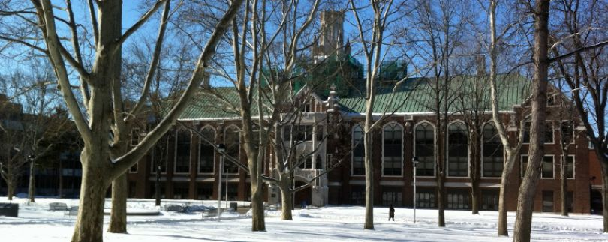
Student Accessibility Services (SAS) Dillon hall- lower level
Students seeking academic accommodation for an ongoing, diagnosed disability (whether permanent or temporary) must begin the process by completing an intake & registration form: http://www.uwindsor.ca/studentaccessibility/
Students need to get registered every semester to receive accommodations.
Notes:
Disability types include Medical; Mental Health; Hearing and Vision; Mobility; Acquired Brain Injury; Learning Disabilities and (ADHD).*Please see http://www.uwindsor.ca/studentaccessibility/297/student-information (copy and paste in browser) for additional information on documentation required for (SAS) as confirmation of disability.
*Identify yourself to the University of Windsor and register with Accessibility Services on campus to receive the necessary letters of accommodation. Every semester you will need to register with SAS to be eligible to receive accommodations.
Students with disabilities who require academic accommodations in any nursing course must contact an Advisor in SAS to complete registration and receive the necessary Letters of Accommodation. After registering with SAS, you must present your Letter of Accommodation and discuss your needs with your course professor(s) as early in the term as possible. Please note that deadlines for submission of documentation and completed forms to Student Accessibility Services are available on their website: http://www.uwindsor.ca/studentaccessibility/317/disability-documentation (copy and paste in browser).

Slide 14
Work & Volunteer
Are YOU ready to GET INVOLVED?!
Ignite Work Study & VIP Community Service Learning Experiences
Living Well Lancers; Connecting4Success (campus mentoring program)
Nursing Society; Class Advocate
IHI Open School Workshops and Professional Development
Notes:
Ignite Work Study
All students are eligible regardless of financial aid. Students must attend a mandatory launch session; be in good academic standing; cum ave above 60%, not on academic probation; be registered in a min course load (60% for domestic, 80% for international, 40% for students with a documented disability).
Supervisors will pay their students from the department- departments are then reimbursed a 100% wage subsidy of up to $2500 for 8 months or $1250 for one term.
Volunteer on Campus!
Wellness Lancers
Connecting4Success (after being here for a semester)
Alumni Association
UWSA; Campus Pride Centre; Peer Support Centre; Shinerama- Cystic Fibrosis fundraiser; Student groups (150 on campus); Walksafe; Womxn’s centre; Bluegold pack – Lancer Leadership
Career Development & Experiential Learning: Peer Advisor: http://www.uwindsor.ca/career-development-experiential/319/becoming-peer-advisor
IHI Open School
The Faculty of Nursing is leading the University of Windsor Chapter of the Institute for Healthcare Improvement (IHI) Open School for Health Professionals. The goal is to educate students in patient safety and quality improvement issues. There are IHI Open School chapters all over the world.
Nursing Society
Links:
Student Health Services: http://www.uwindsor.ca/studenthealthservices/524/about-us
UWSA- get involved site: http://www.uwsa.ca/get-involved/

Slide 15
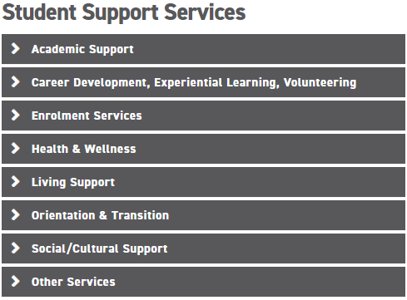
UWindsor Student Support Services
For a comprehensive list, visit:
http://www.uwindsor.ca/156/lots-student-support-services

Slide 16
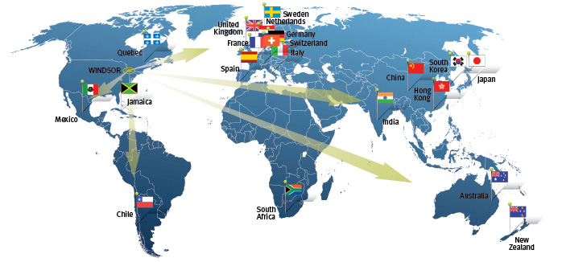
International Exchange Opportunities
Australia- Winter of 3rd Year
Sweden- Fall of 4th Year
Please contact Prof. Natalie Bownes for information nbownes@uwindsor.ca
Notes:
If interested please contact Prof. Natalie Bownes for further information.

Slide 17
Year 3 Community Consolidation Opportunity in Tanzania, Africa
Tanzania Interprofessional Experience
April-May 2025 (approx 3 weeks)
In collaboration with Dr. Beckford and the Faculty of Education
Prof. Rachel Elliott will be taking a clinical group to Tanzania (8 students will be accepted)
Estimated cost $2000-$3000

Slide 18
Year 3 Community Consolidation Opportunity-Tanzania
Students must take NURS 4990: Issues in Global and Planetary Health in the winter semester of Y3
special permission given to take course if accepted for this consolidation experience
You may want to consider taking summer course(s)?
Students must commit to meetings with the Education Faculty group weekly starting in January
Students will need to fundraise/secure funding to go to Tanzania
GoGlobal application funding available through Uwindsor

Slide 19
Year 3 Community Consolidation Opportunity-Tanzania
Expression of Intent due September 15 by 2359 using this link:
https://uwindsor.ca1.qualtrics.com/jfe/form/SV_0wwnYMclD5eRux8
Interviews will take place in October with final team selected by end of October/early November
For more information, please contact:
Prof. Natalie Bownes nbownes@uwindsor.ca or
Prof. Rachel Elliott Rachel.Elliott@uwindsor.ca

Slide 20
Year 3 Clinical Information
Notes:
Introduce the clinical placement team
Clinical placements are such an important part of your education in preparing you for your nursing career. The goal of our BScN Collaborative program is to equip you all to become graduates for general practice.
We hope that you will enjoy the clinical placements that are offered to continue to build onto the learning that you have gotten so far in this program.

Slide 21
Clinical Opportunities
Medical-Surgical
Cardiology
Neurology
Community or LTC
Palliative
Psychiatry
Oncology
Obstetrics
Pediatrics
Notes:
As previously mentioned the BScN Collaborative Program Goal: To prepare graduates for general practice.
Through our University of Windsor program we offer many different placement opportunities for students with the goal to prepare you for general practice. Different areas that we have placements in include (see slide)
All our year 1-3 Students are placed by the Clinical Coordination Team
There are placement opportunities in the Sarnia/ Chatham areas however these are due to placement and instructor availability so there are No guarantees that students will be placed in the area from which they are coming (ie Chatham or Sarnia).
Please email Sue Rotondi-Moore well in advance of each semester if requesting a Sarnia or Chatham placement. For fall please let us know as soon as possible
Please note: The clinical coordination team has the right to finalize student placements. Things can change so quickly- based on a number of circumstances (sessional instructor, agency policies- eg. sudden closure of unit).

Slide 22
Clinical Placement Policy
Students are expected to complete clinical placements in the tri-county area (Windsor, Essex County, Chatham-Kent County and Lambton County)
Students are responsible to arrange their own transportation to and from placements (e.g. vehicle, public transit, car-pool, car share, etc.) and for any costs of travel and accommodation (if required).
Notes:
Some notable policies related to our clinical placements.

Slide 23
Conflict of Interest Policy
Students are to contact the Clinical Placement Coordinator as soon as possible if you think you have identified a conflict in your clinical placement setting.
You cannot work as an RPN or as a UNE on the floor where you are completing clinical. If you are working in hospital, you must contact Susan Rotondi-Moore srotond@uwindsor.ca to let her know where you are working.
Potential Sources of Conflict: Family members in your group, working as your clinical instructor, working as the supervisor/manager on the floor. More information can be found on our Faculty of Nursing website. (See Undergraduate Student Handbook).
Notes:
Students must report immediately to one of the Faculty of Nursing Clinical/Course Coordinators if you think you have identified a conflict in your clinical placement setting.
Some examples are:
a. A student has a family member in his/her clinical group;
b. A student has been assigned to a clinical setting in which they are employed in a paid or unpaid position; ** if you work as an RN or UNE at one of the hospitals please contact Susan Rotondi Moore and let her know where you are working **
c. A student has been assigned to a clinical setting in which one of his/her family members is employed or is a client;
d. A student has been assigned to a clinical instructor, faculty advisor, or preceptor who is related to him/her.
In any of the above situations, students will be re-assigned to a clinical area where there is no relational conflict.
Family members- include but are not limited to the following: sister, brother, mother, father, spouse, significant other, daughter, son, nephew, niece, uncle, aunt, cousin, or in-laws.
Other interpersonal relationships that may pose a conflict must be disclosed by the student and will be assessed on an individual basis

Slide 24
Social Media Policy
Use of social media and cell phones or smart watches for non-academic purposes is not permitted during any clinical experience.
Social media behaviours must be consistent with CNO Standards of Practice and Guidelines. More information can be found on our Faculty of Nursing website. (See Undergraduate Student Handbook)
Notes:
What is Social Media?
Social media refers to online technologies and practices that are used to share information and opinions, host conversations and build relationships. It can involve a variety of formats, including text messaging, pictures, videos, audio and “live,” real-time dialogues of a few, or thousands of participants. Examples of social media include but are not limited to discussion forums, blogs, social networks, wikis, and podcasts.
The Faculty of Nursing supports the use of social media as an instructional tool. In this instance, sharing of information must occur through Brightspace or other University of Windsor approved platforms. We also recognize that students use social media networks outside of the classroom. The following policies and guidelines provide overall policies for social networking within the Faculty of Nursing, and guidelines for individual social media use.
Use of social media and cell phones for non-academic purposes is not permitted during any clinical experience.
1. Students may not access agency computers for personal use.
2. Students are prohibited from posting any private or confidential content, including client health information on any social media site, even if client identifiers are removed. This also includes images of clients, agencies, staff, volunteers, visitors or family.
3. Social media behaviours must be consistent with the following CNO Standards and Practice Guidelines: Ethical Framework, Nurse-Client Relationship, and Documentation. Unauthorized use of social media, cell phones, or the internet in the clinical setting will result in removal of the student from the clinical area or program.

Slide 25
LET’S GET READY!
PRE-CLINICAL CLEARANCE
http://www.uwindsor.ca/nursing/375/pre-clearance-information-and-forms
Notes:
Now we want to talk to you about the process of getting your pre clinical clearance done.
The university uses Verified Synergy Gateway inc as our agency to upload your pre clearance documents.
When should you start preparing this? – As soon as you are done your consolidation and before you get to settled into you vacation mode start looking at the requirements so you can plan to get all this done before the due date of August 19th 2024!

Slide 26
Clinical Pre-Clearance Overview
Hospitals and community agencies mandate that students meet specific medical and non-medical requirements.
Students need to be cleared annually- University of Windsor is now using Verified Synergy Gateway to complete the screening process.
Flexible appointment scheduling.
Confidentiality and privacy maintained.
Fees for screening available on the Synergy ERV forms found on the Pre- Clearance information link found on the main University of Windsor Nursing page.
Notes:
When students are placed in their clinical placements Hospitals and community agencies mandate that students meet specific medical and non-medical requirements.
Students need to be cleared annually- University of Windsor is now using Verified Synergy Gateway to complete the screening process.
Flexible online appointment scheduling- you don’t have to attend these appointments you make appointments to have your documents reviewed online once you have submitted them all.
Confidentiality and privacy maintained.
There are Fees each time you have your documents reviewed so please carefully review all the requirements for your clearances from the Synergy ERV forms found on the Pre- Clearance information link found on the main University of Windsor Nursing page to avoid unnecessary fees.
It is also recommended that you ensure that your documentation does not expire before the end of the semester to avoid any additional fees even if it means completing something a little earlier than needed. This will avoid an additional.

Slide 27
Clinical Pre-Placement Medical Requirements
You will require documentation of the following:
TB skin test- proof of 1-step TB Skin Test. Issued after June 1 of the same year. If EVER had a documented positive, then must book a medical follow-up with chest x-ray. (Chest Xray valid for 2 years).
MMR*- proof of two vaccinations OR blood work results (within 5 years) showing immunity
Varicella*- Proof of two vaccinations OR blood work results (within 5 years) showing immunity
Hepatitis B*- Blood work results (within 5 years) showing immunity
Tetanus/Diphtheria (TD)* in the last 10 years
Pertussis- Proof of complete series of vaccines
Influenza vaccine-Optional for most placements except HDGH (usually available October- not required to pass your clearance )
COVID-19 vaccination receipts Double vaccination status (proof of 2 doses)
Notes:
Here is a quick look at the Pre clinical Medical requirements, this is all listed in the ERV online. Be careful to read the requirements
ie TB testing needs to be done annually after June 1st of the year you are testing for and if you have ever had a positive test in the past you need a medical exam (yearly) and a chest x ray (the chest Xray is valid for 2 years) .
For your MMR and Varicella you only need either your proof of 2 vaccines or blood work within 5 years not both.
For your hepatitis you will need to make sure you have a blood test that is less than 5 years old. So be careful to make sure you review your ERV carefully and review the details of the requirements before making your review appointment.

Slide 28
Clinical Pre-Placement: Non-Medical Requirements
Annual
Every 2 years
Vulnerable Sector Police Clearance
Attestation of Clear Criminal Record
CPR - Basic Life Support (BLS)
WSIB Waiver
Student Verification of Health Status- Please be sure to note a latex allergy if you have one on this form.
SMG- Crisis Intervention Training? Initial Crisis Intervention or refresher plus (new this year) online Physical Techniques Training
Mask Fit Test- unless needed due to mask size availability or major physical changes ie significant weight changes. See the ERV for the sizes available at the area hospitals
First year students only*
Standard First Aid -(does not expire)
Notes:
These are the Non Medical requirements again listed on the ERV. The forms for these are also attached to the ERV to make it easy to find or are located individually on the Main Faculty of nursing website.
Carefully review these and make sure that you do this early. Register for classes and apply early for things like your police clearances as some areas take longer than others to come back after they are requested.
Most of these requirements are done annually, except the first year standard first aid and your Mask fit testing.
Mask fit testing is only done every 2 years unless there is a need due to mask size availability and or any major physical changes ie significant weight changes. The ERV should have listed on it the current Mask sizes that are available in our facilities so be sure that your mask fit is one of the ones listed so your clearance is not delayed.

Slide 29
The Pre-Clearance Summer Check List!
Step 1: Get Prepared
Finish Consolidation 2024
Go on to the U Windsor Nursing site and review Pre-Clearance Information and Forms | Faculty of Nursing (uwindsor.ca)
a)Review the clearance deadlines listed on the site.
b)Review your Synergy ERV document for the year you’re entering. Ie. Year 2-3 ERV including non-medical forms.
Start collecting all the documents for your medical/ non-medical requirements.
After June 1st make an appointment with your doctor to get any missing documentation, immunizations or tests for your medical requirements.
For years 2-4 Update your documents into your e-portfolio. (recommended)
Now you have all your courses, test done and documents ready…
Time for step 2!
Notes:
I like checklists they make it easy to remember Getting your clearance is as easy as 1,2,3…
Step 1 Get prepared- ( see slide )

Slide 30
The Pre-Clearance Checklist Step 2: Getting your Clearance
Make sure you can log into your Verified Synergy gateway account.- for new students you will need to get your uwindsor.ca email set up so that Synergy can send you information to make an account.
Upload all your required documents and completed forms to your Verified Synergy profile as directed
Any time after June 1st 2024 make an appointment for review of your documents on Synergy once everything is uploaded. Please Note: There is a fee for each time a review is done so please ensure you have all the requirements uploaded and that they will all be valid until last day of all your clinical placements this year before making the appointment to avoid additional fees and delays of your clearance.
Be prepared to bring a hard copy of your Verified Synergy clearance to your clinical orientation. In September.
Due Dates to complete Clearances is August 19th 2024 – Student not cleared by then risk delays getting into the clinical setting.
Initial appointments for reviews can take up to 48 hours to be done additional reviews can take longer. Please consider that when making your appointments.
Notes:
Step 2 : Get your clearance ( See slide)
- Make sure you can log into your Verified Synergy gateway account.- for new students you will need to get your uwindsor.ca email set up so that Synergy can send you information to make an account.

Slide 31
The Pre-Clearance Checklist Step 3: Relax!
Once you have passed your Verified Synergy clearance take time to enjoy your summer. Knowing you have your clearance completed for your clinical placements next year!
Some additional links for Clinical Resources:
Resources for Current Students:
https://www.uwindsor.ca/nursing/345/resources-current-students
Pre-Clearance Information and Forms:
https://www.uwindsor.ca/nursing/375/pre-clearance-information-and-forms
Notes:
Step 3 Relax! Enjoy your summer as your clearance is all done in preparation for your clinical!
I have attached some additional resources should you need them as well.

Slide 32
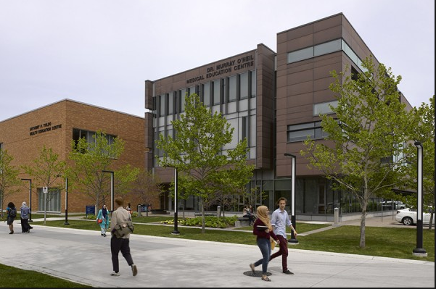
Faculty of Nursing
Anthony P. Toldo Health Education Centre
Video Photo Tour
Dr. Murray O’Neil Medical Education Centre
Notes:
1st Floor (Toldo): café, student study area, classrooms
2nd Floor (Toldo): Clinical Learning Centre (main nursing lab), classrooms, & Nursing Student Support Centre (Clinical Therapist, Academic Advising, Clinical Placement Team – Clinical Placement Coordinator, and Clinical Placement Secretary)
3rd Floor (Toldo): Main nursing office and Faculty offices
Medical Education Building – Satellite site for the Schulich school of Medicine and Dentistry – connected with the University of Western in London, Ontario.
3rd Floor (Medical Education Building): Simulation space + additional labs

Slide 33
Practice Lab
Notes:
This is a photo of one of our lab spaces. We have 2 lab spaces in Toldo on the second floor one is used as the open lab for students to come and practice skills or attend scheduled remediation appointments. Peer mentors are available in the open lab to assist and support students with their learning. There are times posted when this is available.

Slide 34
Instructional Lab spaces
Notes:
In addition to the open lab we have 2 additional lab spaces that you will be taking your lab classes in 1 is located on the second floor of Toldo beside the open lab and the other is on the 3rd floor of the medical education building.

Slide 35
Primary Care Rooms
Notes:
We also have some Primary Car rooms that we use here at the university they are at times used with our SIM, ELL labs, NP Labs and OSCE testing.

Slide 36
Simulation Space
Notes:
In addition to your lab classes all students will have the opportunity to attend the SIM lab once a year. The goal of Sim is to create an immersive safe learning experience in which we can simulate real life clinical experiences for students to use the clinical skills and judgment in an environment and in scenarios that closely resemble experiences they will experience in their practice.

Slide 37
Sim Lab Control and Viewing
Notes:
This is the SIM lab and control center and Viewing area where you are observed during your SIM experiences.

Slide 38
Connect with us!
https://www.uwindsor.ca/nursing/social-follow
Notes:
That is a quick overview of our facility. Here are some links that you can look into to keep up to date with what is happening at our campus.

Slide 39
Questions?
General Questions: nurse@uwindsor.ca
Academic Advising for the BScN Program:
Kathryn Corby corby1@uwindsor.ca (until May 2024)
Fran Meloche fmeloche@uwindsor.ca (after May 15th, 2024)
Clinical Placement Team:
Clinical Placement Coordinator: Katharine Maclean katharine.maclean@uwindsor.ca
Clinical Placement Secretary: Susan Rotondi-Moore
srotond@uwindsor.ca
Year 3 Clinical Lead:
Prof. Natalie Bownes nbownes@uwindsor.ca

Slide 40
Save the Dates!
Transitions Welcome Day Friday June 14th, 2024 Toldo Health Education Building Room TBA
Mandatory Transitions Orientation Thursday, August 29th, 2024 9:30-12:00 Virtual – Microsoft Teams
Mandatory Year 3 Lab and Clinical Orientation Tuesday September 3rd, 2024 1:00-3:00 pm Virtual – Microsoft Teams

